Slide 1



Exploring new possibilities in Compton sources based on free-electron lasers
Ryoichi Hajima
Kansai Institute for Photon Science (KPSI),
National Institutes for Quantum Science and Technology (QST)
Oct. 7, 2025

Slide 2
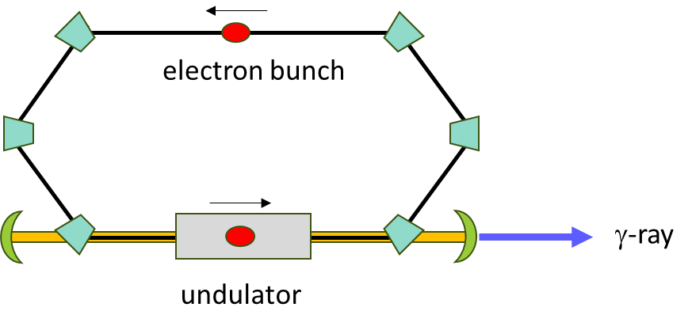
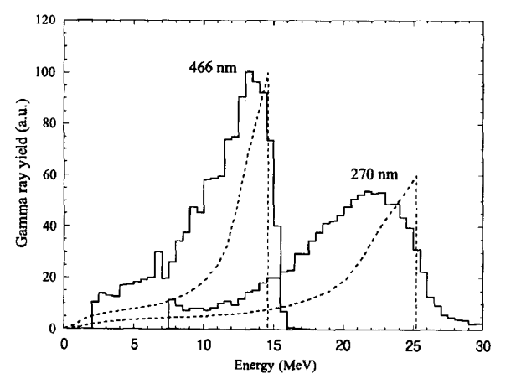
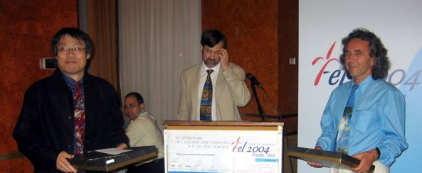
Compton source based on FEL
FEL
First Compton γ-ray at UVSOR FEL
M. Hosaka, H. Hama et al.
NIMA 393, 525 (1997).
No external laser required
Automatic synchronization
High-power intra-cavity optical pulse
Continuous and wide energy tunability
Hiroyuki Hama and Vladimir Litvinenko
were awarded 2004 FEL prize.

Slide 3
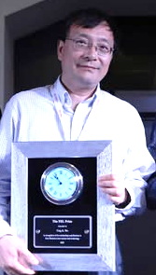
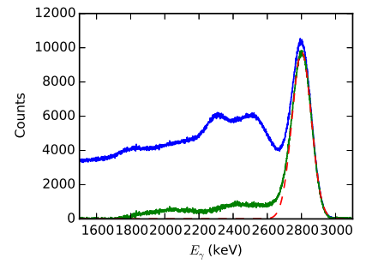
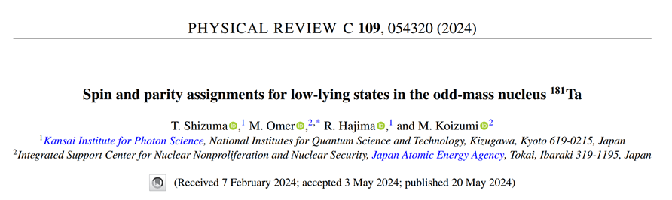
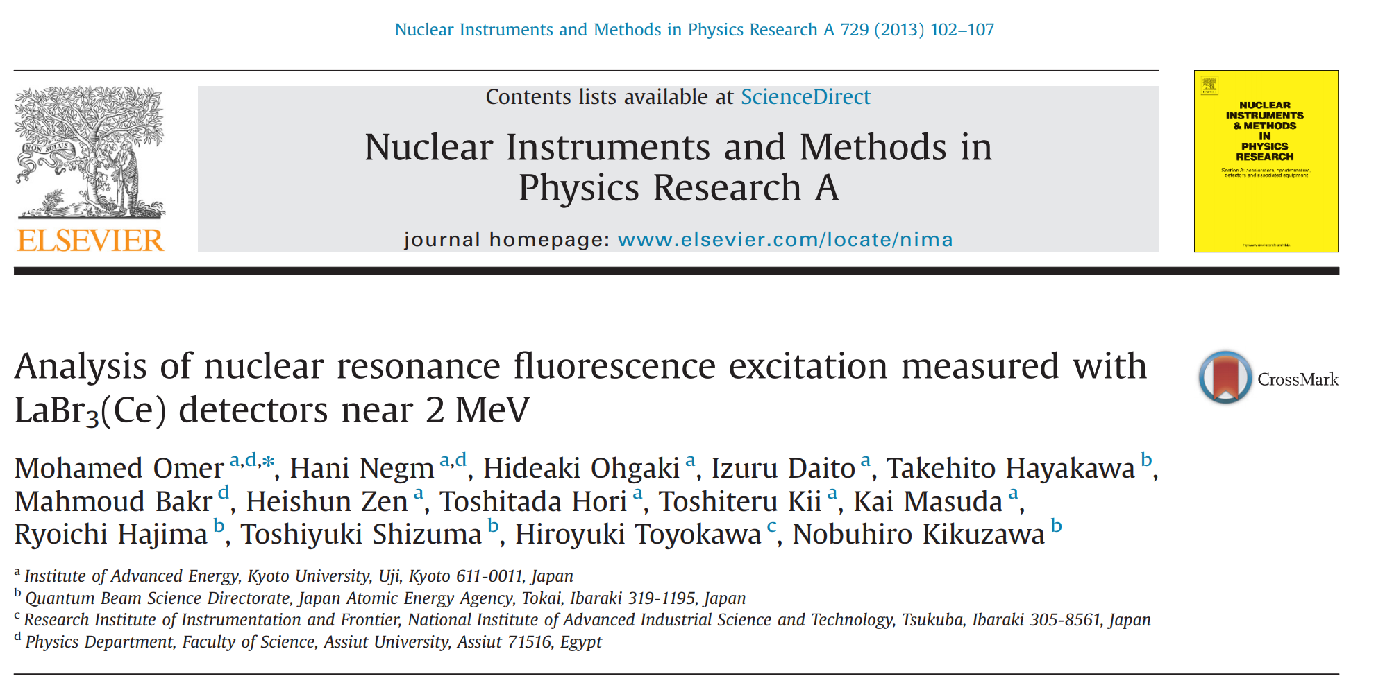
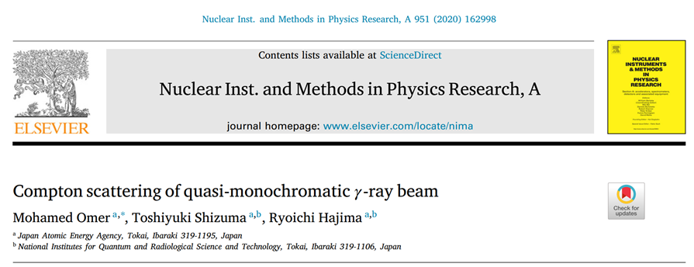
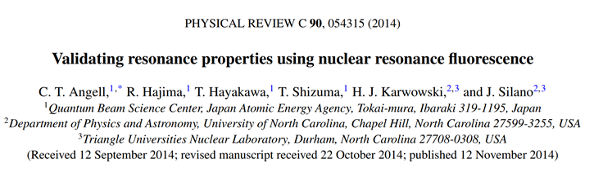
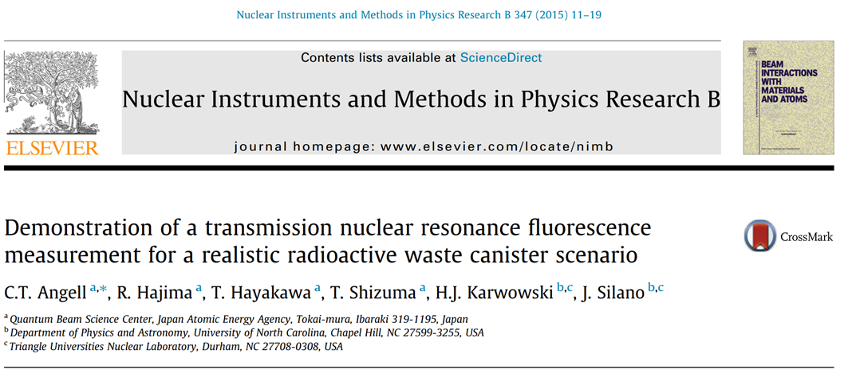
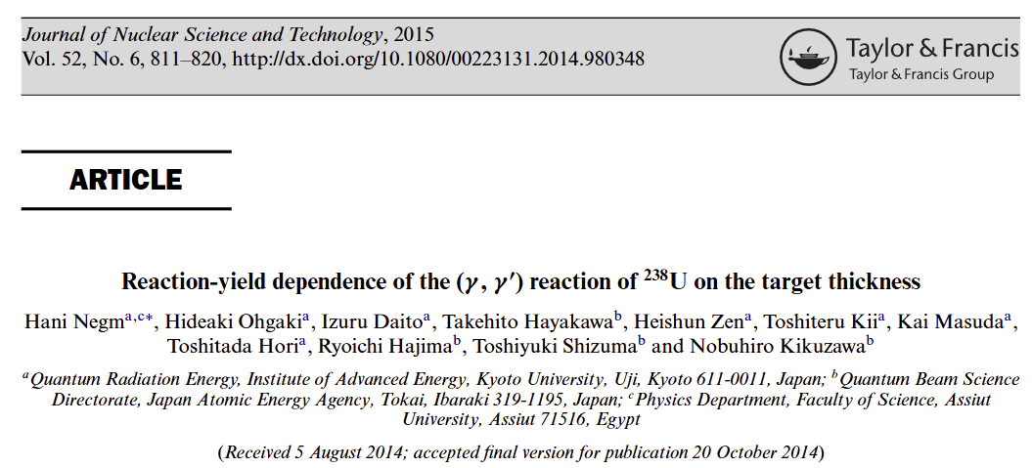
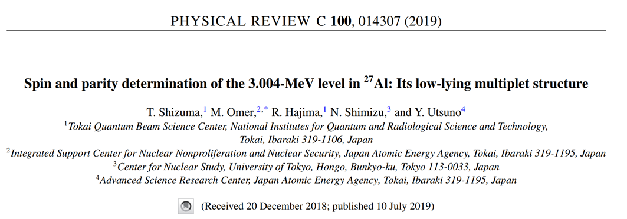
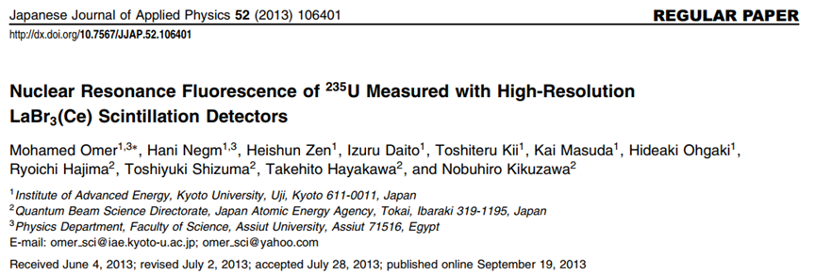
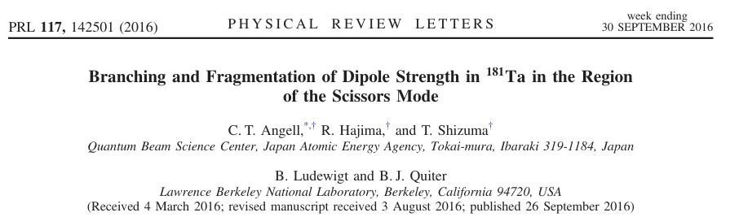
HIGS at Duke University
1-GeV storage ring
2022 FEL prize
Ying Wu
Eγ = 1-110 MeV

Slide 4
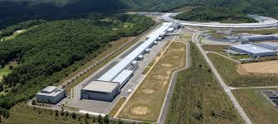
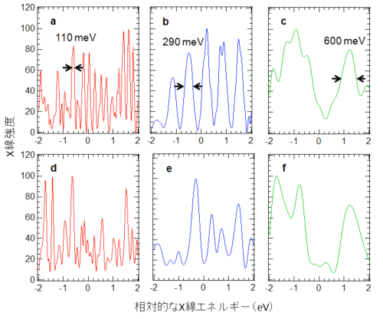
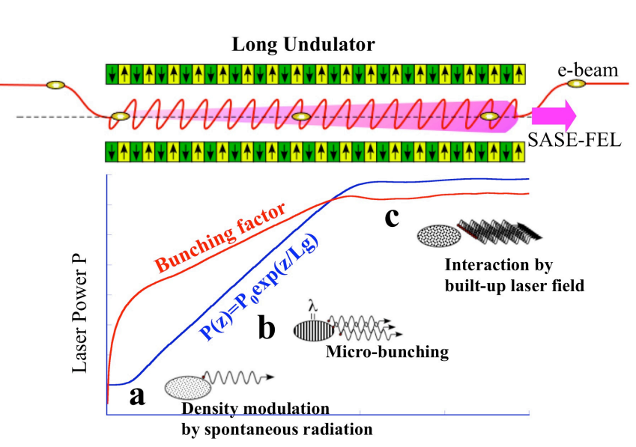
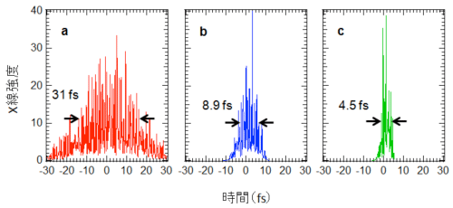
X-ray Free-Electron Laser
Self-amplified spontaneous emission (SASE)
SACLA
http://accwww2.kek.jp/oho/OHOtxt/OHO-2013/
01_tanaka_hitoshi_20130710.pdf
Y. Inubushi et al., Phys. Rev. Lett. 109, 144801 (2012)

Slide 5
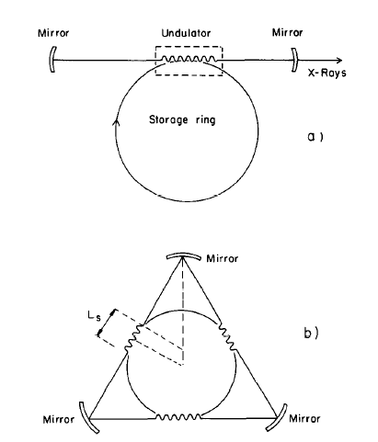
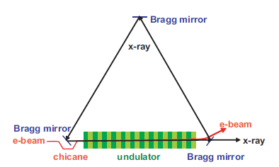
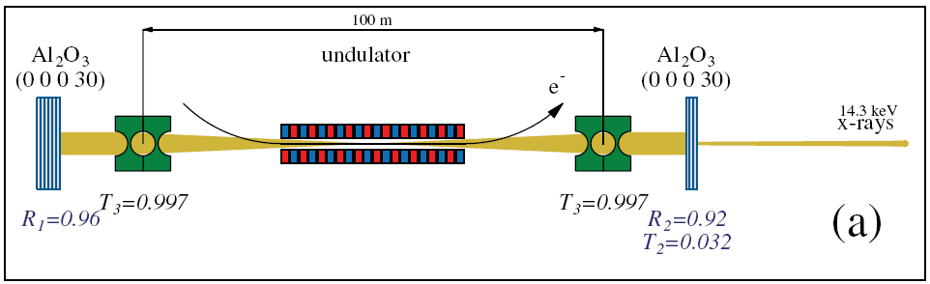
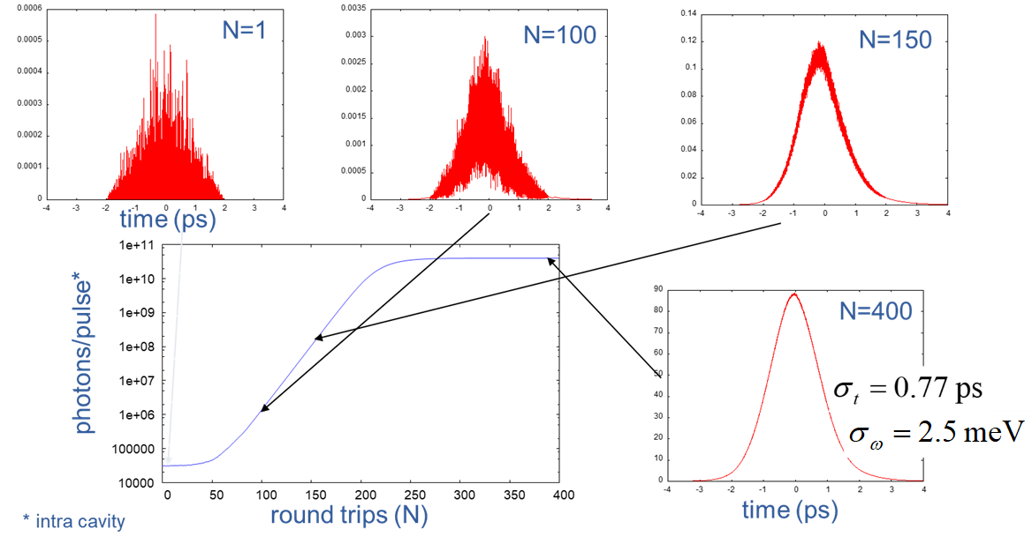
Cavity-based XFEL for ‘true X-ray laser’
K-J. Kim et al. PRL 100, 244802 (2008)
Z. Huang, D. Ruth
Phys. Rev. Lett. (2006).
R. Colella, A. Luccio,
Opt. Comm. (1984)
Using Bragg mirrors
Fully coherent
(transform limited)
Extremely narrow bandwidth
(~10meV)
High stability
R, Hajima, FEL-2012.

Slide 6
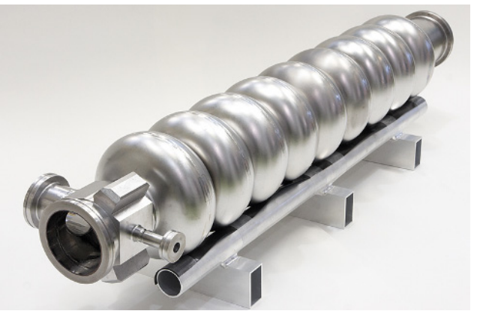
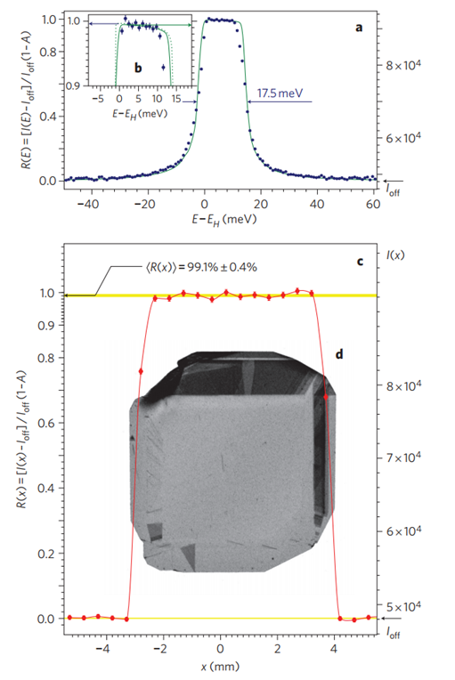
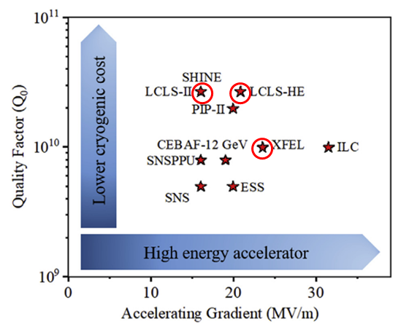
Technologies for X-ray FEL Oscillator (XFELO)
Superconducting accelerator
Bragg mirror (diamond or other crystals)
KEK ERL
P. Dhakal, Phys. Open 5, 100034 (2020).
Y. Shvyd’ko et al., Nature Phot. (2011).
Significant advancement in high-Q and
high-acc. gradient through world-wide projects over 30 years.
A millimeter-seized perfect crystal can act as a Bragg mirror with a reflectivity of over 90%.

Slide 7
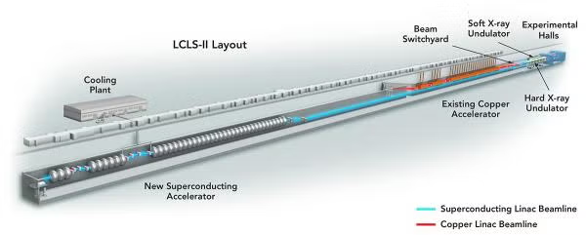
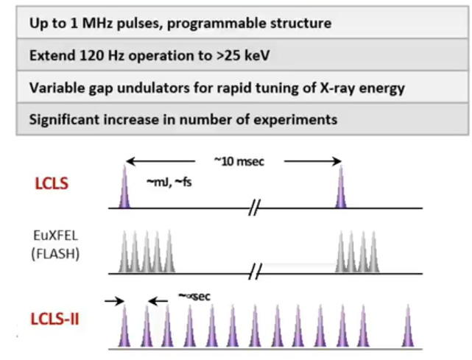
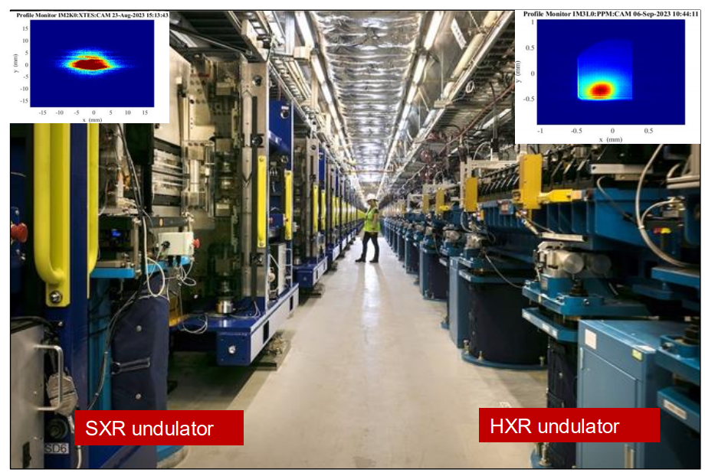
SLAC LCLS-II
Electron beam energy
4 GeV (present)
8 GeV (after upgrade in 2027)
https://lcls.slac.stanford.edu/lcls-ii/ldesign-and-performance
First lasing (2023)
1 MHz, CW operation
N. Neveu, “LCLS-II commissioning results and
lessons learned” (2024)

Slide 8
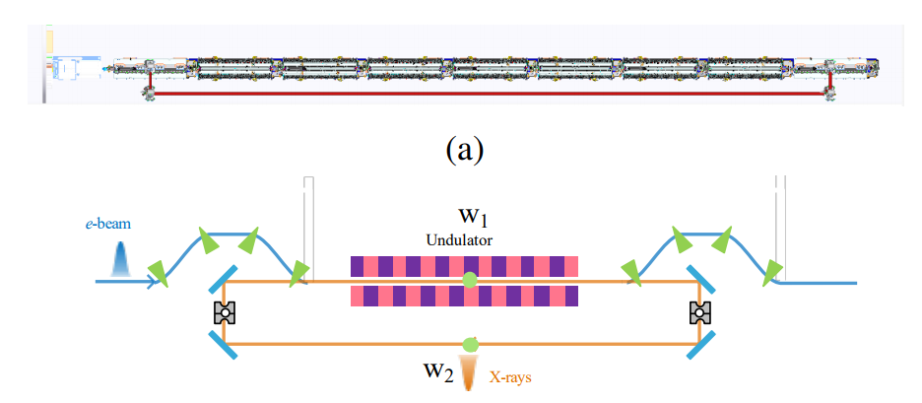
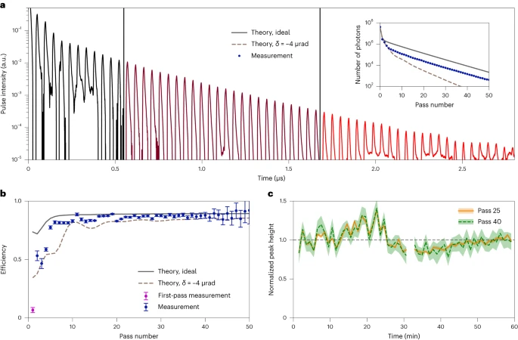
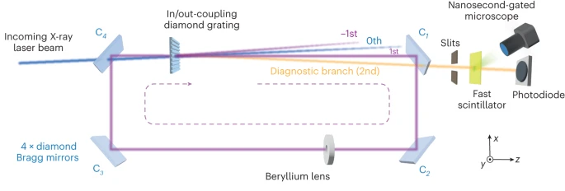
Cavity-Based XFEL at SLAC LCLS
Utilizing the MHz-beam at LCLS-II,
cavity-based XFELs are under development.
XFEL oscillator
and
X-ray regenerative amplifier
G. Marcus et al., FEL-2019.
Demonstration of X-ray cavity
Low-loss stable storage of 1.2 Å X-ray pulses
in a 14-m Bragg cavity.
Roundtrip efficiency >96% without the grating.
R. Margraf et al. Nat. Photon. 17, 878–882 (2023).

Slide 9
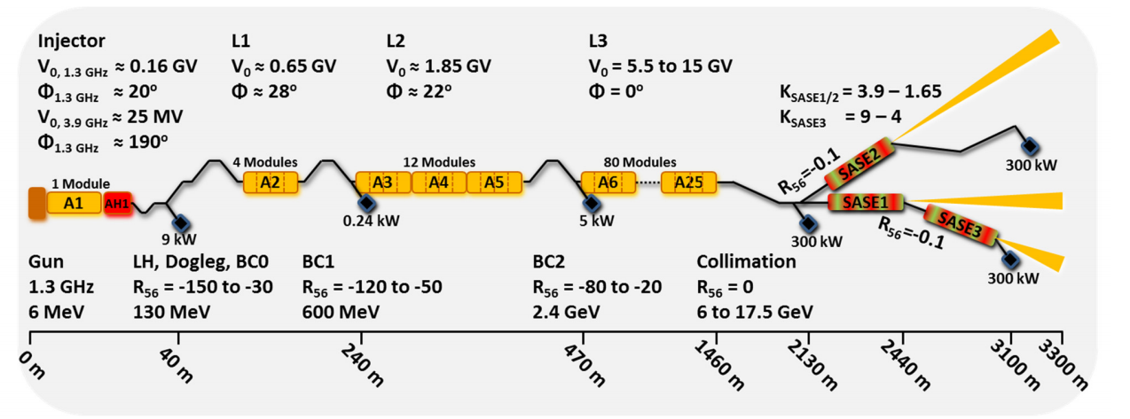
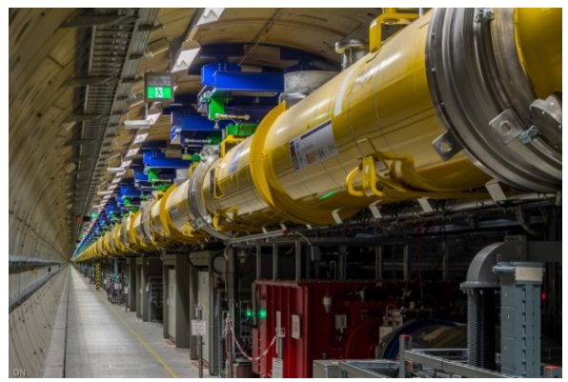
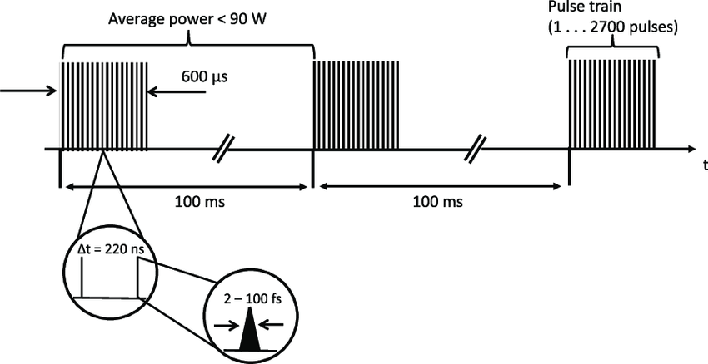
European XFEL
First lasing in May 2017
User operation since Sept. 2017
D. Nölle, FEL-2019
N. Kujala et al., Rev. Sci. Inst. 91, 103101 (2020).

Slide 10
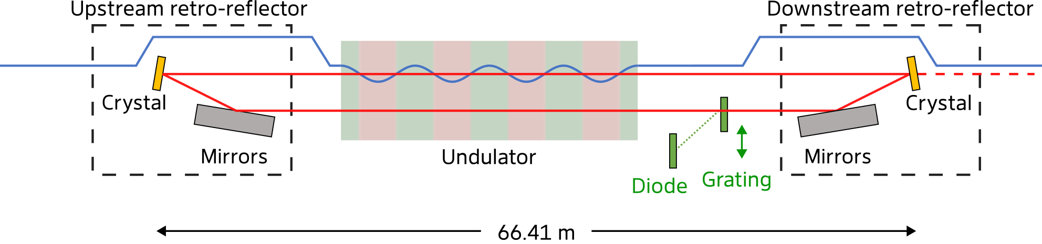
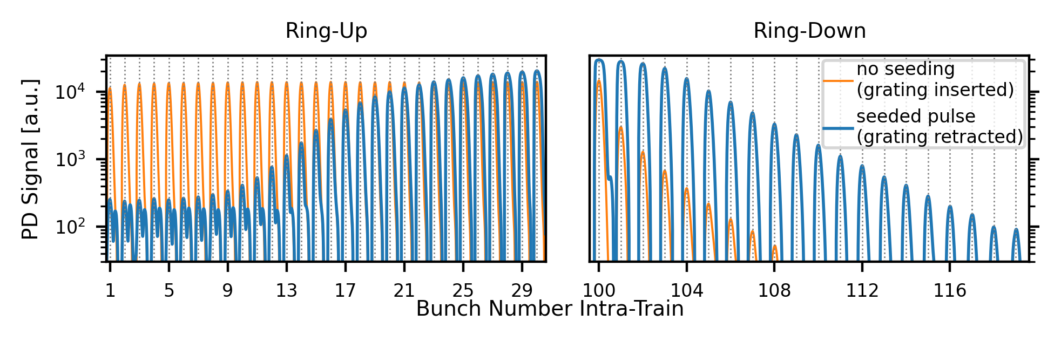
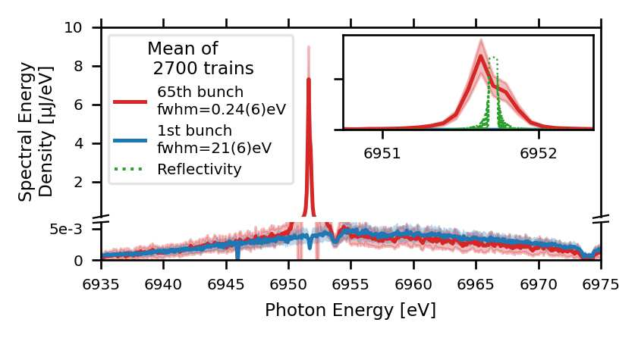
Lasing of XFEL oscillator at European XFEL
20 m
X-ray cavity was installed at SASE1.
The cavity path length = 132.8 m
→ 2.23 MHz
Diamond (400) reflection → 6.9517 keV
Successful Lasing of XFEL Oscillator
σ_{E} = 50 meV
100 bunches at a rep rate of 2.23 MHz were injected.
FEL gain per round trip = 40%
Patrick Rauer et al. “Lasing of a Cavity Based X-ray Source”, preprint
https://doi.org/10.21203/rs.3.rs-7274597/v1

Slide 11
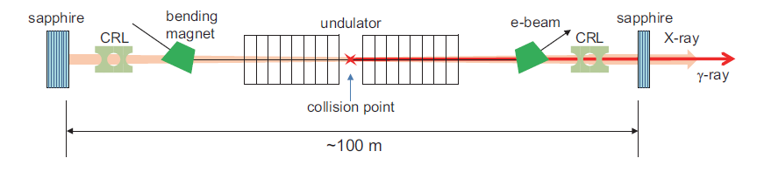
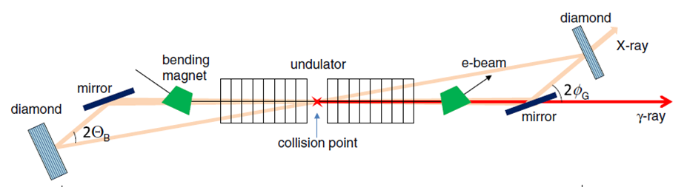
Compton γ-ray from XFEL oscillator
γ-ray
collision
In a two-mirror cavity with two X-ray pulse inside,
gamma photons are generated via Compton scattering at the middle of the cavity.
R. Hajima, M. Fujiwara, PR-AB 19, 020702 (2016)
Euro. XFEL
can be converted
into a Compton gamma source

Slide 12
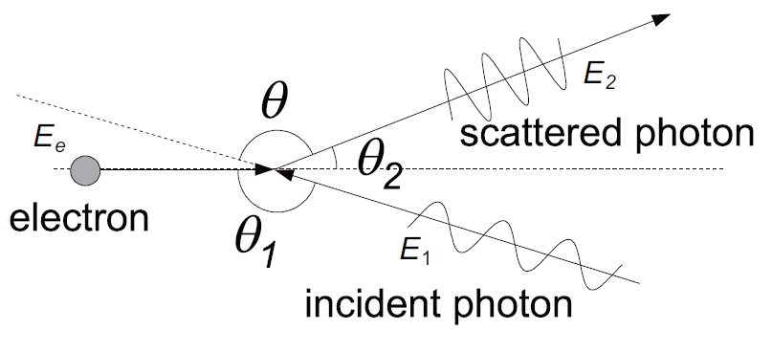
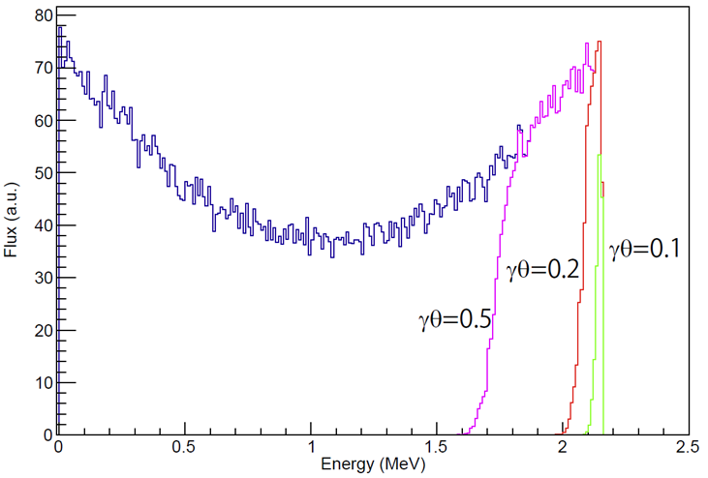
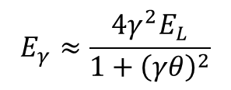
Spectrum of Compton gamma-ray (with IR photons)
electron beam
E = 350 MeV
laser beam
λ = 1064 nm
350 MeV
1064 nm
Rest frame：
photon energy＝1.6 keV << mc²
Approximation with Thomson Scat.
$$E_{γ}≈\frac{4γ^{2}E_{L}}{1+{\left(γθ\right)}^{2}}$$
0
0.5
1
1.5
2
2.5
Energy (MeV)
Scattered gamma energy has a correlation with the scattering angle
→ narrow-band gamma-ray with a collimator
What happens in XFELO-γ?
In a 7-GeV XFELO, 1-Å photons at the rest frame = 330 MeV >> mc²

Slide 13
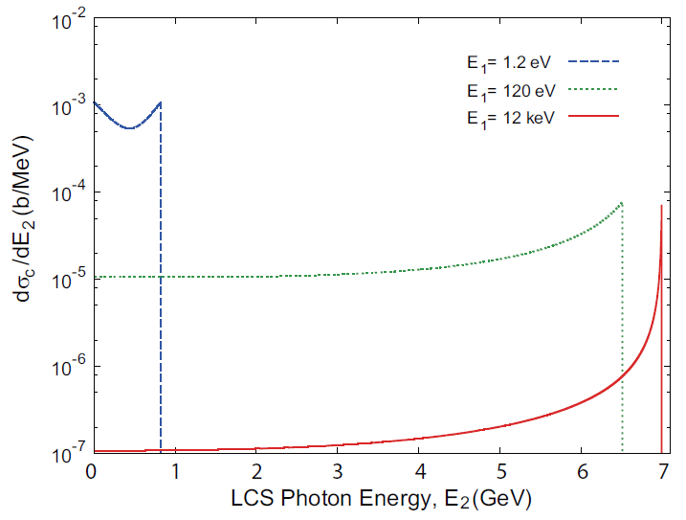
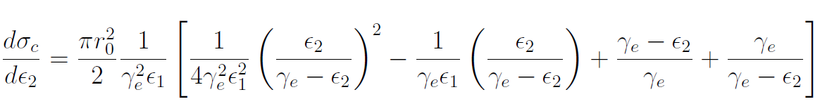
Spectrum of Compton gamma-ray (with X-ray photons)
Electron 7 GeV
7 GeV
12 keV
330 MeV at rest frame
Deep recoil regime
→ Large recoil
XFELO-γ
electron
laser
gamma
F. R. Arutyunian and V.A. Tumanian, Phys. Lett. 4, 176 (1963)

Slide 14
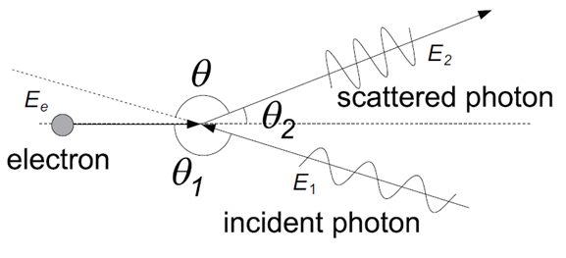
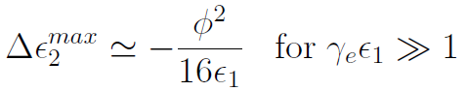
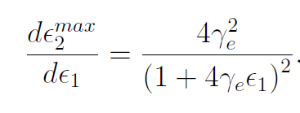
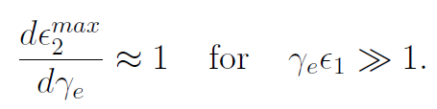

Sources of spectral broadening in XFELO-γ
7-GeV XFELO
Electron beam
Energy 7 GeV, bunch charge 40 pC, rep. 3 MHz
Norm. emittance ε_{n} = 0.082 mm-mrad
Energy spread 1.4 MeV
X-ray pulse
1 Å, 2x10¹⁰ ph/pulse (intra cavity)
electron
X-ray
gamma
Source of energy spread | scale | γ-ray Energy spread
Divergence of electrons and X-ray photons |  | ~ µeV
X-ray photon spectrum |  | 4.5 eV
Electron energy spread |  | 1.8 MeV
high-field nonlinear |  | negligible
$$A=\frac{e}{2πmc^{2}}E_{0}λ$$

Slide 15
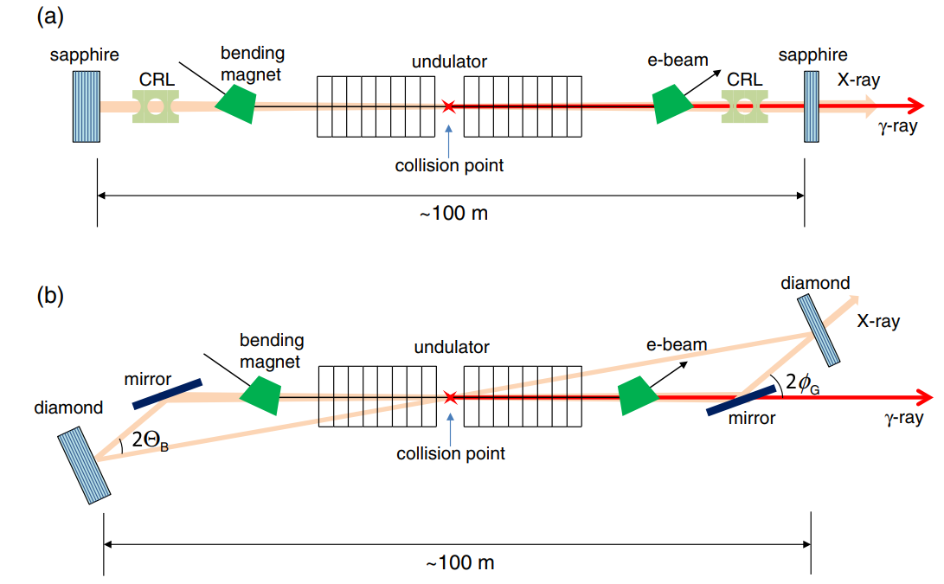
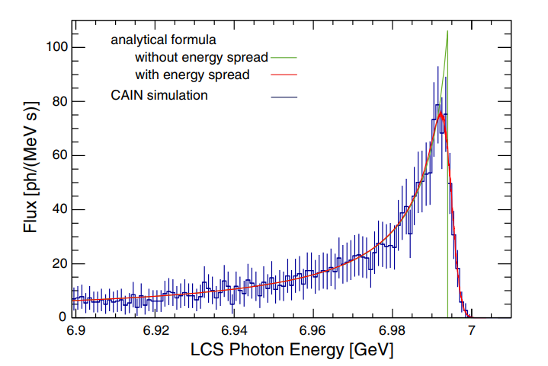

Spectrum of 7-GeV XFELO-γ for two configurations
Collinear and non-collinear collisions.
Diamond can not be used in the two-mirror configuration
due to multiple Bragg scattering.
R. Hajima, M. Fujiwara, PR-AB 19, 020702 (2016)
Crossing = 1 mrad
Two configurations show a similar γ-ray performance.

Slide 16



Generation of circularly polarized γ-ray
In the deep recoil regime,
the polarization of incident laser photons is not preserved
at the Compton scattering.
However, circularly polarized
γ-ray can be generated with
spin polarized electrons.
Spin polarized electrons from a GaAs/GaAsP
strained superlattice photocathode
1
X. Jin et al., Ultramicroscopy, 130 44 (2013).
fully circ. pol.
86%
Stokes parameter
0.5
CAIN simulation
with circ. pol. electrons
0
0
1
2
3
4
5
6
7
γ-ray energy (GeV)
T. Nakanishi et al., Phys. Lett. A 158, 345 (1991)

Slide 17



Energy measurement of γ-ray
Tagging of recoil electrons
Electrons lose a significant amount of energy at the collision.
γ-ray energy can be measured by a tagging detector
Energy resolution is limited by the electron energy
spread at the collision ~ 1.8 MeV for a 7-GeV XFELO-γ
LEPS at SPring-8
1.8 MeV
N. Muramatsu et al.,
NIMA 1033, 166677 (2022).

Slide 18

Possible multi-bunch operation
In the four-mirror cavity, γ-ray flux is simply
proportional to the bunch repetition.
In the two-mirror cavity, flux shows nonlinear
increasing due to multiple collisions.
The bunch repetition is limited by heat load on the Bragg mirrors
and the accelerator design. → ERL allows >100 MHz operation.
Based on the results of diamond mirrors at 3rd-generation X-ray sources,
100 MHz operation might be feasible.
K-J. Kim et al., Phys. Rev. Lett. 100, 244802 (2008).

Slide 19

Energy tunability of γ-ray at XFELO-γ
The γ-ray energy is determined only by the electron energy.
In the European XFEL, electron beam energies from 8 GeV to 17.5 GeV allow
the X-ray photon from 3 keV to 24 keV. → Gamma photon from 8 to 17.5 GeV.
With a harmonic lasing, 3.5-GeV XFELO can be designed.
Continuous energy tuning is feasible with changing the undulator gap and the
electron energy simulrtanously, while keeping the Bragg resonator configuration.
For example, K = 1.4 → K = 0.93, E = 7 GeV → 5.93 GeV.
Patrick Rauer et al. “Lasing of a Cavity Based X-ray Source”, preprint.
J. Dai et al., PRL 108, 034802 (2012)
Notes:
As mentioned earlier, the gamma-ray energy is determined by the electron beam energy.

Slide 20


Comparison of two types of GeV-gamma sources
LEPS, LEPS2 at SPring-8
XFELO-γ
Eγ = 8 – 17.5 GeV (at European XFEL)
For 7-GeV design,
ΔE/E = 0.1% (FWHM)
Flux = 1700 ph/s (1%BW) at 3 MHz repetition.
Random polarization
(or circular polarization with spin electrons)
Eγ = 1.3-2.4 GeV with a 355-nm laser
Flux 2.3 x 10⁶ ph/s
Linear polarization

Slide 21


Summary
Cavity-based XFELs are under development or planned in superconducting
XFEL facilities, European XFEL, LCLS-II and SHINE.
GeV-energy gamma-ray sources are realized with just minor changes to
these cavity-based XFELs.
Due to the deep recoil regime of Compton scattering, narrow-band photons
almost equal to the electron energy (0.1% FWHM) are generated
(8-17.5 GeV at European XFEL).
With a set of typical parameters based on a 7-GeV XFELO operated at 3 MHz,
the gamma flux is evaluated to be 1700 ph/s (1%BW), 540 ph/s (0.1%BW).
Gamma photons from XFELO-γ can be used for studying charmed quark
production dynamics.
Please suggest other applications if you have any.
$$γ+p→p+J/ψ$$
Eγ > 8.2 GeV
$$γ+p→\overline{D}0+Λ_{c}^{+}$$
Eγ > 8.7 GeV

