Slide 1
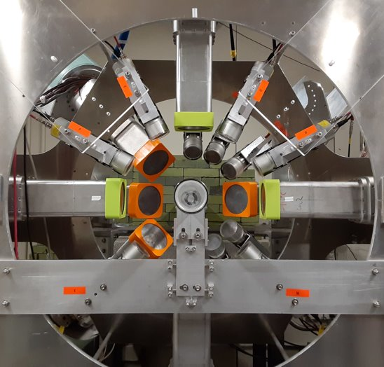
​5th Nuclear Photonics Conference​
Darmstadt, Germany
Excited 0⁺ Levels, Spin-4 States, and Everything In-Between in ⁶⁸Zn with Nuclear Resonance Fluorescence
Samantha R. Johnson
North Carolina State University and Triangle Universities Nuclear Laboratory
7 October 2025

Slide 2
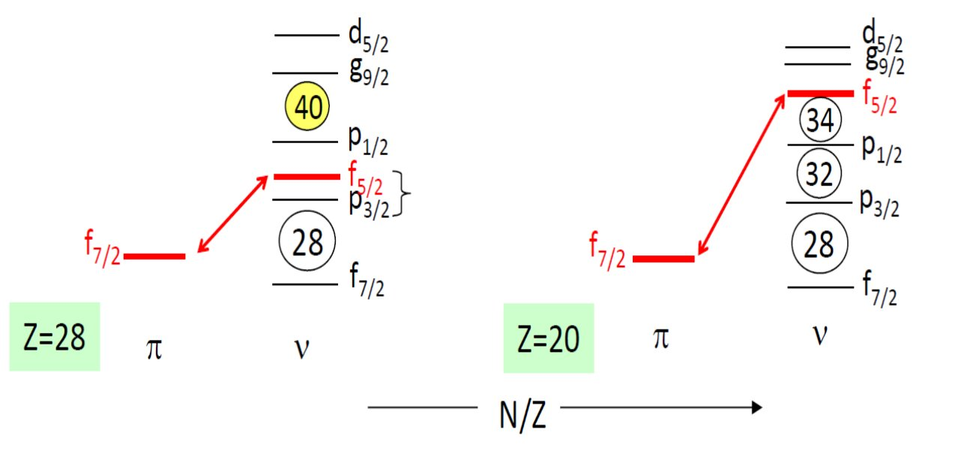
Motivation: Shell Evolution in the Ca – Ni region
Ordering of shells is changing with proton/neutron ratio, leading to new magic numbers in very neutron rich systems
Notes:
What appears to be happening is that the ordering of shells is changing with the proton/neutron ratio.
In particular, starting at Z=28 in Ni, have shell gaps at N=28 and 40. Moving to Z=20 in Ca, the proton/neutron interaction appears to shift the neutron f5/2 orbital so that different shell gaps are apparent.

Slide 3
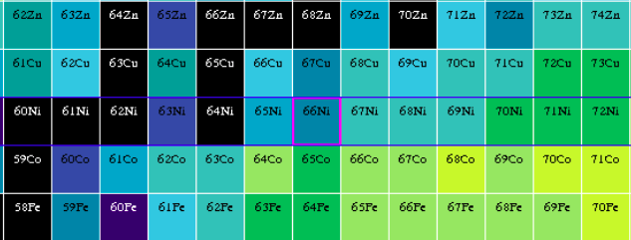
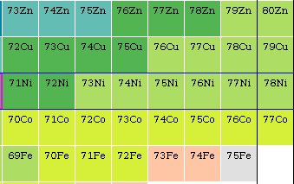



0⁺ States of the Ni isotopes
That impact can be seen at the Z=28 shell closure
The coexistence of three distinct shapes is apparent beginning with ⁷⁰Ni​
Evolution highlights the impact of occupation-driven changes in SPEs
Z=28
⁶²Ni
⁶⁴Ni
⁶⁶Ni
⁶⁸Ni
⁷⁰Ni
⁷²Ni
⁷⁴Ni
⁷⁶Ni
⁷⁸Ni
5
4
E [MeV]
3
2
1
0
​N. Marginean, Bormio 2025
⁶²Ni
⁶⁴Ni
⁶⁶Ni
⁶⁸Ni
⁷⁰Ni
⁷²Ni
⁷⁴Ni
⁷⁶Ni
⁷⁸Ni
Notes:
This impact can be seen in the well-studied Ni isotopic chain at the proton number 28 shell closure.
A spherical ground state is apparent, with a coexisting oblate configuration which comes down in energy with decreasing neutron number.
At 70Ni, three coexisting shapes have been found, with a prolate shape appearing above the oblate one.

Slide 4
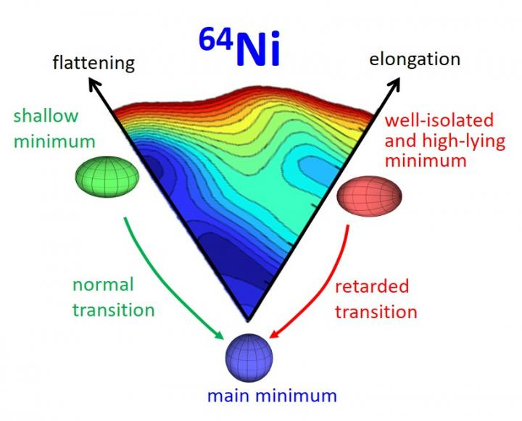
Shape Coexistence in Stable ⁶⁴Ni
Z=28
⁶²Ni
⁶⁴Ni
⁶⁶Ni
⁶⁸Ni
⁷⁰Ni
⁷²Ni
⁷⁴Ni
⁷⁶Ni
⁷⁸Ni
Shape coexistence picture was extended to stable ⁶⁴Ni
Deep inelastic reactions, neutron capture, Coulomb excitation, and NRF at HIγS, where all excited 0⁺ states were observed
​N. Marginean et al. Phys. Rev. Lett. 125, 102502 (2020).
Notes:
All 0+ states were seen in the NRF measurement

Slide 5
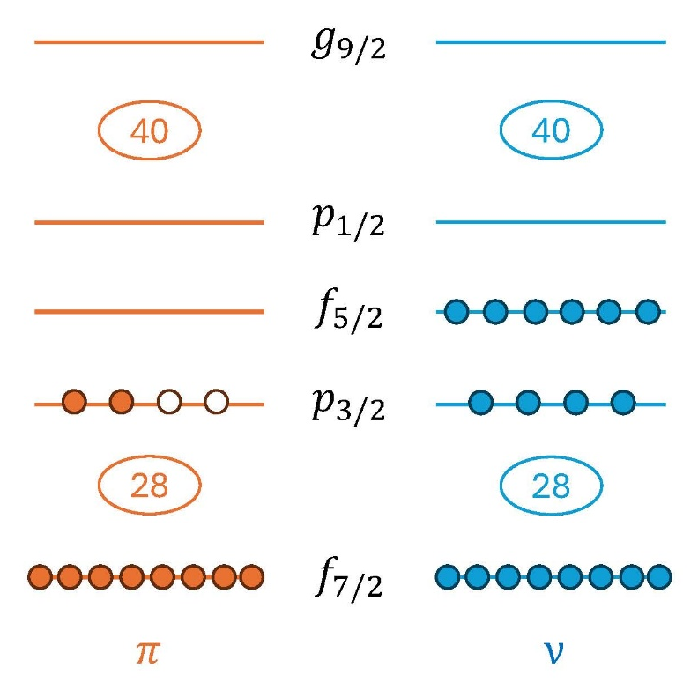
Additional Protons: The Zn isotopes
⁶⁸Zn
Z=28
⁶²Ni
⁶⁴Ni
⁶⁶Ni
⁶⁸Ni
⁷⁰Ni
⁷²Ni
⁷⁴Ni
⁷⁶Ni
⁷⁸Ni
How do the shapes change with Z?
Do the same excitations persist in a stable system with two additional protons?
Hope to see extended level structure using NRF

Slide 6
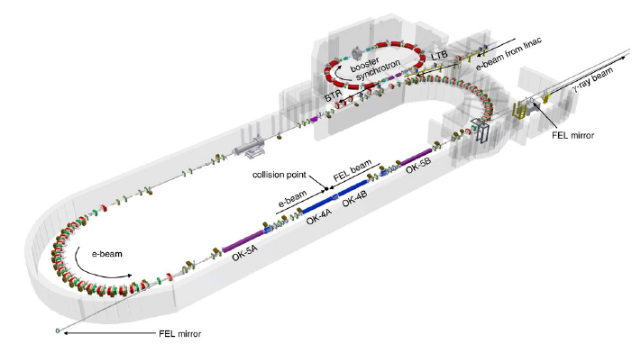
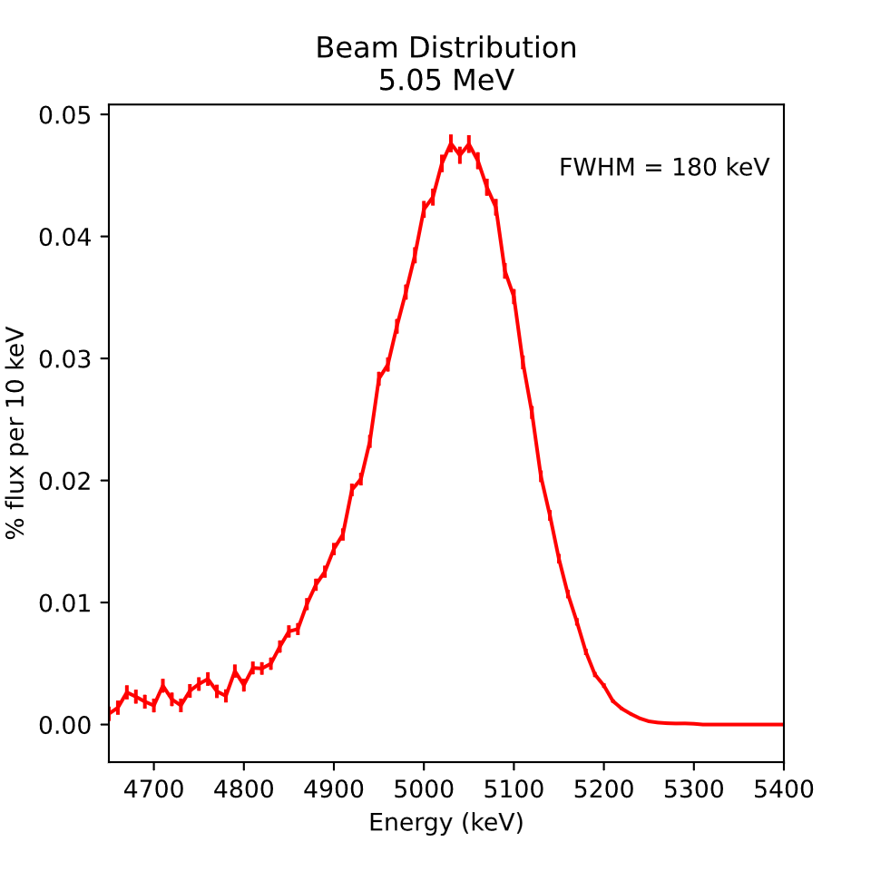
High Intensity Gamma-Ray Source (HIγS)
Laser Compton backscattering used to produce quasimonochromatic gamma-ray beams
Energy ranging from 2 to 120 MeV
Linear or circular polarization option
H. R. Weller et al., Prog. Part. Nucl. Phys. 62, 257 (2009).
Energy of the beam can be tuned to selectively excite states within an energy range of only a few hundred keV at a time​
Notes:
Electron beam from linac and a storage ring
Booster synchrotron that acts as an injector

Slide 7
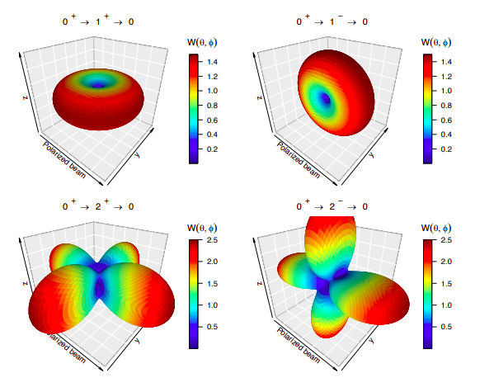
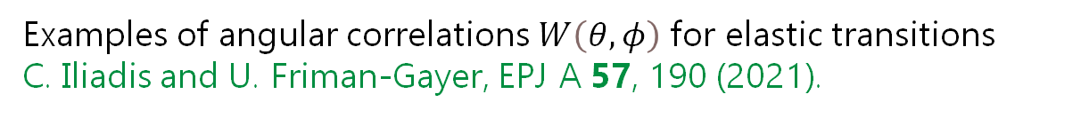
Detector Placement and Angular Distribution of NRF Radiation
For a nucleus with a 0⁺ ground state, mainly spin-1 states are excited.
Elastic decays occur via gamma emission following well-defined angular distributions depending on the spin/parity of the state
1^{+/-}
2⁺
0⁺
Inelastic
Elastic
Examples of angular correlations $W\left(θ,φ\right)$ for elastic transitions
C. Iliadis and U. Friman-Gayer, EPJ A 57, 190 (2021).

Slide 8
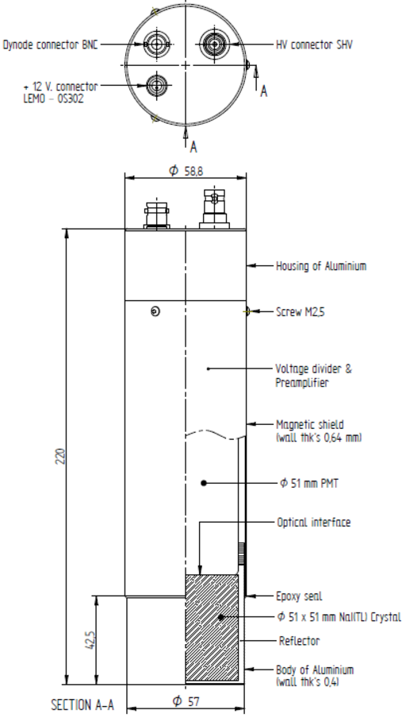
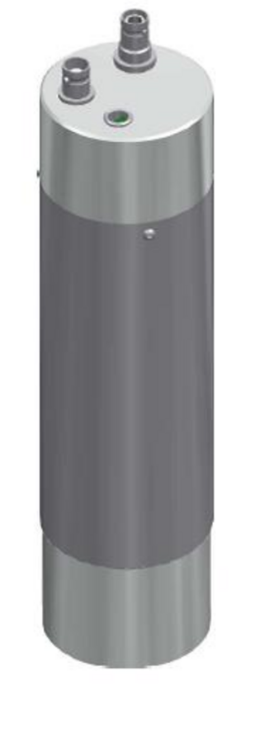
Clover Array at HIγS
These measurements were the first with the modular Clover Array
8 clover-type HPGe
12 CeBr₃ scintillators: 2” x 2”, no intrinsic radioactivity
Notes:
Detectors in strategic positions to distinguish these patterns

Slide 9
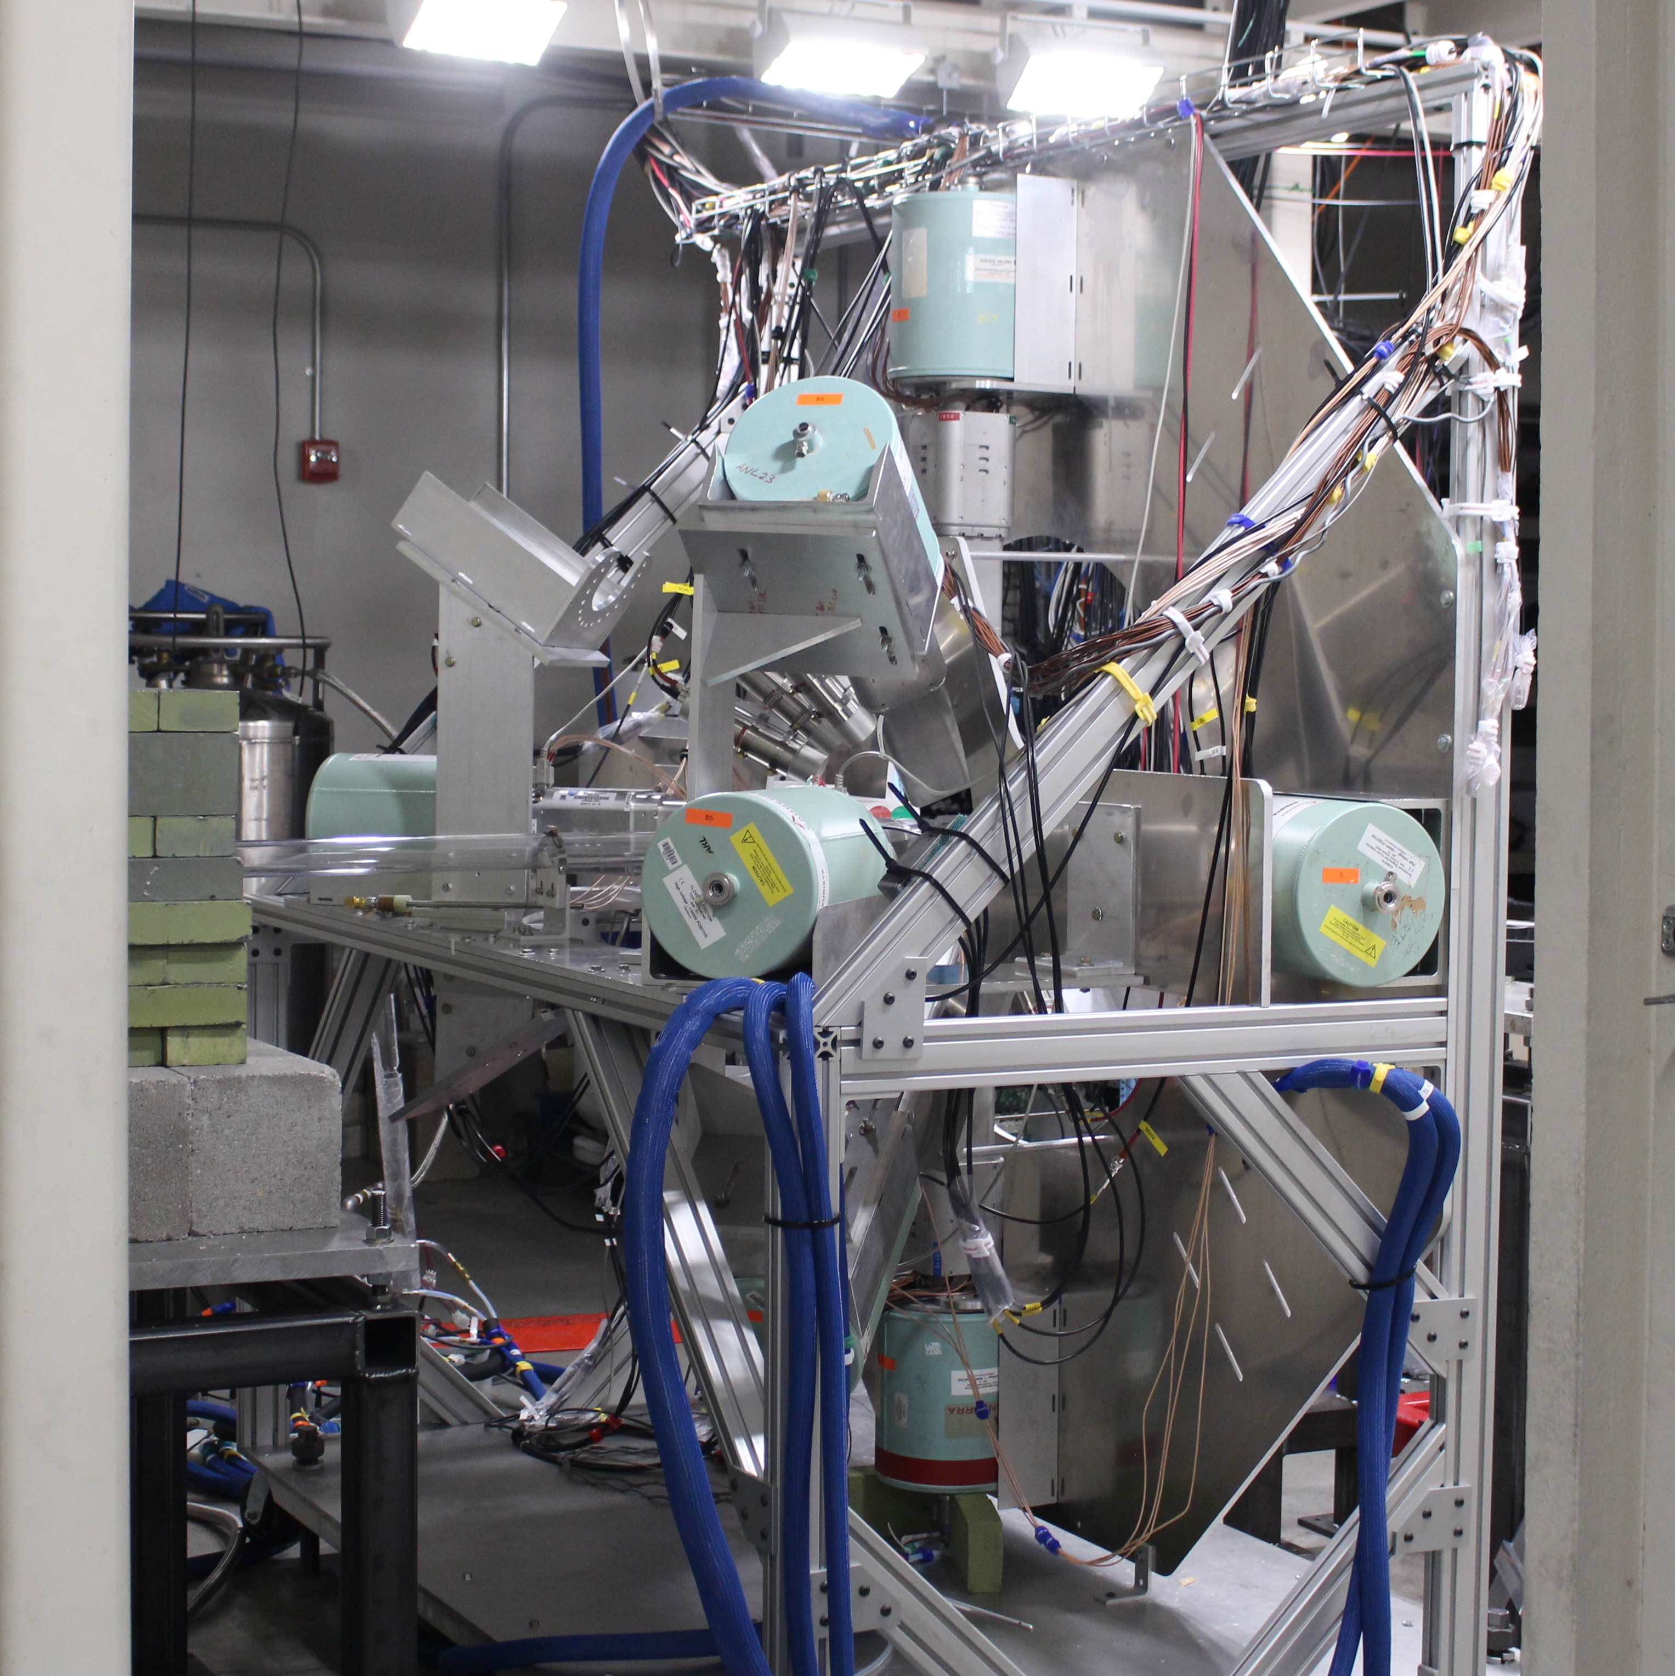
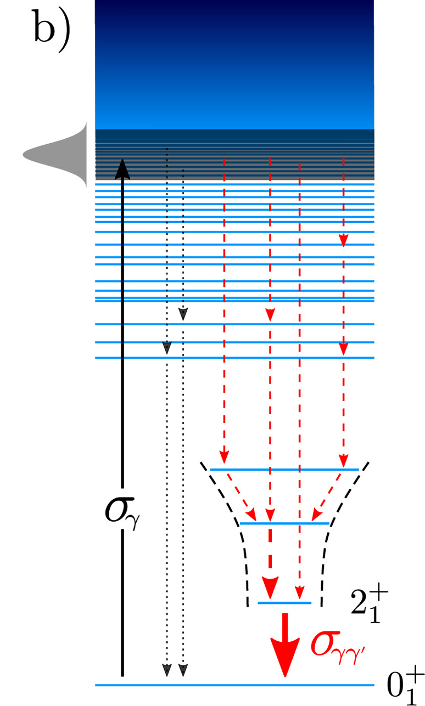
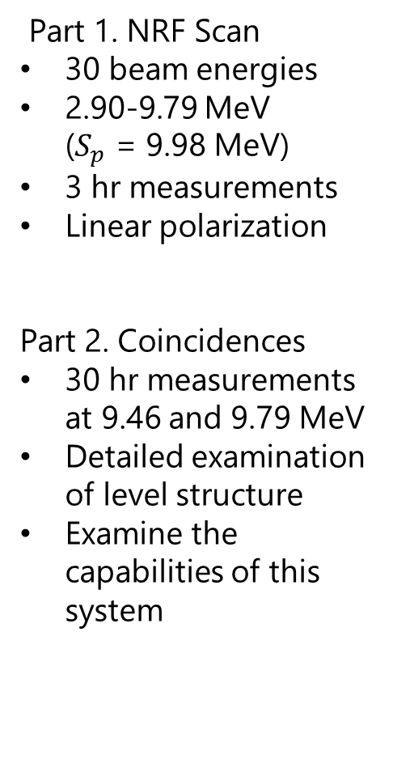
Experiment Outline
Part 1. NRF Scan
30 beam energies
2.90-9.79 MeV ($S_{p}$ = 9.98 MeV)
3 hr measurements
Linear polarization
Part 2. Coincidences
30 hr measurements at 9.46 and 9.79 MeV
Detailed examination of level structure
Examine the capabilities of this system
A. Zilges et al., Prog. Part. Nucl. Phys. 122, 103903 (2022).
Notes:
Scan at the nucleus at a range of energies to find all the low-spin states that we could
Gamma-gamma coincidence measurements

Slide 10
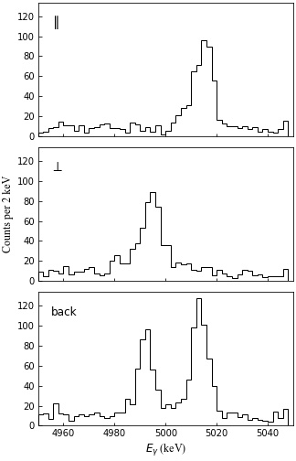
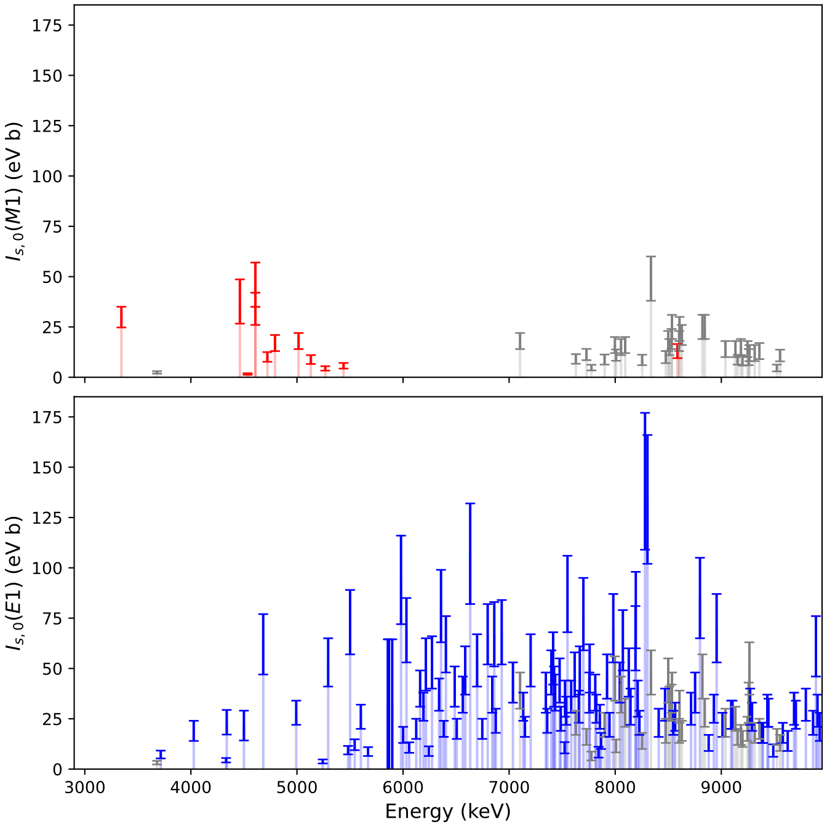


Results for ⁶⁸Zn
M1
M1
158 excited states were found below the particle threshold!
Only 10 had been studied previously using NRF.
Some uncertain parities
E1
E1
M1
E1
$$⊥$$
$$∥$$
polarization vector

Slide 11
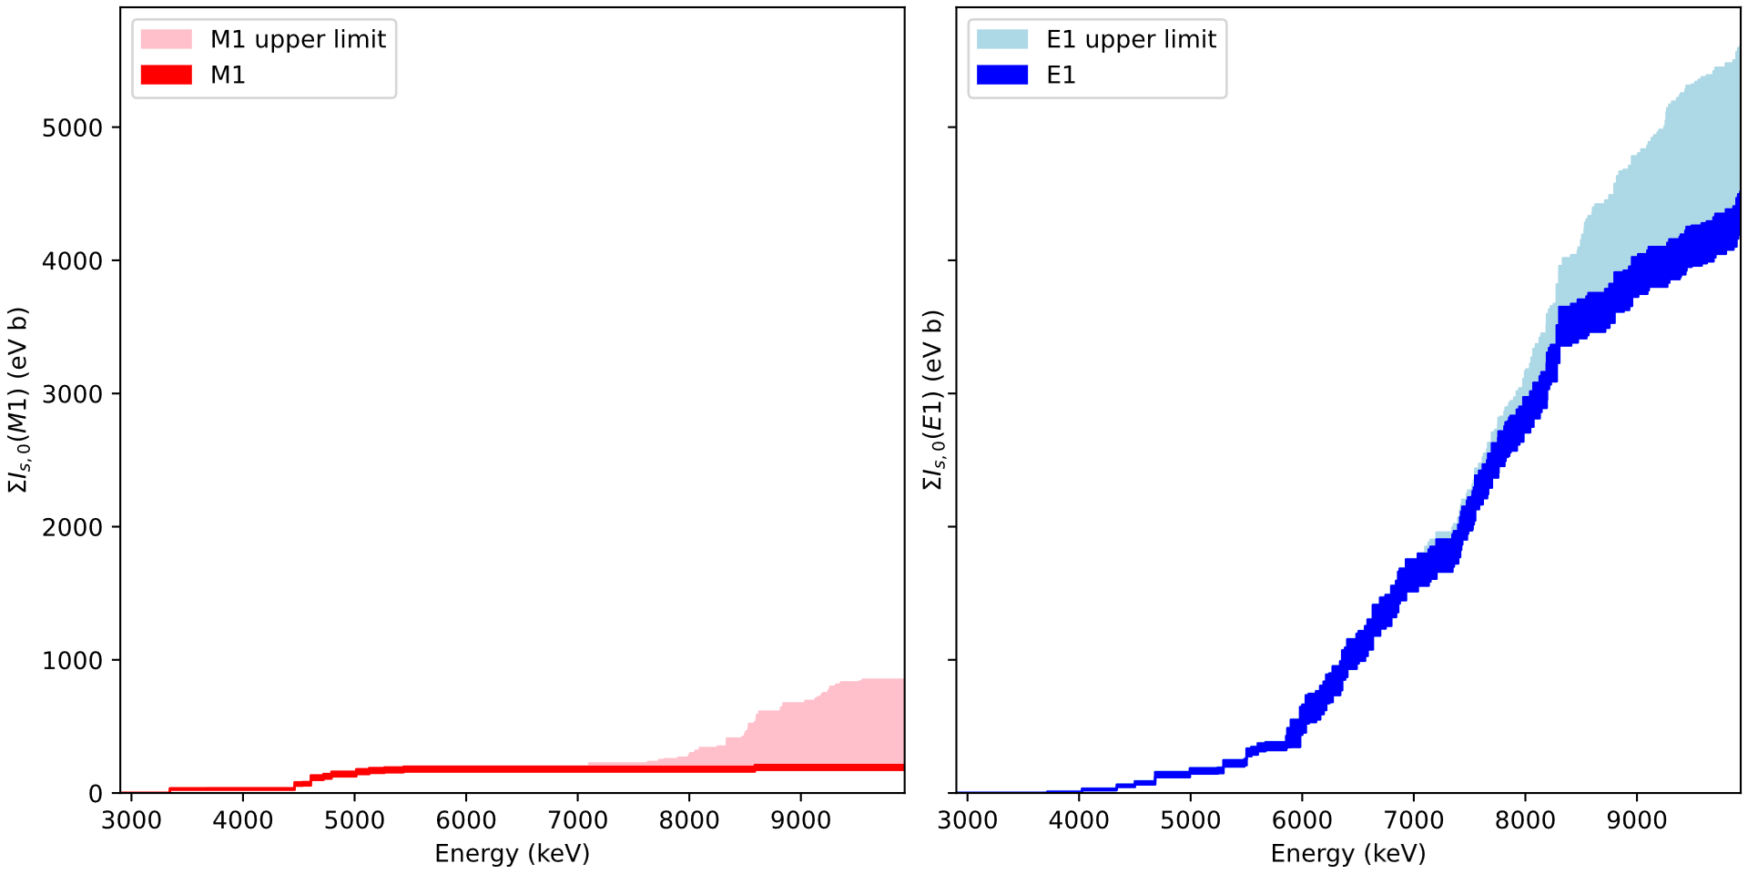
Running Sum of the Cross Section
Notes:
Showing now the sum as a function of energy of the cross section for both positive parity and negative parity states
Also the upper limit of the potential contribution of states with unknown parity to either plot
E1 response dominates, as expected
M1 rises at low energy, levels out, with another potential increase at high energy.

Slide 12
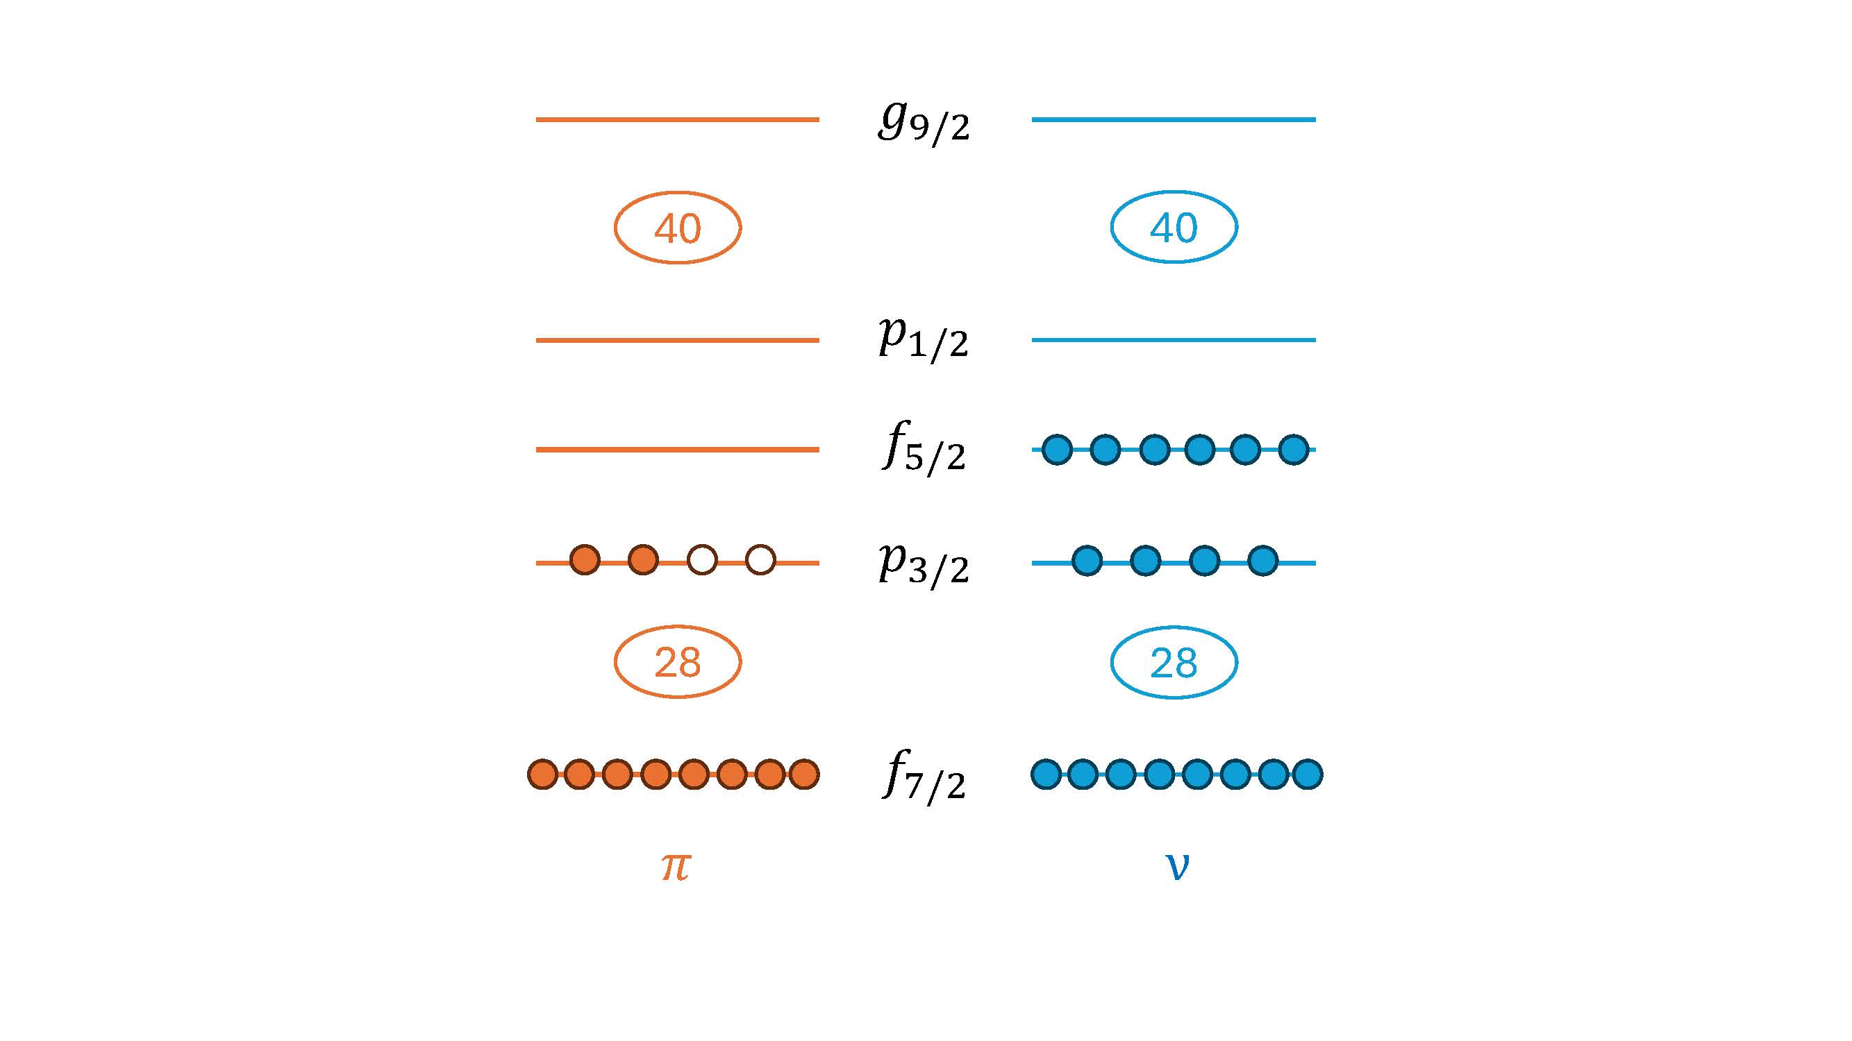
M1 Strength in the Shell-Model Picture
Model space: jj44
⁵⁶Ni core: 28 protons and neutrons
⁶⁸Zn: 2 valence protons, 10 neutrons
A test of the JUN45 and jj44b Hamiltonians in a unique regime
Calculations by B. A. Brown
Notes:
These interactions are the most recent and most effective in this region, and the present experimental data represent a regime where they are seldom tested

Slide 13
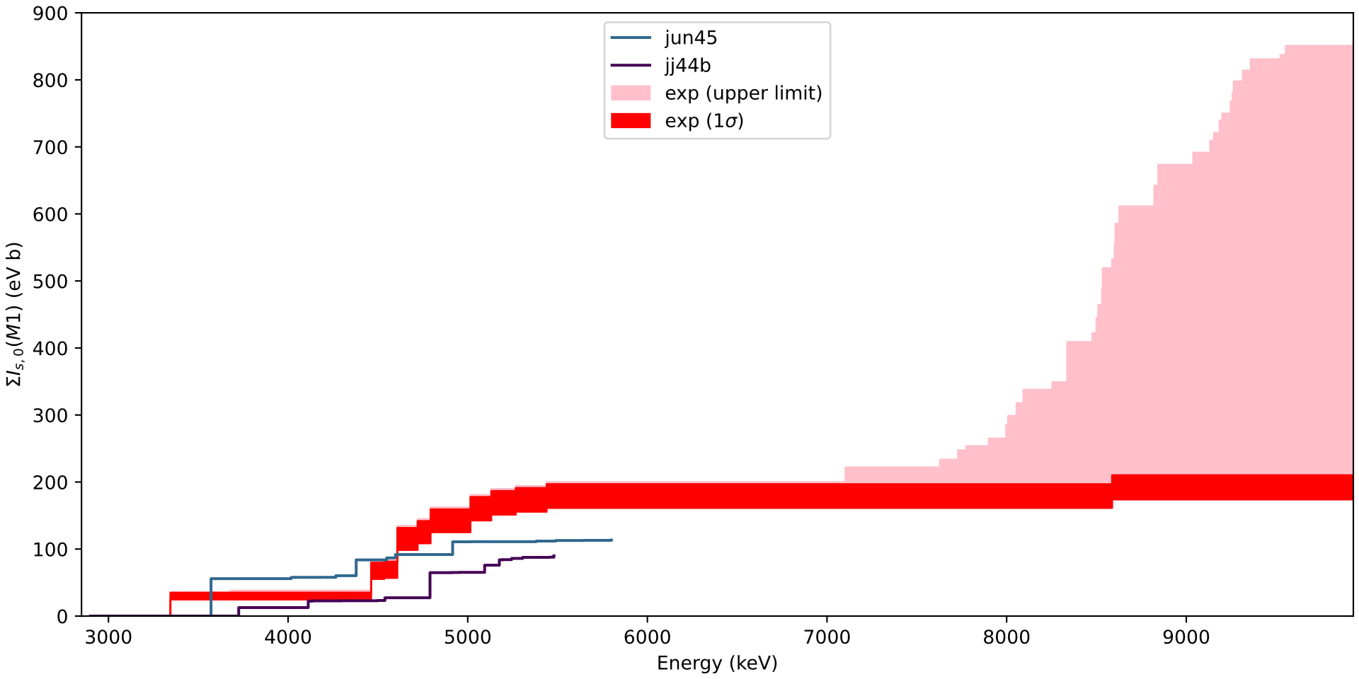
Shell-Model Predictions for M1 States
Strength comes from transitions within the p_{1/2}, p_{3/2}, f_{5/2}, and g_{9/2} orbitals, and between the p_{3/2} and p_{1/2} shells
Notes:
The right trend is there at the beginning, with the first 1+ states predicted in the right location, but
…at a certain point, this model space becomes exhausted, which is why the theory lines stop; very little strength is expected in these calculations above this energy, coming from highly-mixed configurations
In this model space, the strength is coming from transitions within p1/2, p3/2, f5/2, and g9/2 shells, and between the p3/2 and p1/2 shells. (Note: the latter is also a spin-flip transition)

Slide 14
Shell-Model Predictions for M1 States
M1 Spin-Flip Giant Resonance
L-½
L+½
0f_{5/2}
0f_{7/2}
An expanded model space is needed to account for the experimental M1 strength
Notes:
Higher-energy strength should be due to the M1 giant resonance, or the spin-flip resonance
This should come from 0f7/2 to the 0f5/2 transitions, which is not included in this model space.
To account for the total cross sections predicted in this model space, calculations were performed with an expanded model space...

Slide 15
Opening up the model space
Consider to full “fp” model space:
⁴⁰Ca core: 20 protons and neutrons
Proton and neutron f_{7/2} excitations are now allowed
The g_{9/2} orbital is no longer included

Slide 16
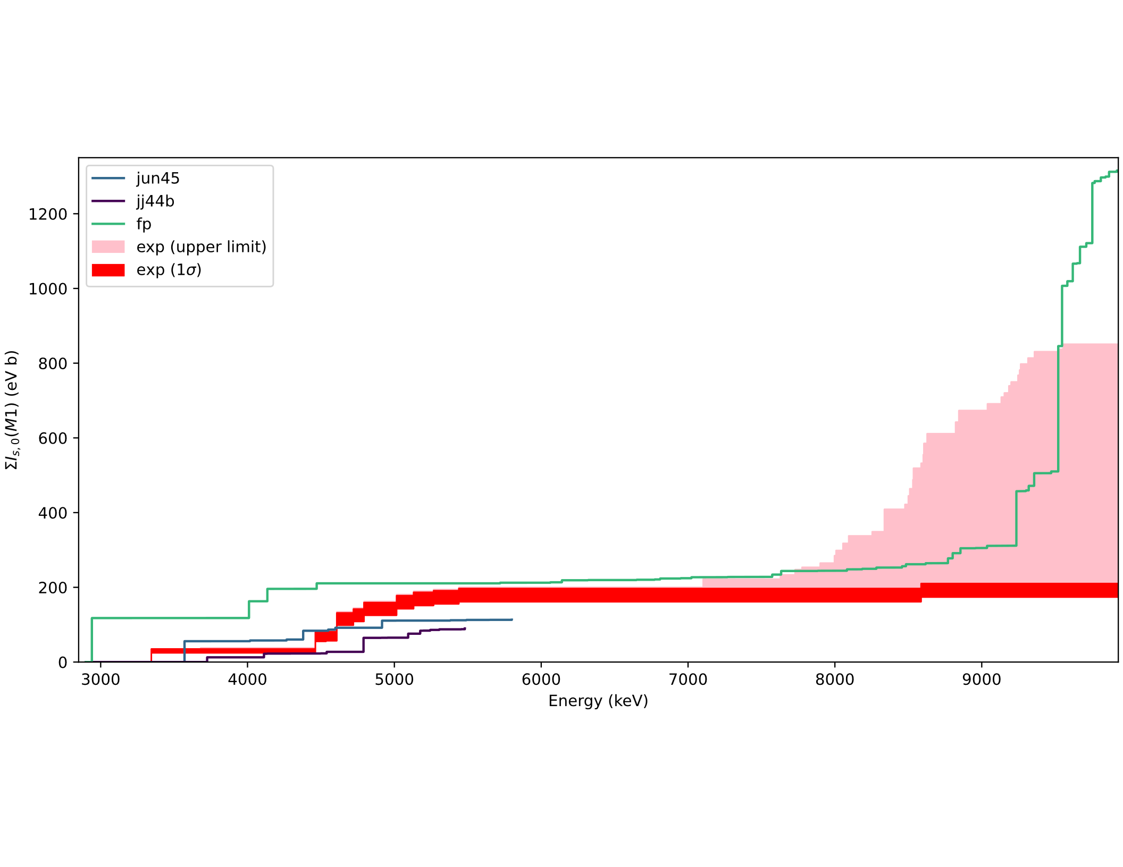
Shell Model Predictions for M1 States
High-energy strength is described well by including the f_{7/2} shell
Low-energy p_{3/2} -> p_{1/2} strength is overestimated when nucleons are not allowed to occupy the g_{9/2} shell
The fp model space does not allow for 1⁻ states
Need both model spaces!
These results demonstrate core breaking in ⁶⁸Zn
Notes:
At the highest energies, have to reach deep into the f7/2 shell to get these excitations out. Remarkable prediction of the mid-range strength!
However, low-energy structure is not captured as well. The overestimation of the strength at low energy is because the p1/2 p3/2 strength is overestimated in this model space.
Also, 1- states are not included in the fp model space

Slide 17
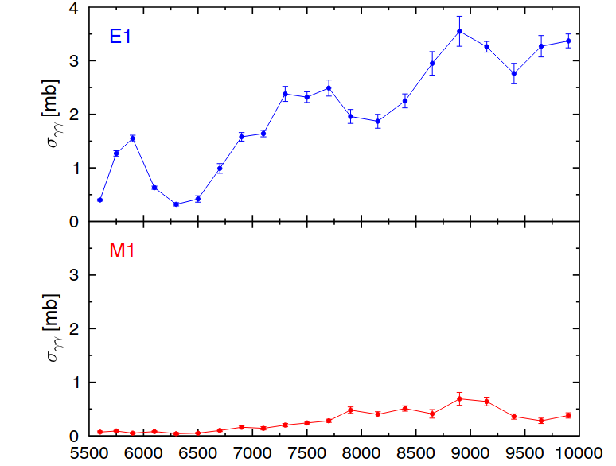
Comparison to ⁶⁶Zn
⁶⁶Zn
Positive-parity states represent only 4% of the total spin-1 cross section in ⁶⁶Zn
⁶⁸Zn is very similar with 3-16% M1
Similar cross section trend with energy and average branching ratios
Recent/future NRF studies of ⁷⁰Zn and ⁶⁴Zn will give a complete characterization of the stable even-even Zn chain (See poster of J. Hauf)
D. Savran et al., Phys. Rev. C 106, 044324 (2022)

Slide 18
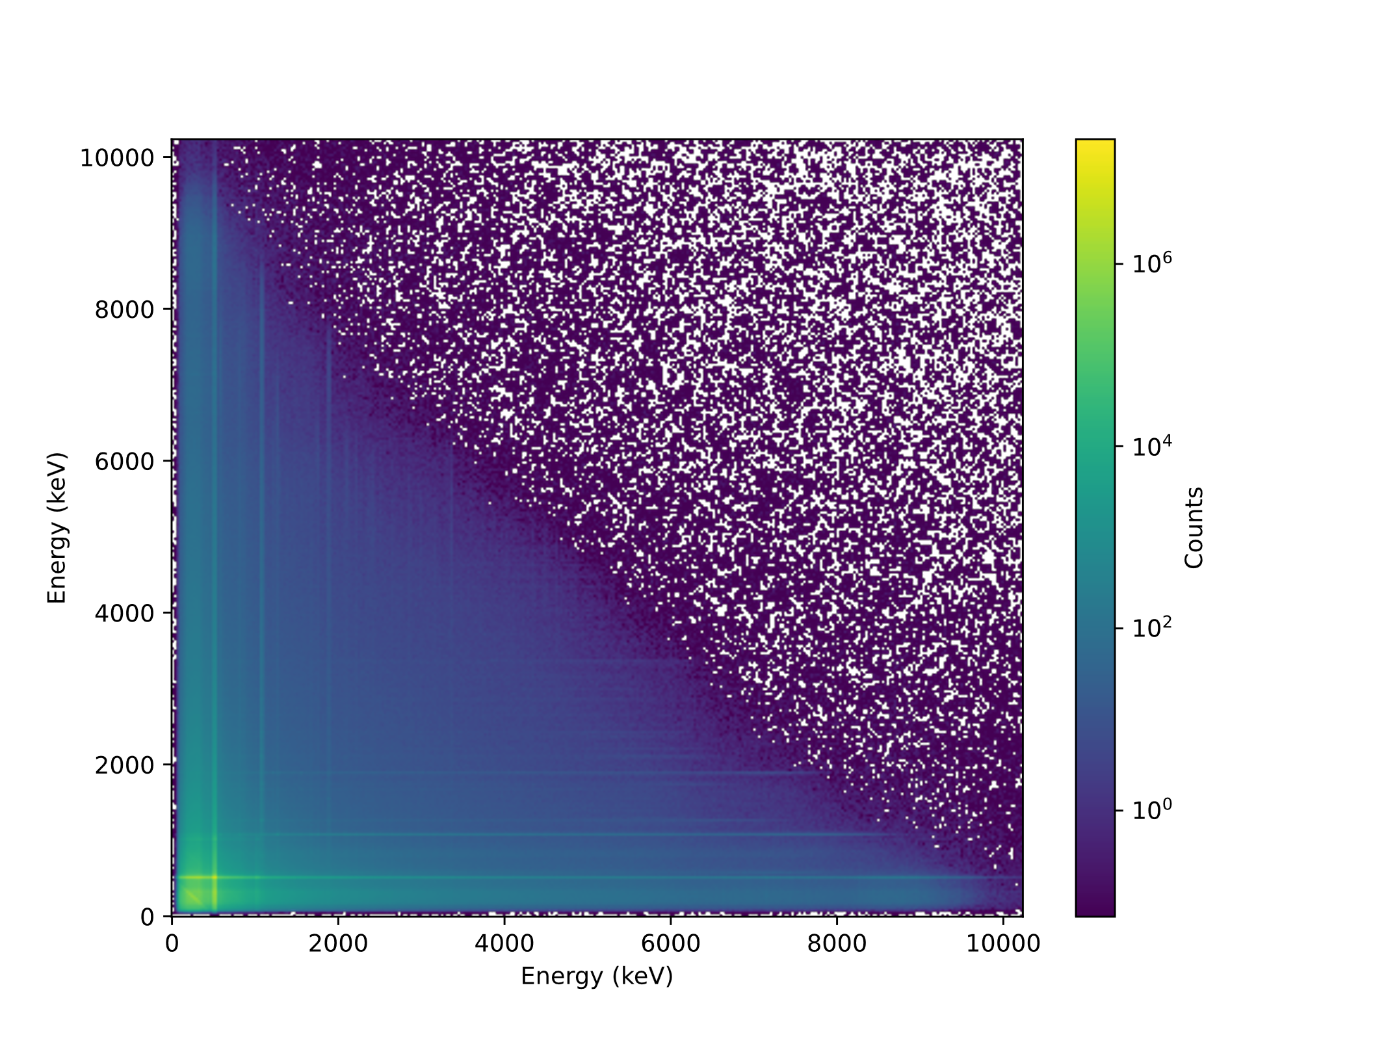
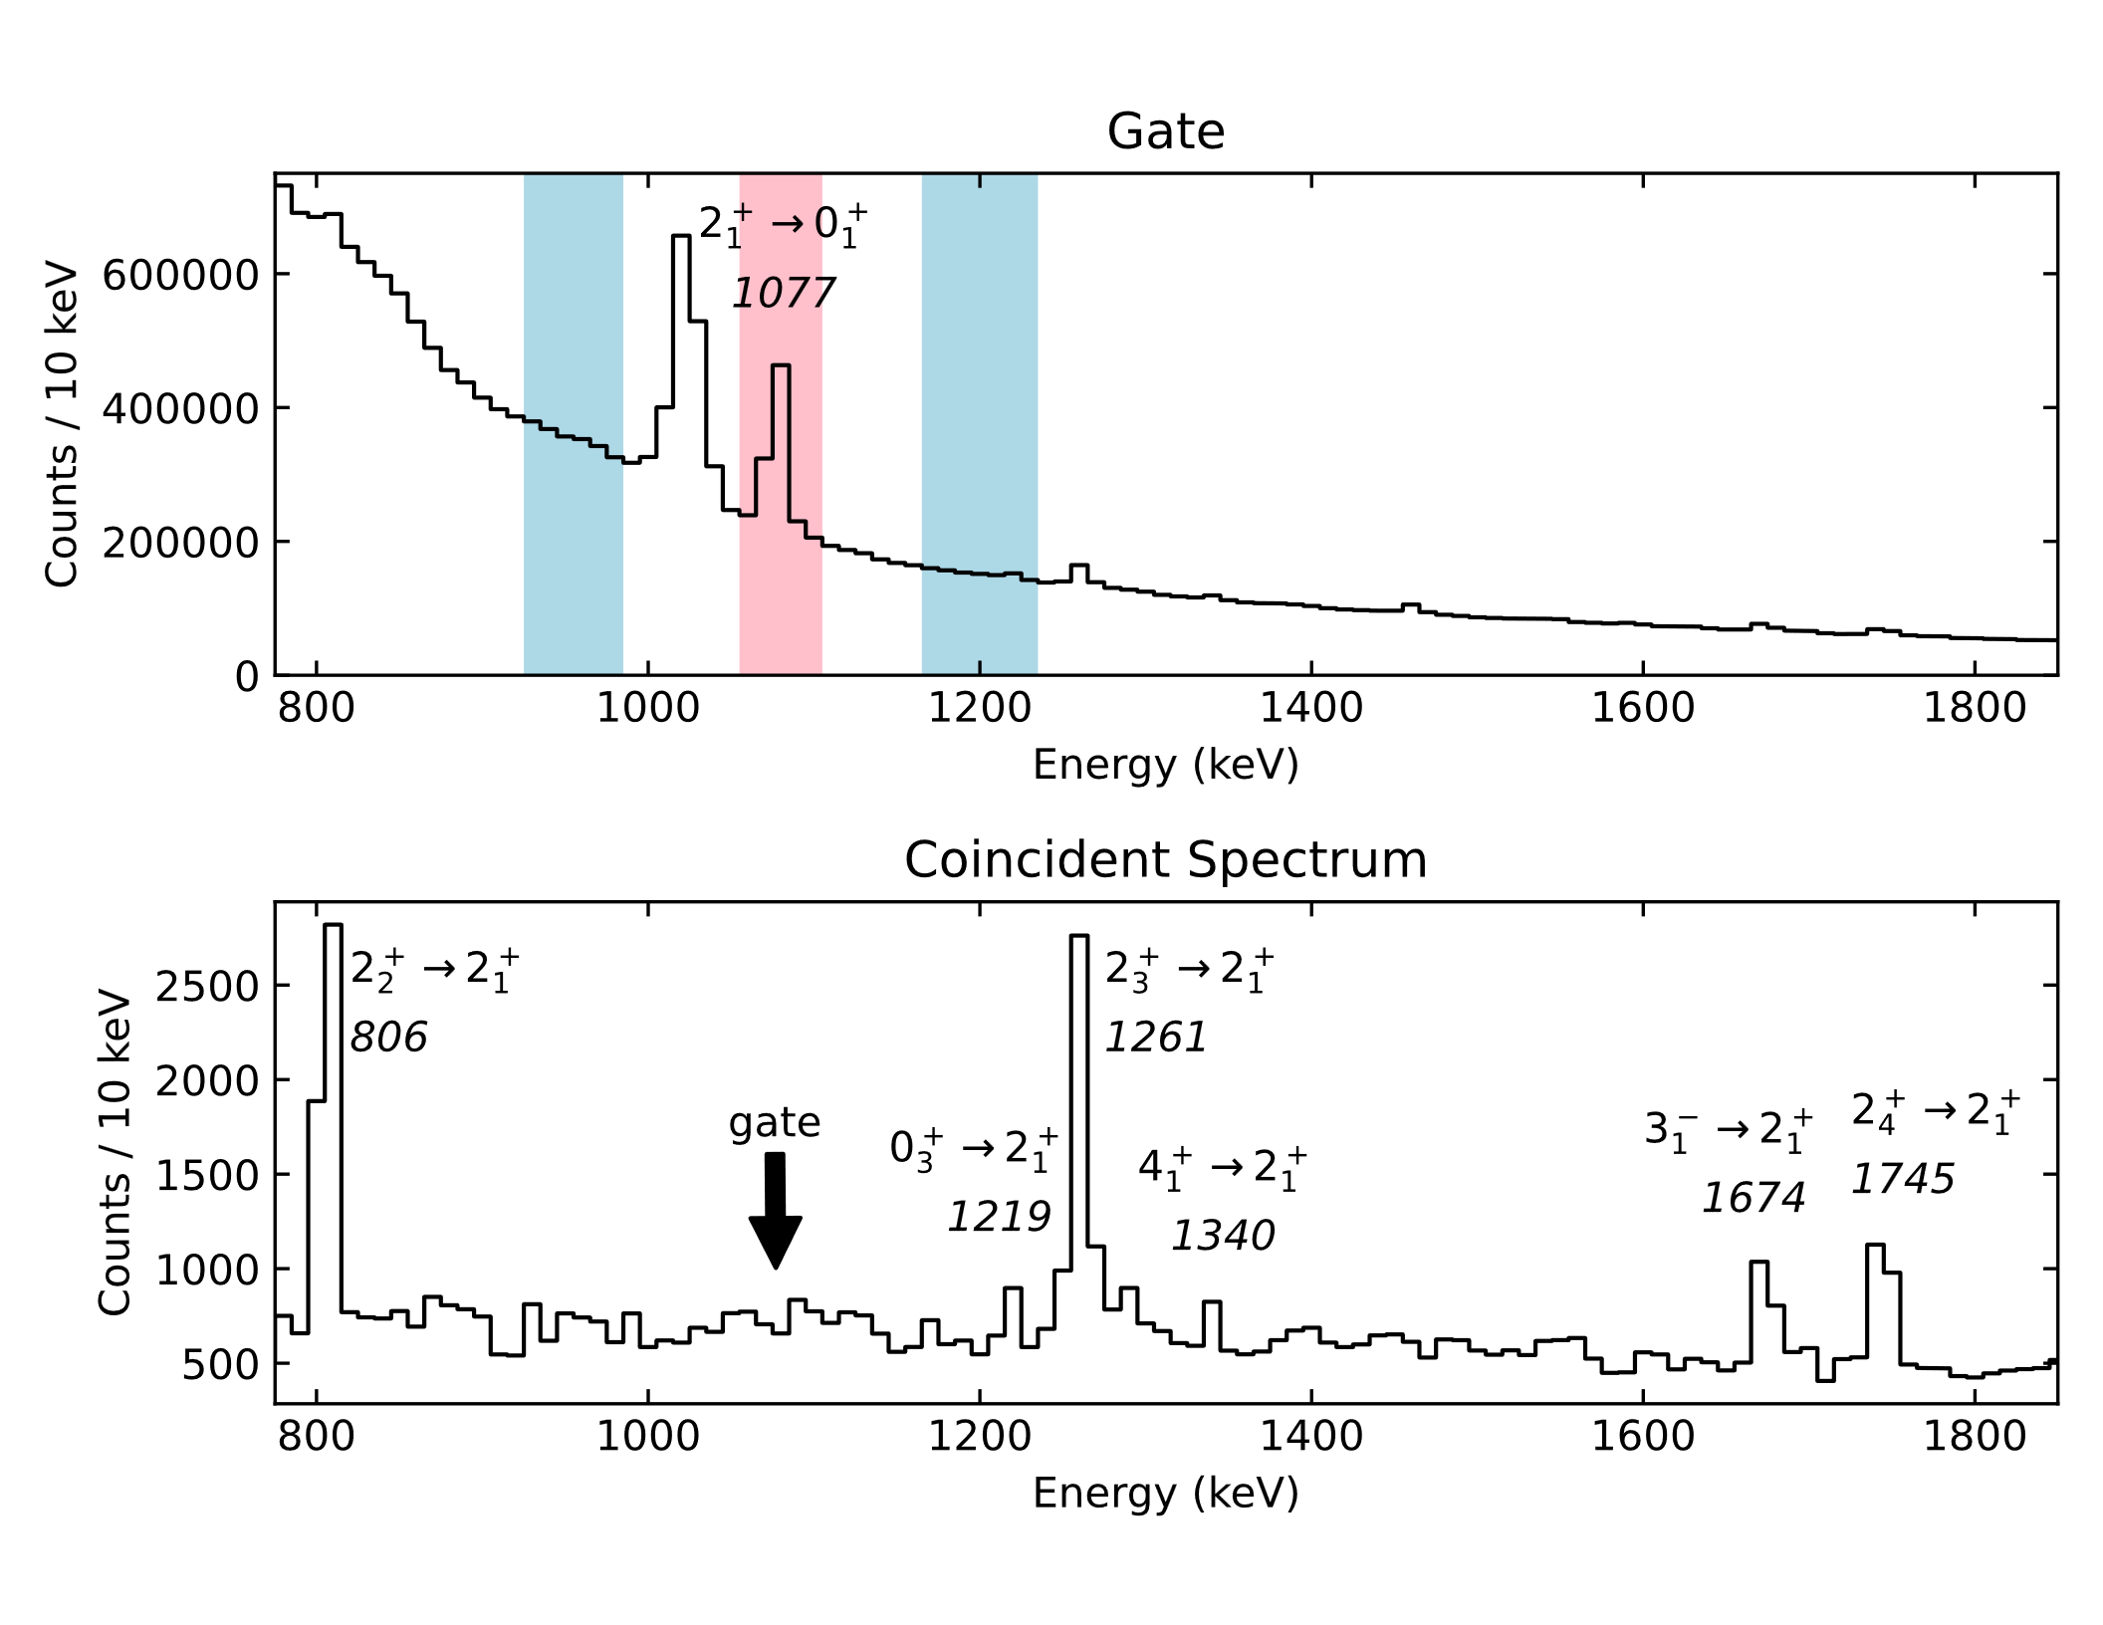
Coincidence data may unveil more structural details
Two long-duration measurements at 9.46- and 9.79-MeV entrance points

Slide 19
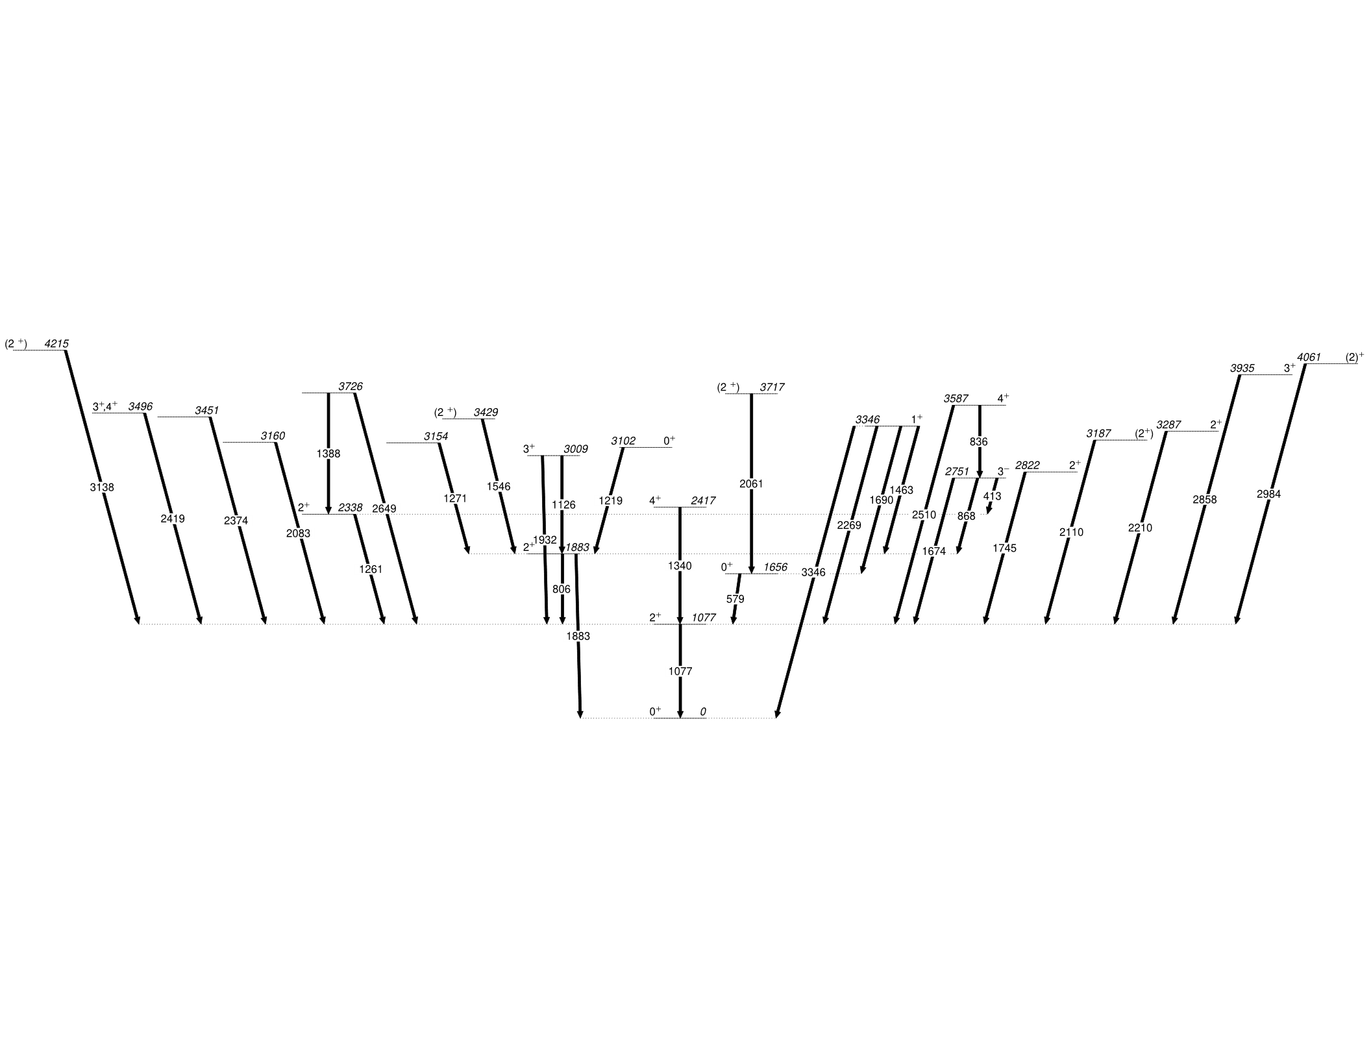
Experimental Level Scheme
23 excited states up to ~4.2 MeV were identified
Notes:
More complete picture of the low-spin structure of the nucleus

Slide 20
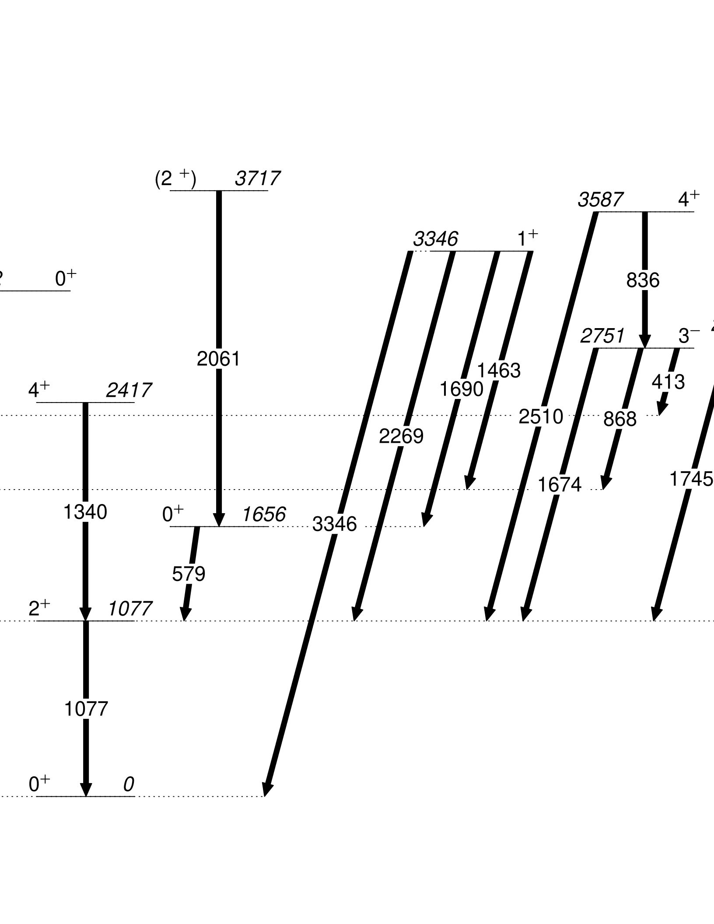
Experimental Level Scheme: High Spin for NRF!
Higher angular momentum than expected coming from multi-step decays

Slide 21
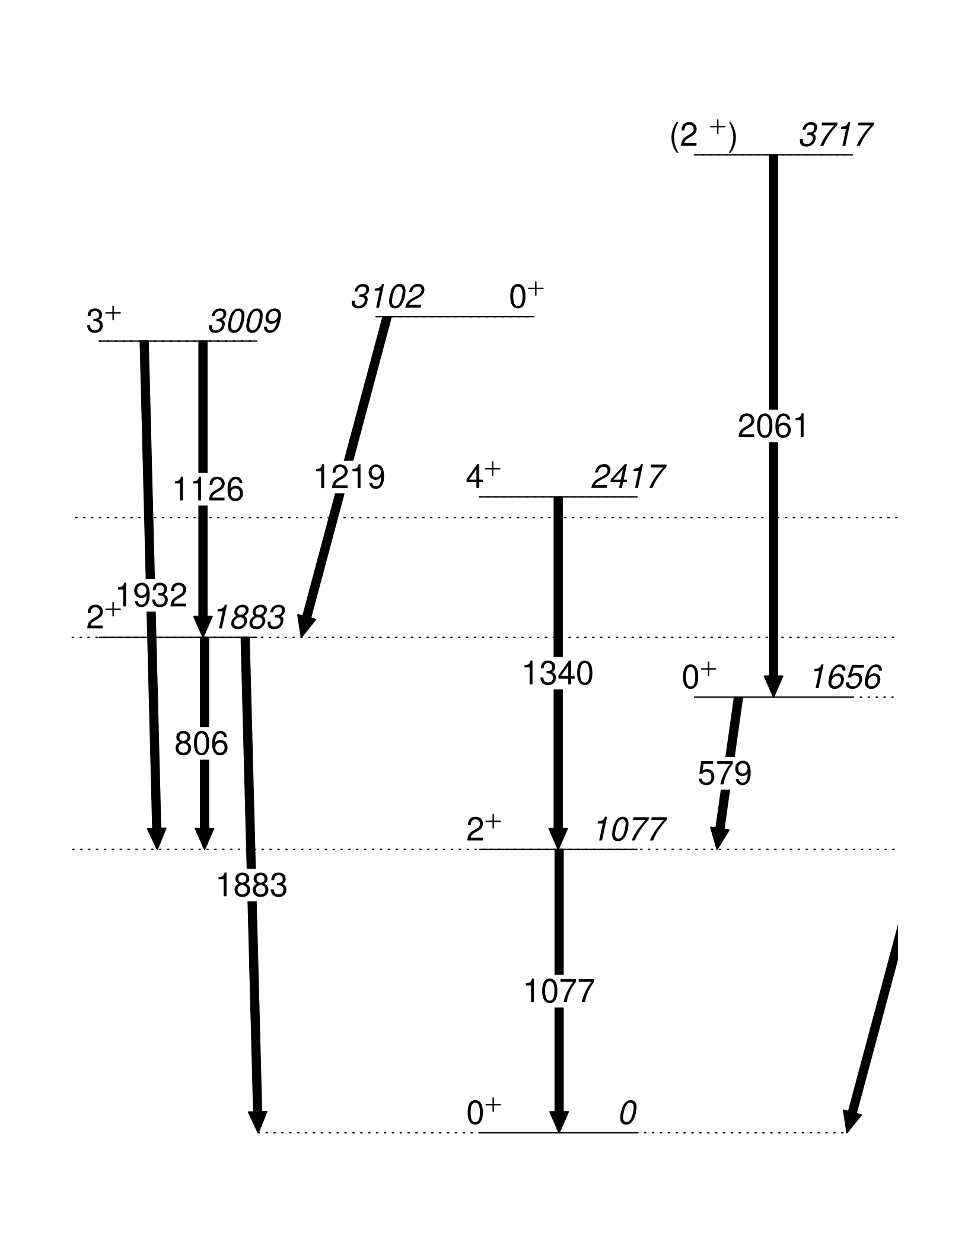
Experimental Level Scheme: 0⁺ States
Reached several of the 0⁺ states relevant for shape coexistence
Notes:
Here begins the discussion on collectivity

Slide 22
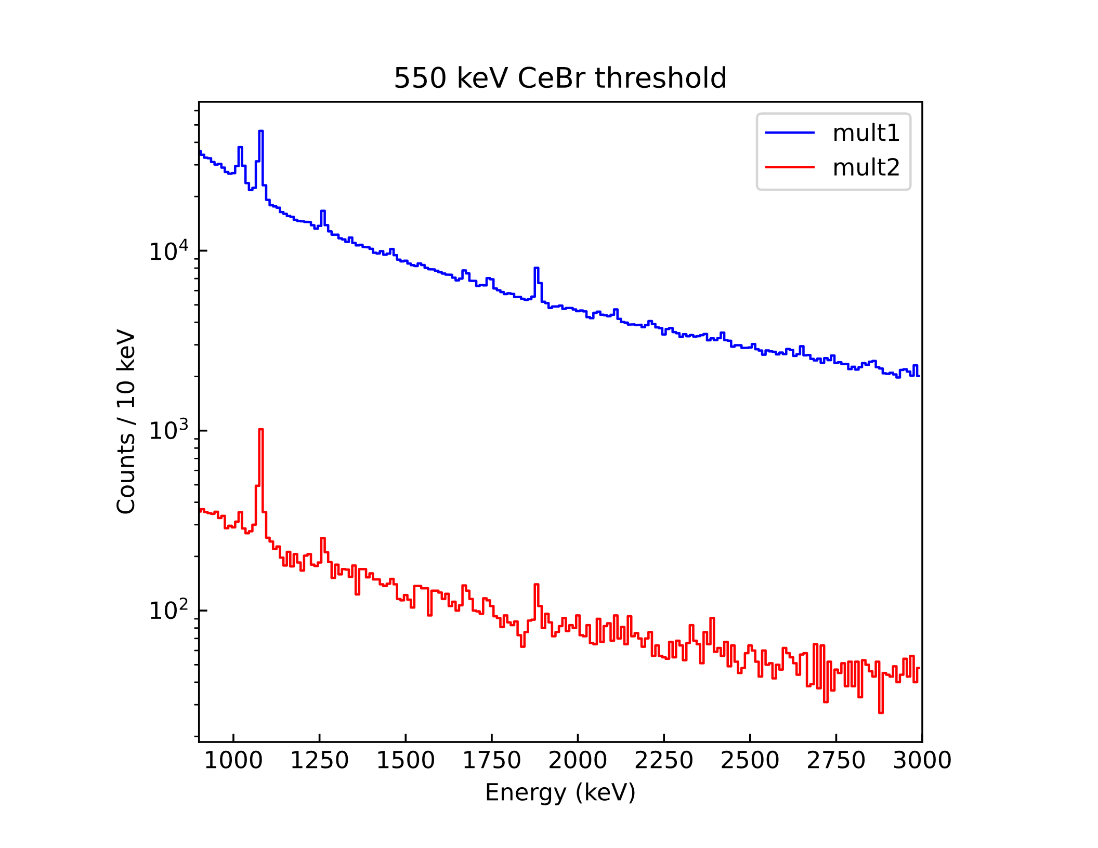
Outlook
Complementary measurements are needed to learn more about coexisting shapes in ⁶⁸Zn
The present experimental technique can be expanded
Scintillators can be leveraged for their higher efficiency (as a multiplicity counter, etc.)
Higher-statistics datasets are needed for this type of analysis
Promising timing capabilities
2⁺₁ -> 0⁺₁
bkg
Notes:
Have discussed already many capabilities of the NRF technique with the Clover Array at HIGS, but it is capable of much more, particularly by leveraging the scintillators

Slide 23
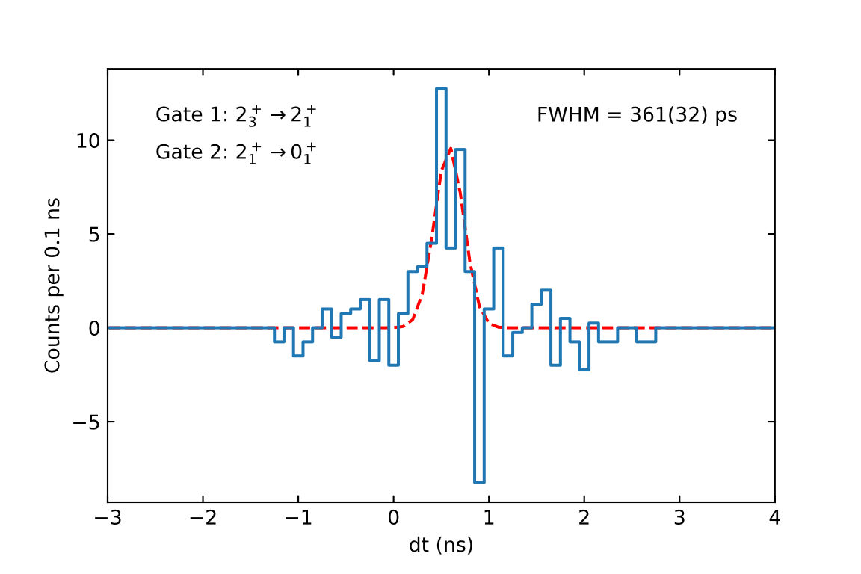
Lifetime measurements using NRF?
CeBr₃ resolution of 250 ps demonstrated with real NRF data – a huge step forward
Lifetime measurements may be possible after careful calibration
Project of Daniel Melayes, UNC
2⁺₃
2⁺₁
0⁺
1261
τ=1.61(2) ps
1077
​⁶⁸Zn​
​
Notes:
The resolution of the CeBr3 detectors has been demonstrated with using data of actual nuclear excited states, demonstrating the capabilities of these detectors for lifetime determinations later on!

Slide 24
Conclusions
Many new excited states and decay paths delineated in ⁶⁸Zn
To describe the low-spin structure of this nucleus requires a large number of orbitals which become active in different energy regimes
NRF with the Clover Array is a good method for studying level structures up to J=4
Much more potential for physics discoveries with the array, particularly with higher-statistics datasets

Slide 25
Thank you
Robert V. F. Janssens, B. Alex Brown, Akaa D. Ayangeakaa,
Soumendu Bhattacharjee, Emily Churchman, Sean Finch, Udo Friman-Gayer,
S. Gaither Frye, Matteo Fulghieri, David Gribble, Xavier H.-K. James,
Richard Longland, Daniel Melayes, Clay Wegner
This work is supported by the DOE, Office of Science, Office of Nuclear Physics, under Grants DE-FG02-97ER41041 (UNC) and DE-FG02-97ER41033 (TUNL).

Slide 26
Backup Slides

Slide 27
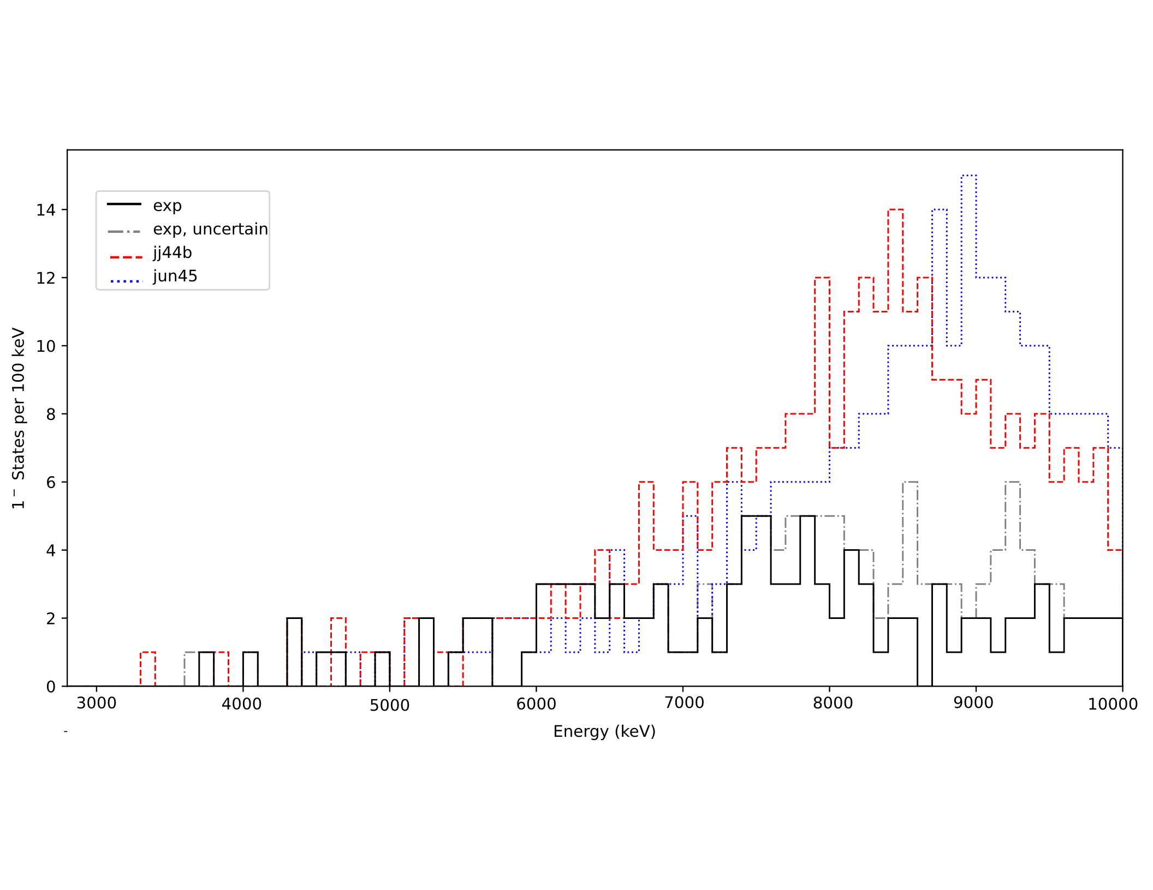
Distribution of 1⁻ States
Good agreement up to 7 MeV, with jj44b tracking more closely
Both interactions predict more 1⁻ states than seen experimentally
1⁻ excitations not included in fp model space
Notes:
Perhaps due to the high density of states which is not resolvable experimentally, or potentially for some physical reason

Slide 28
Coincidence Matrix Analysis
Gate on one gamma and background-subtract to see what others are associated
Example: Gating on the 2⁺₁ → 0⁺₁ transition
2⁺₄
0⁺₃
3⁻₁
4⁺₁
2⁺₃
1219
1340
1745
1674
1261
2⁺₂
806
2⁺₁
0⁺₁
1077

Slide 29
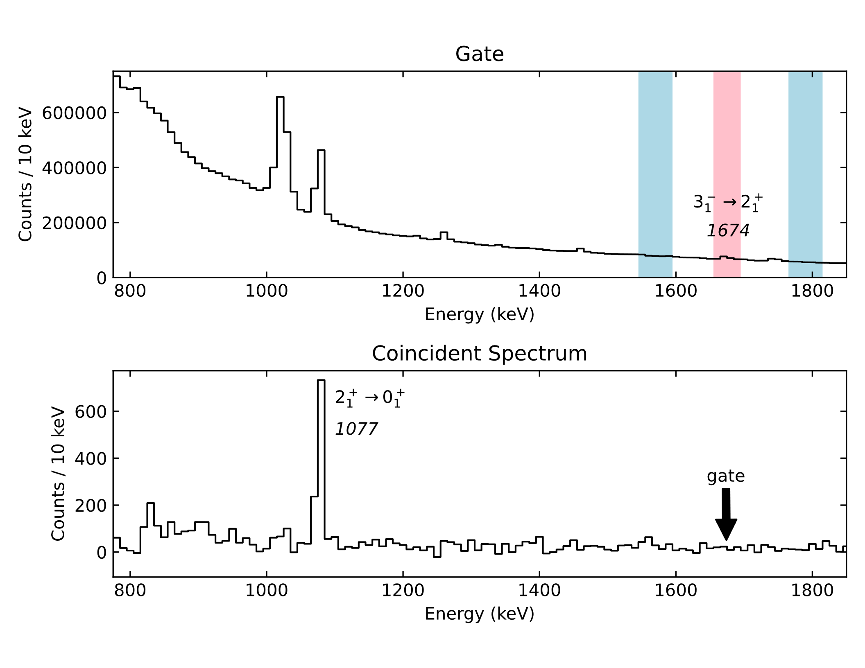
Coincidence Matrix Analysis
Gate on one gamma and background-subtract to see what others are associated
Example: Gating on the 2⁺₁ → 0⁺₁ transition

Slide 30
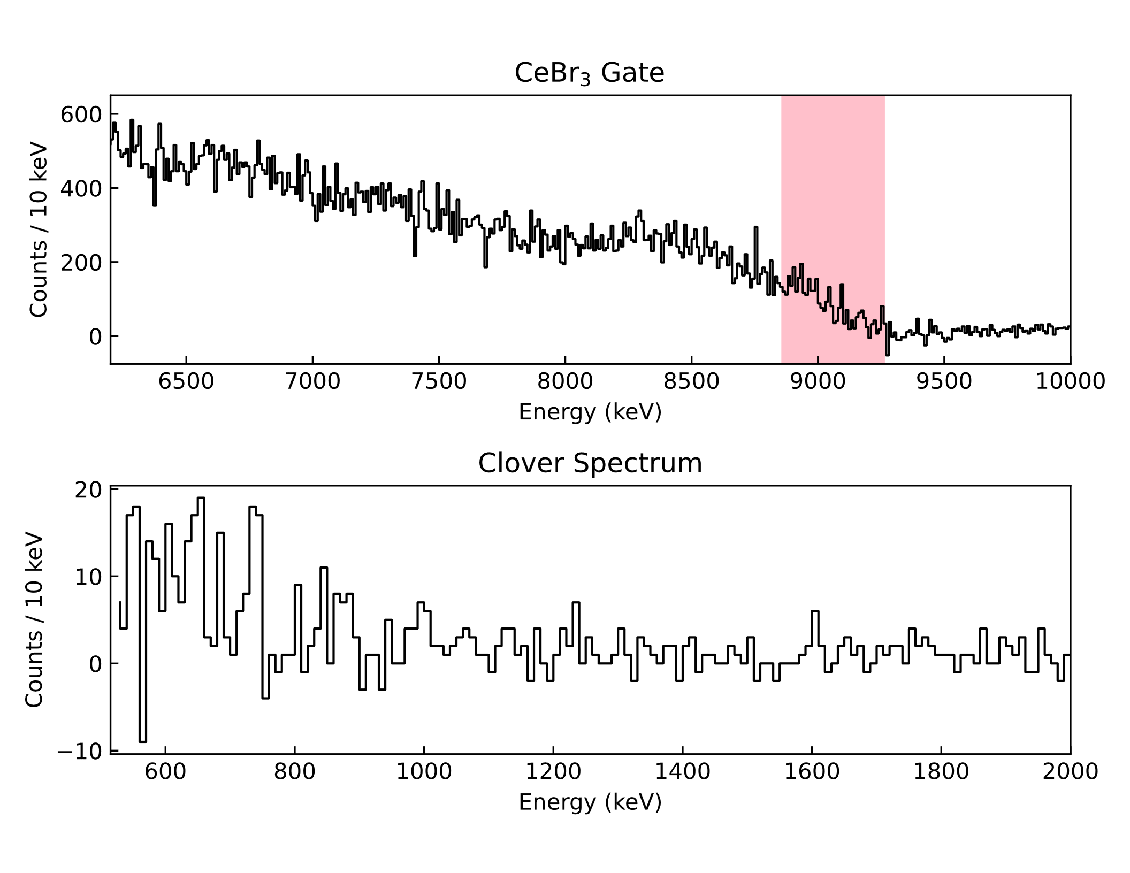
Utilizing unresolved transitions
1^{+/-}
0⁺
~9500 keV
​⁶⁸Zn​
​
Notes:
Can also utilize unresolved transitions. For example, when gating at the very top of this distribution in the CeBr detectors, because of energy conservation, should only include ground-state decays

Slide 31
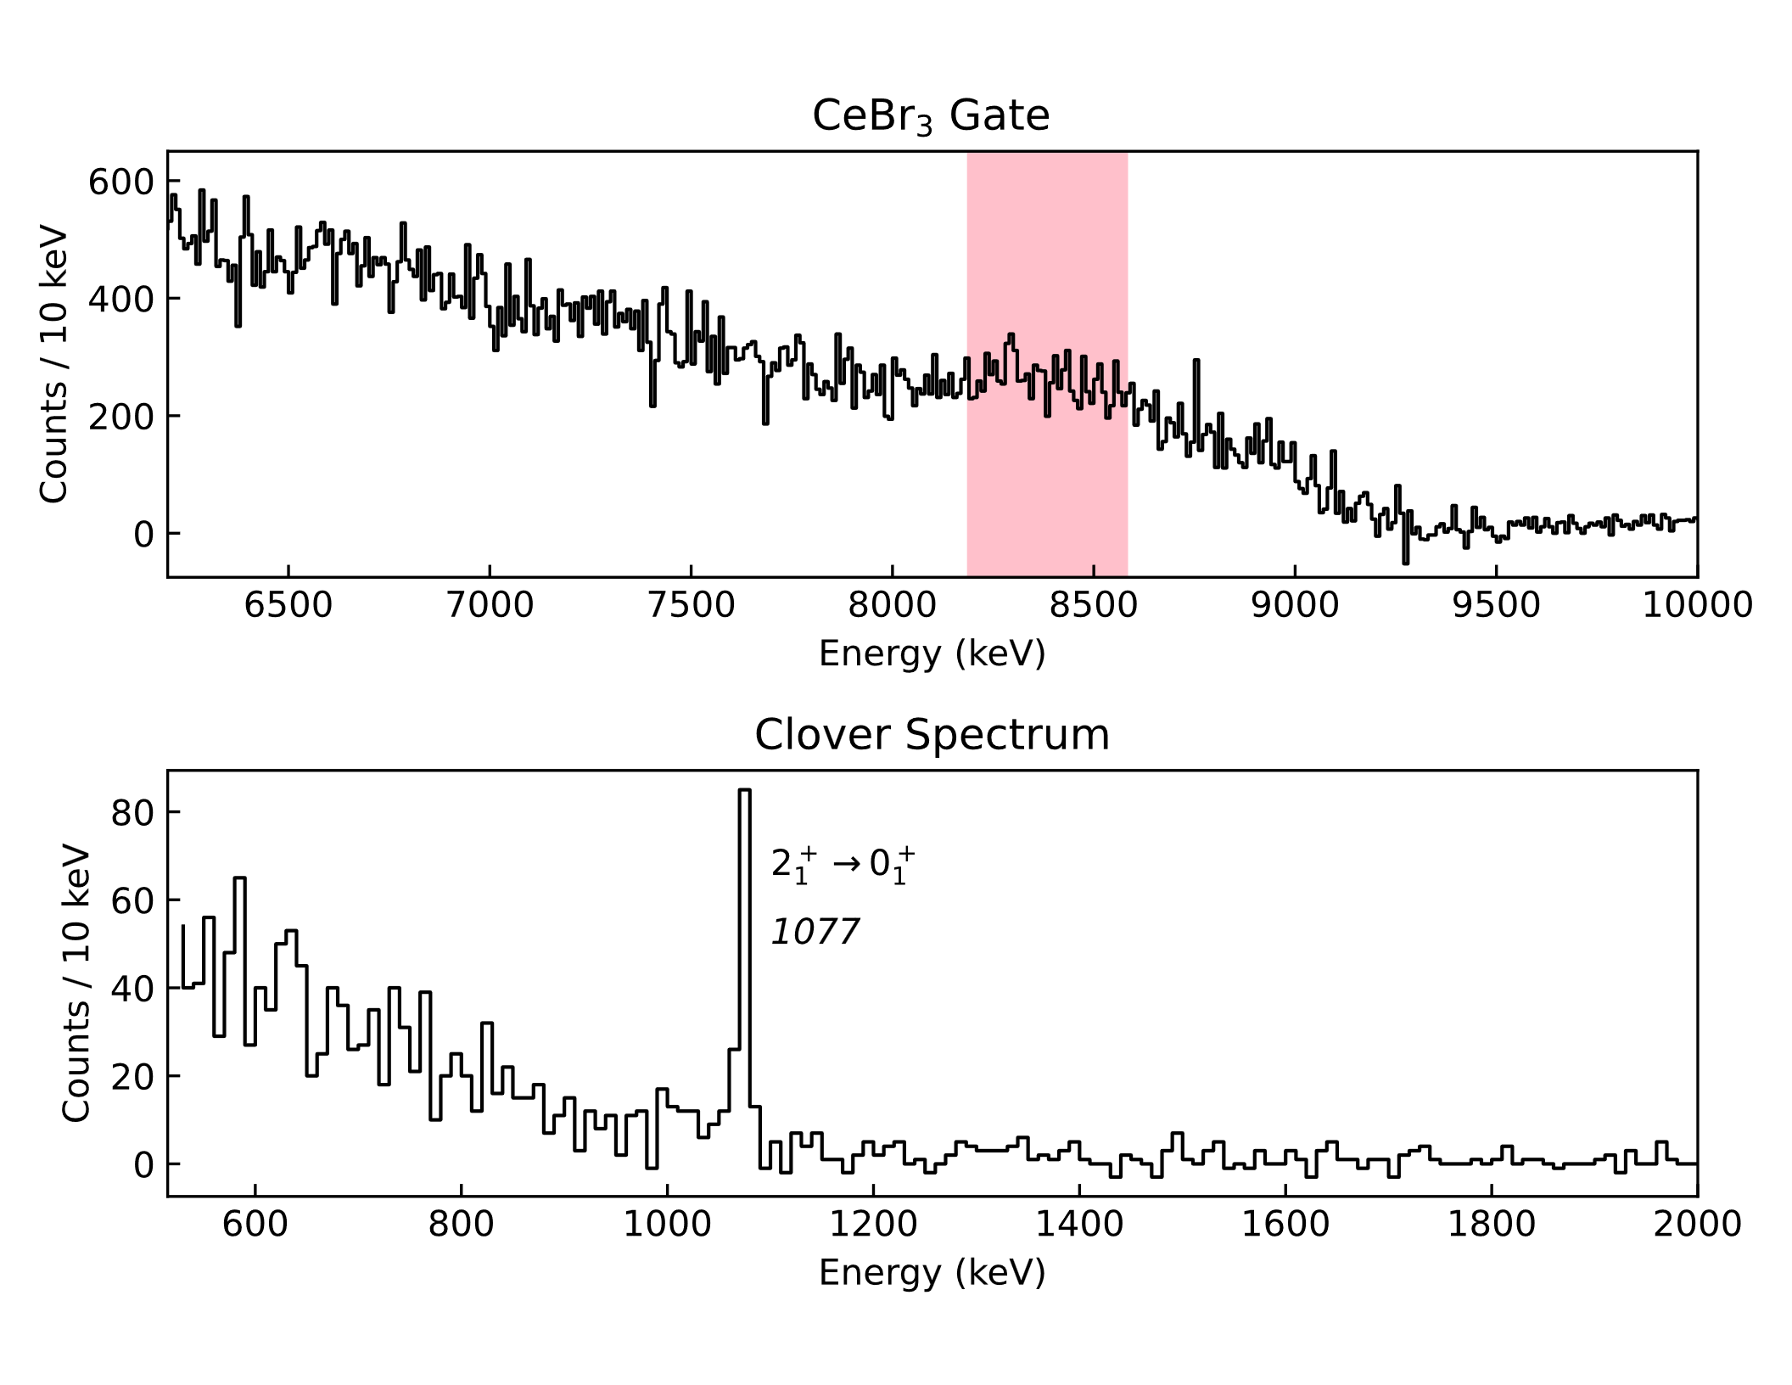
Utilizing unresolved transitions
1^{+/-}
2⁺₁
0⁺
~9500 keV
1077 keV
1077
​⁶⁸Zn​
​
Notes:
As you move this gate down in energy, even though there are no discrete gamma-rays visible in the gate, it is clear that the first excited state is being fed directly

Slide 32
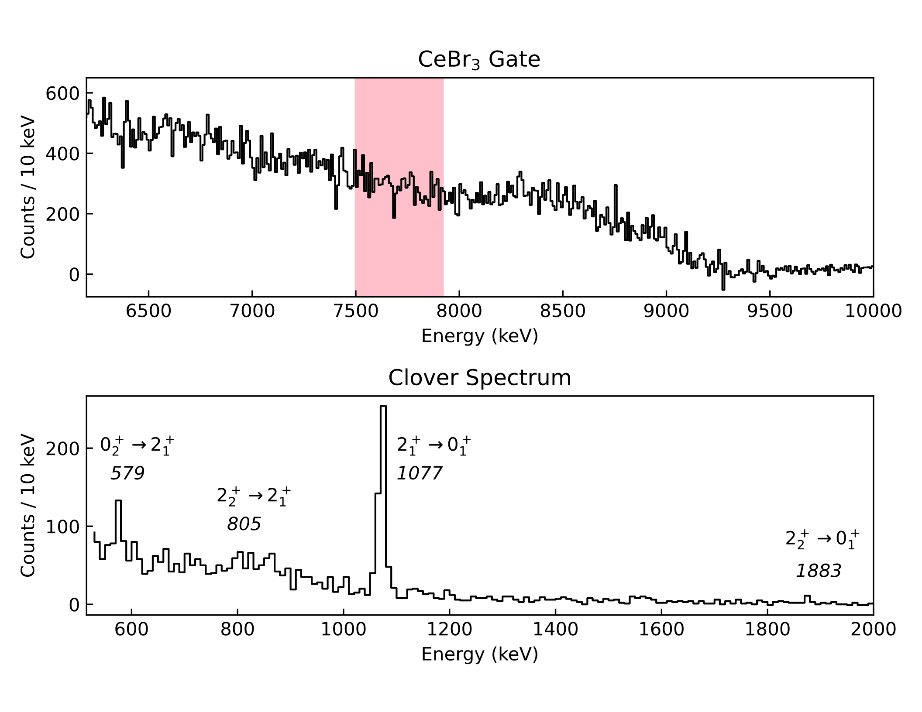
Utilizing unresolved transitions
1^{+/-}
2⁺₂
0⁺₂
2⁺₁
0⁺
~9500 keV
1883 keV
805
579
1656 keV
1883
1077 keV
1077
τ=1.61(2) ps
​⁶⁸Zn​
​
Notes:
Moving even lower in energy, see other levels being fed

Slide 33
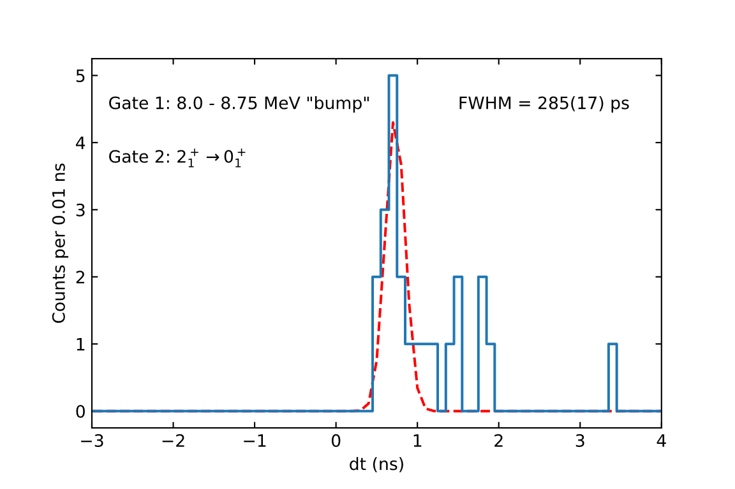
Utilizing unresolved transitions
1^{+/-}
2⁺₁
0⁺
~9500 keV
1077 keV
1077
τ=1.61(2) ps
​⁶⁸Zn​
​
Notes:
Now we can use these unresolved transitions as a gate for timing purposes
Emphasize stability of centroid and that resolution is maintained

Slide 34
Utilizing unresolved transitions
1^{+/-}
2⁺₁
0⁺
~9500 keV
Daniel Melayes (UNC) is working on calibrating timing response of all scintillators
This should open a new dimension of measurement for NRF experiments which can be compared to theory
1077 keV
1077
τ=1.61(2) ps
​⁶⁸Zn​
​

Slide 35
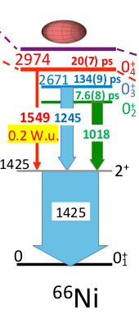
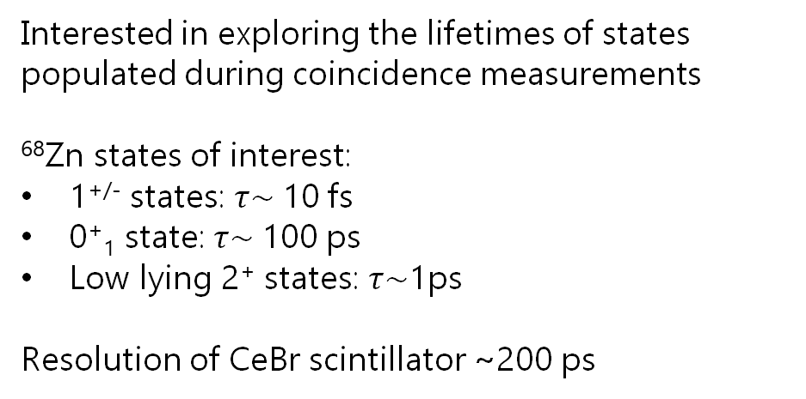
Coincidences: Fast-timing techniques for measuring lifetimes
Interested in exploring the lifetimes of states populated during coincidence measurements
⁶⁸Zn states of interest:
1^{+/-} states: $τ\sim$10 fs
0⁺₁ state: $τ\sim$100 ps
Low lying 2⁺ states: $τ\sim$1ps
Resolution of CeBr scintillator ~200 ps
S. Leoni et al., Phys. Rev. Lett. 118, 162502 (2017)

Slide 36
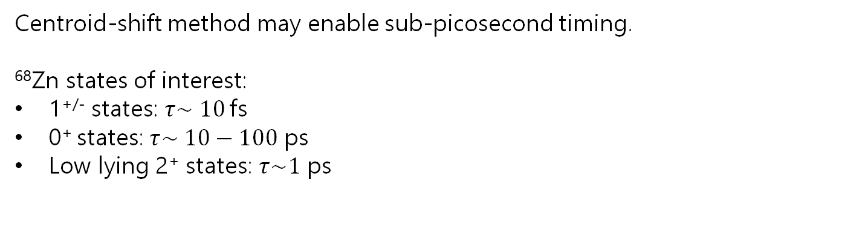
Fast-timing techniques for measuring lifetimes
Centroid-shift method may enable sub-picosecond timing.
⁶⁸Zn states of interest:
1^{+/-} states: $τ\sim 10$fs
0⁺ states: $τ\sim 10−100$ ps
Low lying 2⁺ states: $τ\sim 1$ ps

Slide 37
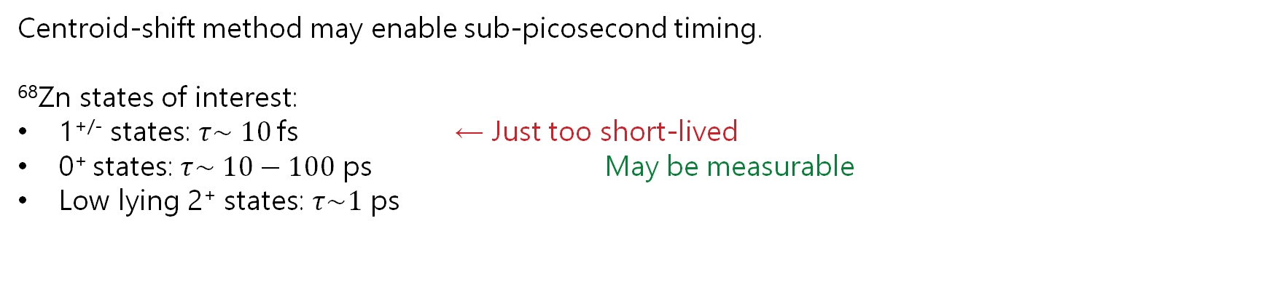
Fast-timing techniques for measuring lifetimes
Centroid-shift method may enable sub-picosecond timing.
⁶⁸Zn states of interest:
1^{+/-} states: $τ\sim 10$fs ← Just too short-lived
0⁺ states: $τ\sim 10−100$ ps May be measurable
Low lying 2⁺ states: $τ\sim 1$ ps

