Slide 1




First Results from the PANDORA Project
Jacob Bekker : Nuclear Photonics 2025
Funded by: Japan-South Africa Bilateral Funding from JSPS with a grant number of JPJSBP 120216502 and from NRF with grant number 132993, the SAINTS Prestigious Doctoral Scholarship and the NRF Postdoctoral Grant with reference number PSTD240423215494

Slide 2
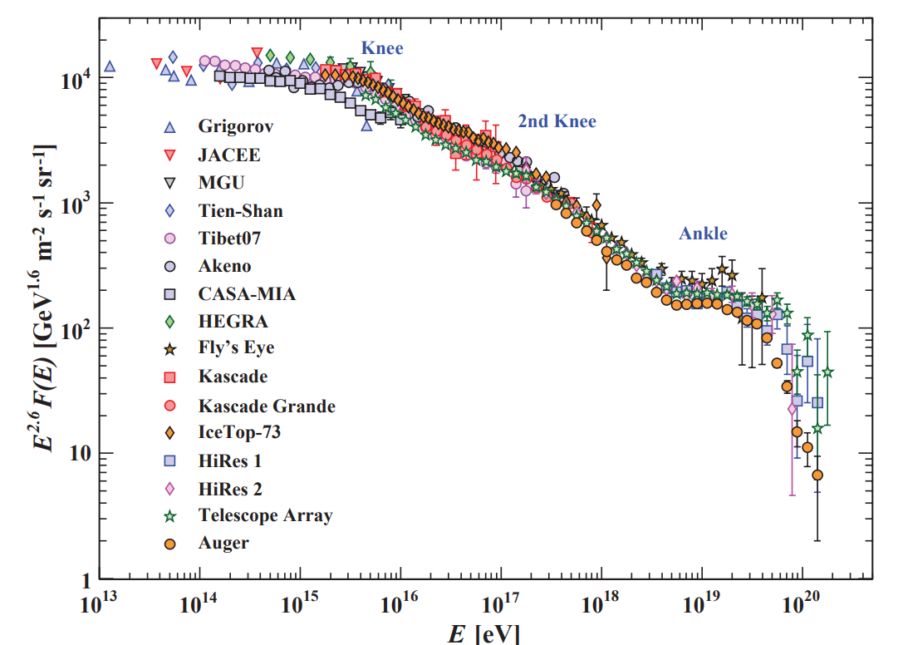
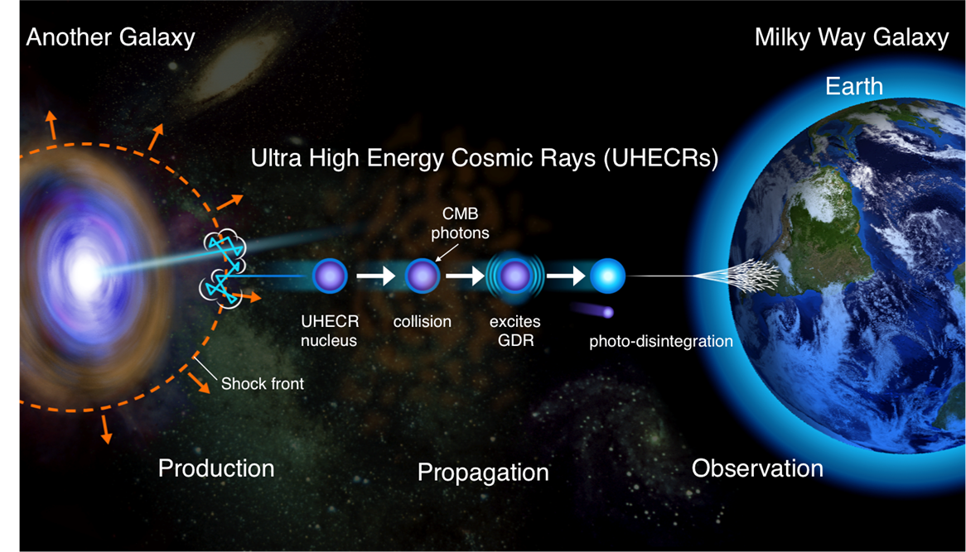
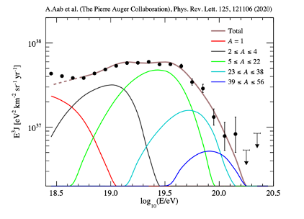
Photoreactions of UHECRs
We also care about other stuff such as the effect of clustering in light nuclei, dipole polarizability, fragmentation of the IVGDR etc!
Tanabashi et al. Review of particle physics. Phys. Rev. D, 98:030001, Aug 2018.

Slide 3



Enter the PANDORA Project
(Photo-Absorption of Nuclei and Decay Observation for Reactions in Astrophysics)
Multinational collaboration
Astrophysics
Nuclear/Particle physics
L. Pellegri
A. Tamii
P-A. Söderström
Theory
Experiment
Theory
Experiment
Propagation Calculations
Cosmic magnetic field
Acceleration mechanisms
Measurements of UHECRs
AUGER array
TA (Telescope Array)
Composition Analysis
(Amaterasu @ 244 EeV)
Reaction theory
Structure Theory
Systematics
Extensions to unstable Nuclei
Virtual Photon Method, RCNP, Japan and iThemba LABS, South Africa
Real Photon measurements, ELI-NP, Hiγs
Candidate target nuclides
• ¹²C, ¹⁶O, and ²⁷Al -> Reference cases
• ⁶Li, ⁷Li, ⁹Be, ¹⁰B, ¹¹B -> Very light nuclei IVGDR
• (²⁰Ne), ²⁴Mg, ²⁸Si, ³²S, (³⁶Ar), ⁴⁰Ca -> α-cluster effect, deformation
• ²⁶Mg, ⁴⁸Ca, ⁵⁶Fe -> N>Z nuclei
• ¹³C, ¹⁴N, ⁵¹V -> odd and odd-odd nuclei
Happened in October 2023

Slide 4
Enter the PANDORA Project
(Photo-Absorption of Nuclei and Decay Observation for Reactions in Astrophysics)
Multinational collaboration
Astrophysics
Nuclear/Particle physics
L. Pellegri
A. Tamii
P-A. Söderström
Theory
Experiment
Theory
Experiment
Propagation Calculations
Cosmic magnetic field
Acceleration mechanisms
Measurements of UHECRs
AUGER array
TA (Telescope Array)
Composition Analysis
(Amaterasu @ 244 EeV)
Reaction theory
Structure Theory
Systematics
Extensions to unstable Nuclei
Virtual Photon Method, RCNP, Japan and iThemba LABS, South Africa
Real Photon measurements, ELI-NP, Hiγs
The target nuclides of the 2nd PANDORA beamtime at RCNP: • ¹²C, ¹⁶O, and ²⁷Al -> Reference cases
• ⁶Li, ⁷Li, ⁹Be, ¹⁰B, ¹¹B -> Very light nuclei IVGDR
• (²⁰Ne), ²⁴Mg, ²⁸Si, ³²S, (³⁶Ar), ⁴⁰Ca -> α-cluster effect, deformation
• ²⁶Mg, ⁴⁸Ca, ⁵⁶Fe -> N>Z nuclei
• ¹³C, ¹⁴N, ⁵¹V -> odd and odd-odd nuclei
Happening in October 2025

Slide 5
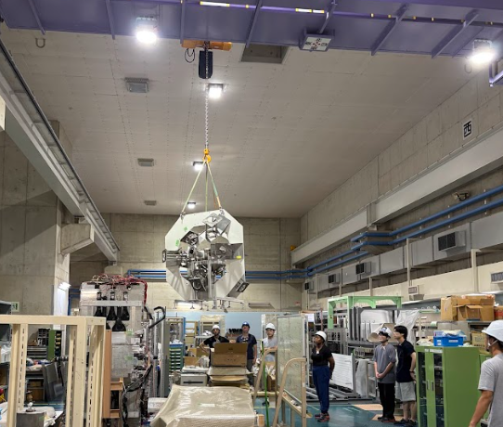
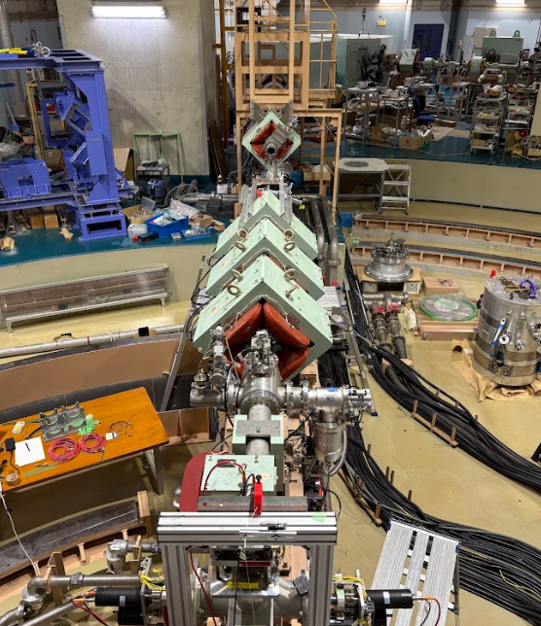
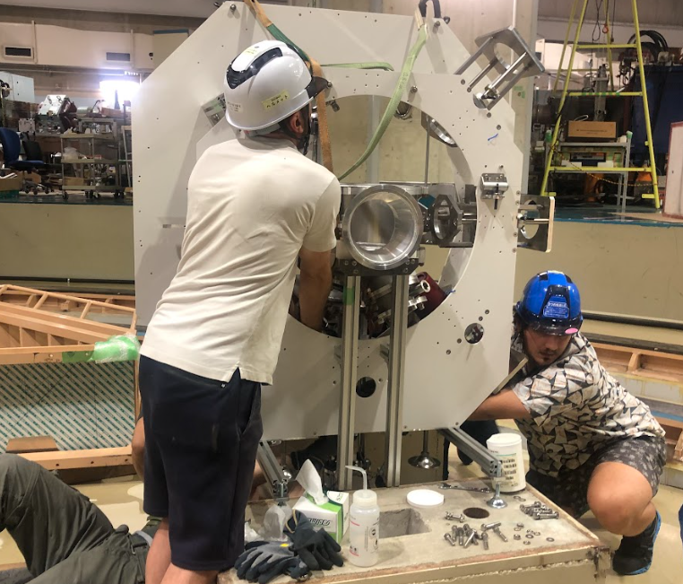
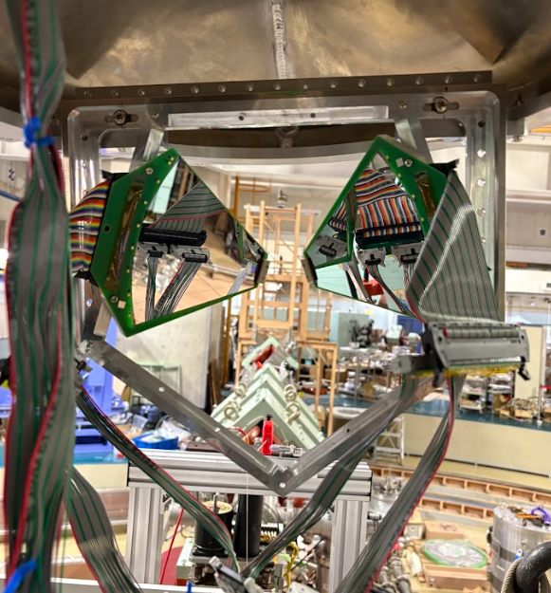
Work has already begun!

Slide 6
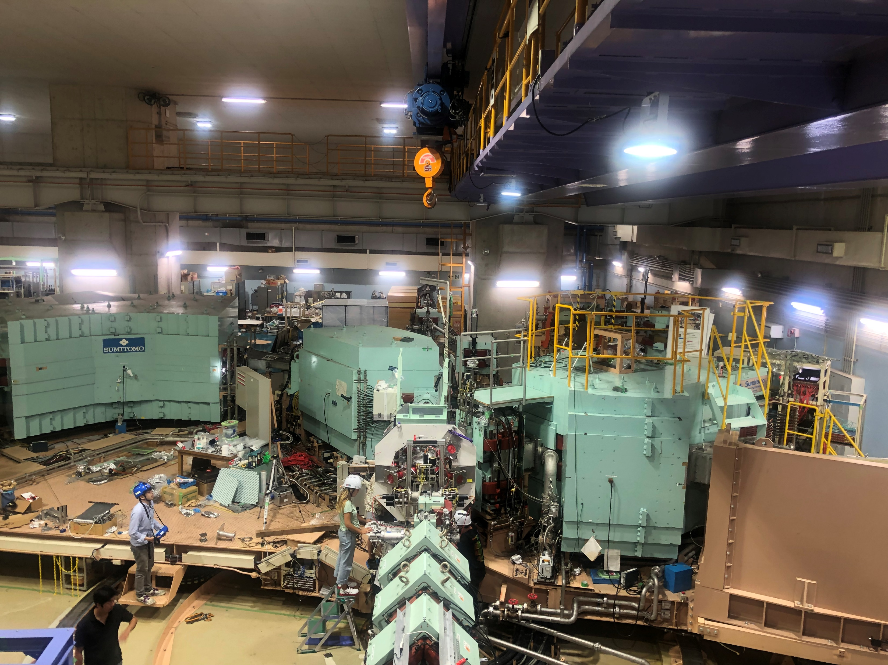
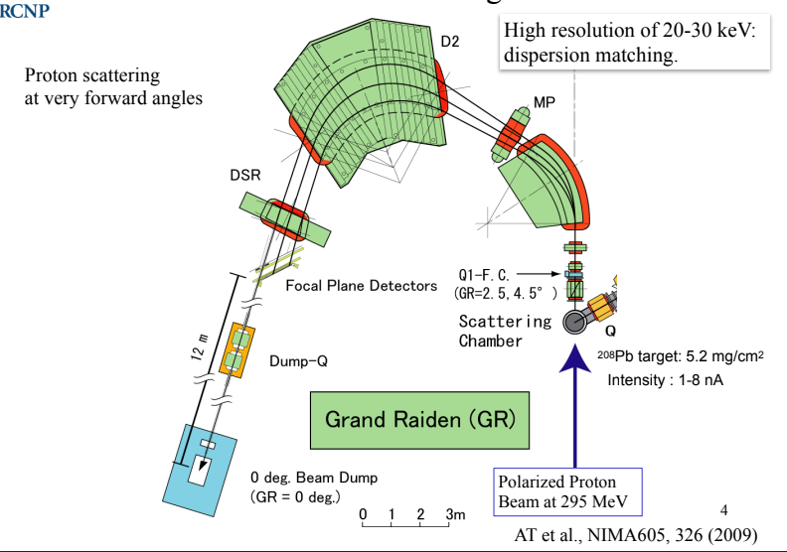
RCNP – GRAND RAIDEN
392 MeV protons
Used for Virtual Photon Method

Slide 7
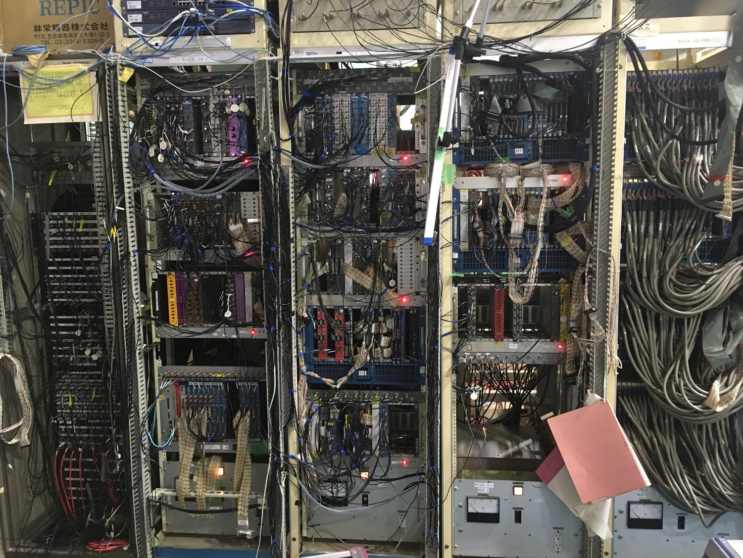
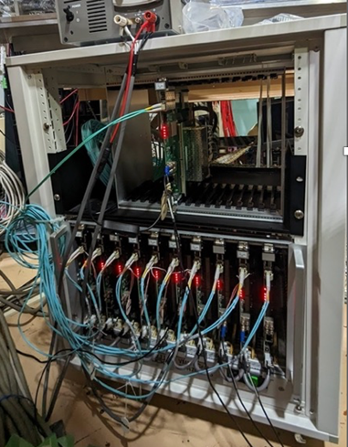
Change from Analog to digital DAQ.
~10s kHz
Potentially 10s MHz (leakage currents permitting)
VME, CAMAC FPGA, NIM
Less hardware, more software.

Slide 8
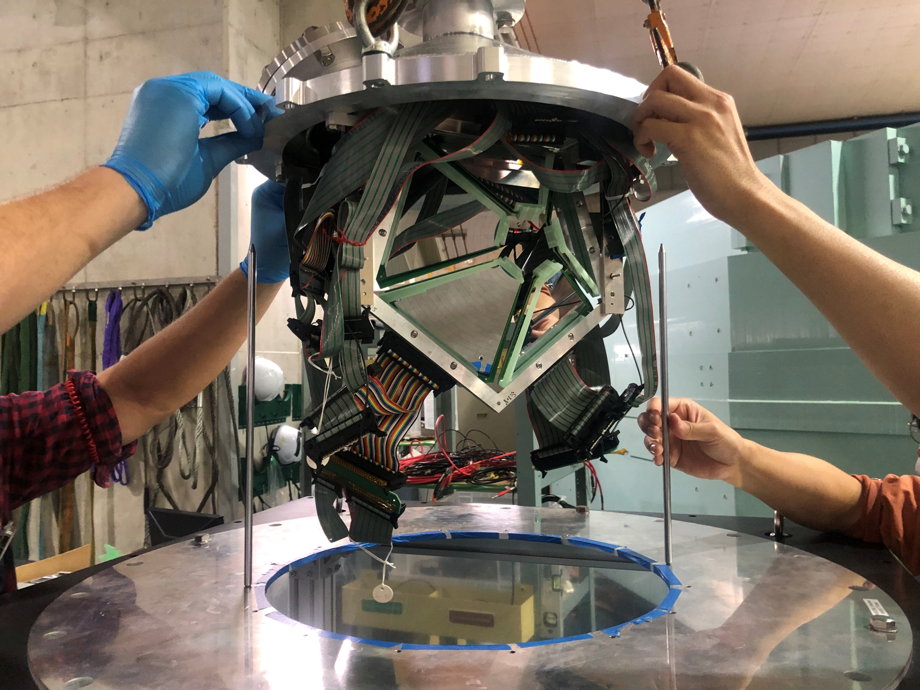
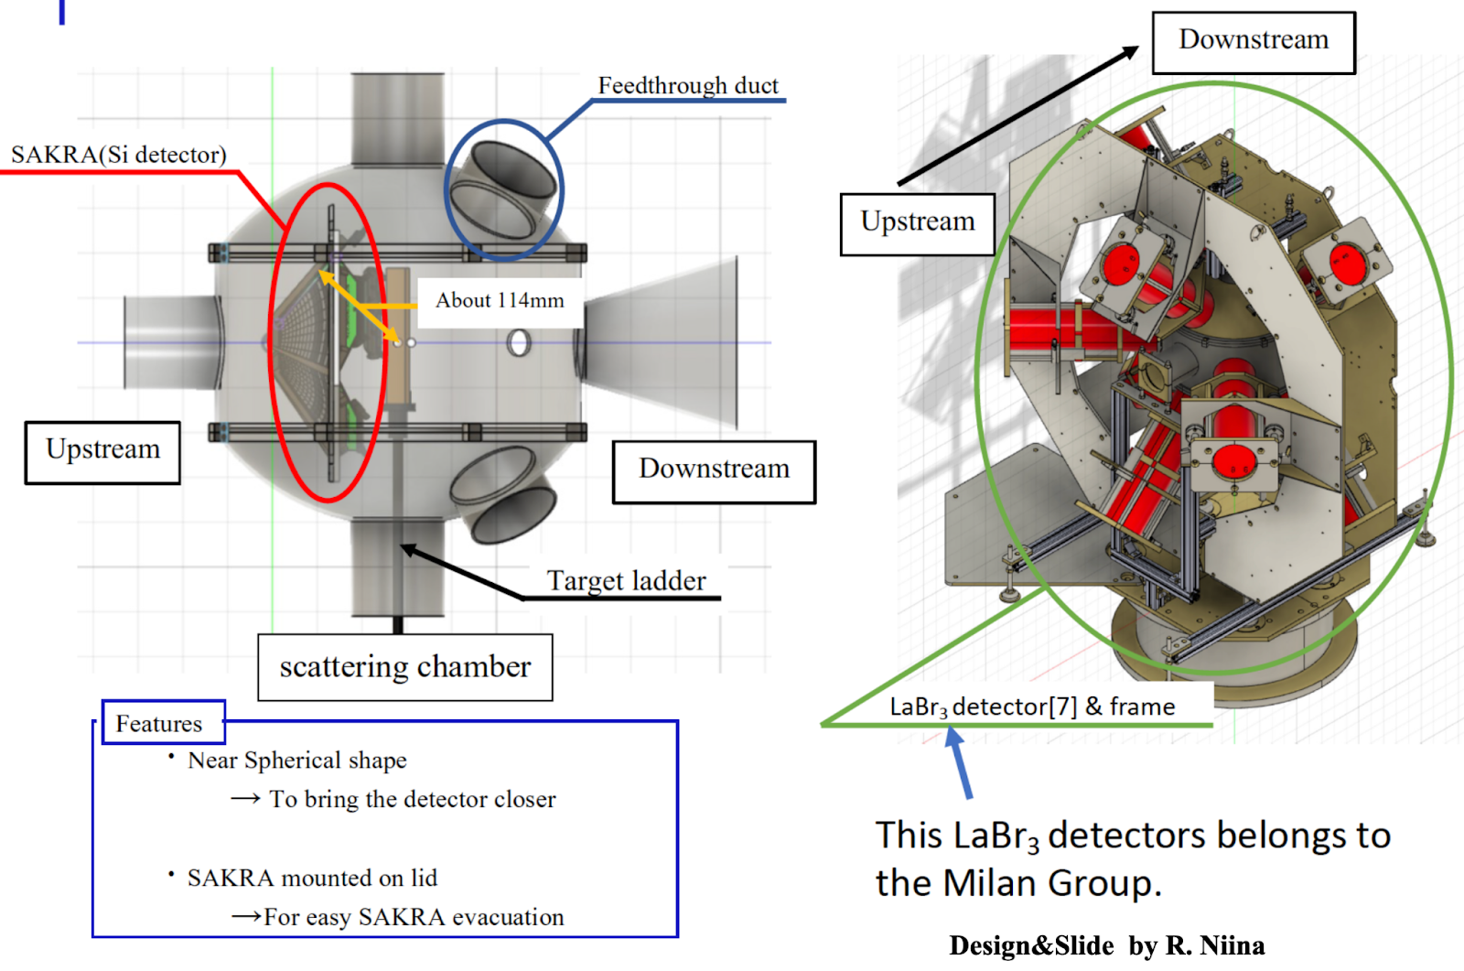
RCNP-SAKRA
Charged particle coincidence decay setup.
10 Double Sided Silicon Strip Detectors (DSSSDs) at backwards angles.
Two layers of 500μm detectors, to measure protons up to 12 MeV.
Covers ~23% solid angle for the configuration with 5 MMMs
Old Scattering Chamber, new one can house 16 LaBr

Slide 9
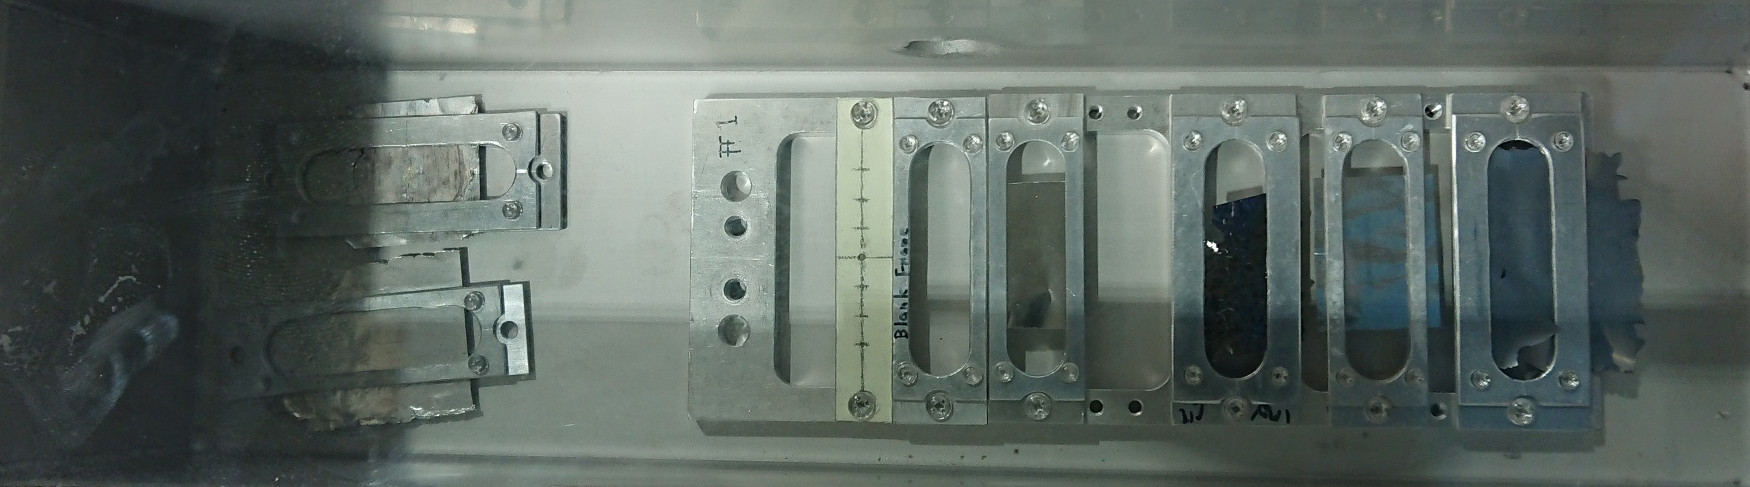
Results from the Oct 2023 Experiments
¹²C and ¹³C datasets will be shown.
10,11B and 27Al is in the process of being analysed.
Viewer
Mg26
1 mg
C12
1 mg
Al27
C13
1.6 mg

Slide 10
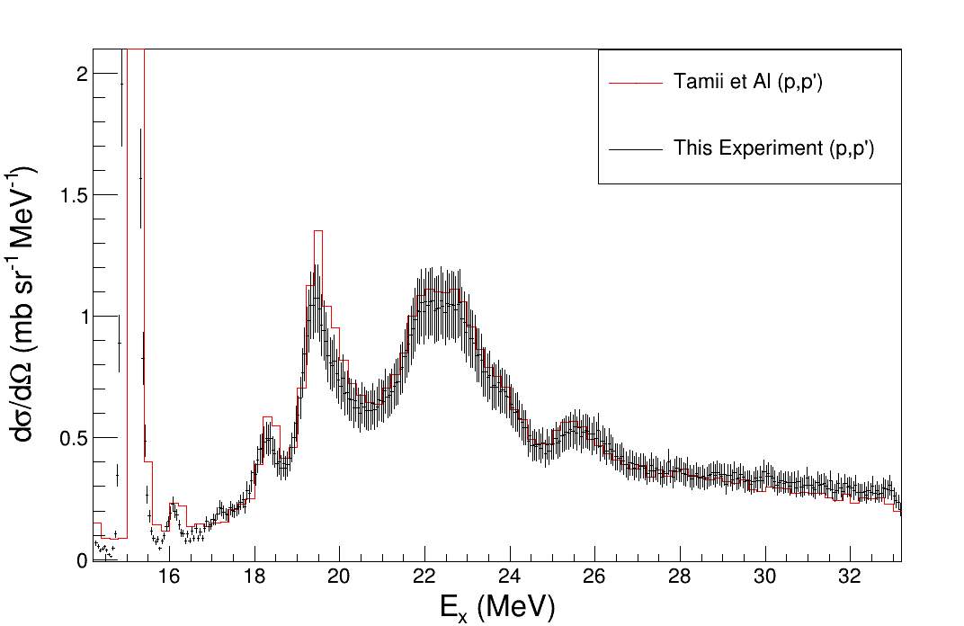
Comparison to previous similar conditions
Very close agreement with previous data set that is experimentally similar: Both data sets at 0º central angle
Collimators differ slightly : Same horizontal acceptance
1º Difference in vertical acceptance
Energies both at 392 MeV
Targets are thin 1 mg/cm2 versus 30 mg
Dispersion matched vs not dispersion matched

Slide 11
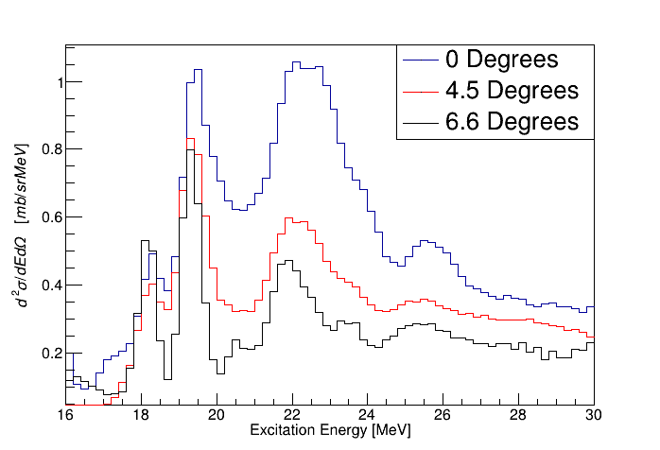
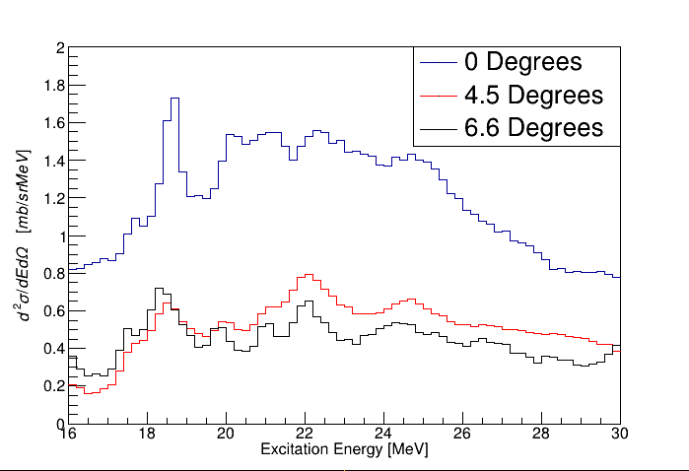
Double Differential Cross sections for all ¹²C and ¹³C
No Dispersion matching was used in this experiment, hence the resolution is ~300keV.
¹²C
¹³C

Slide 12
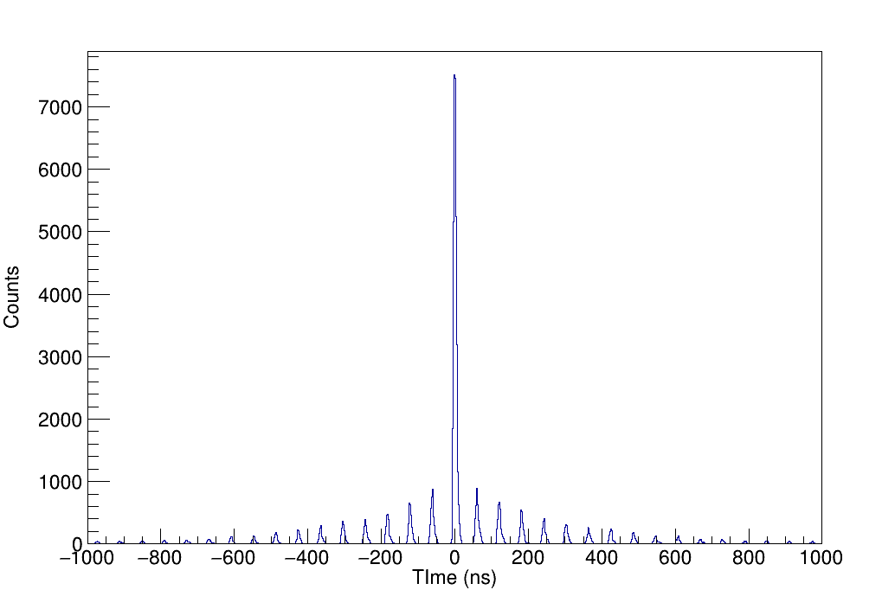
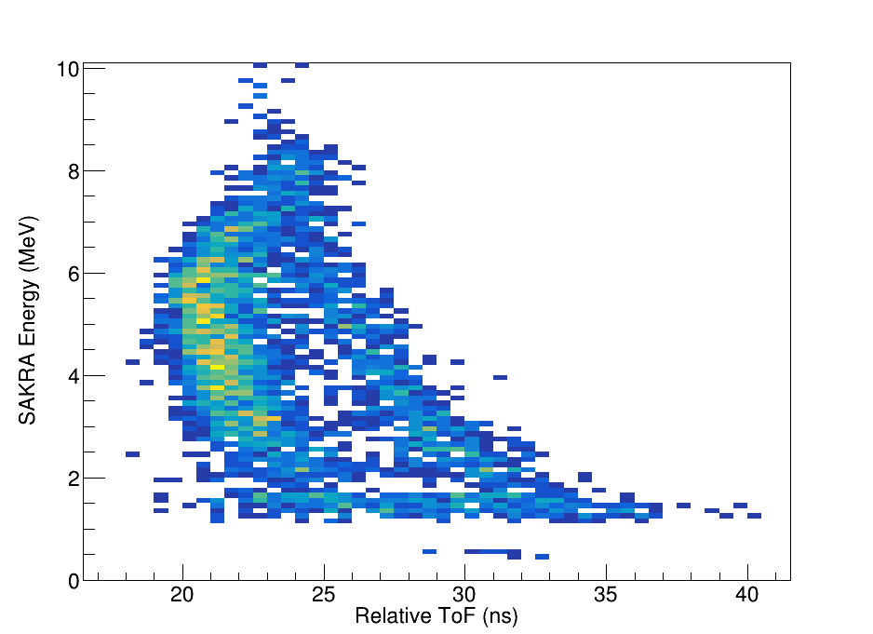
Timing and Time of Flight Selection
Prompt Peak
Alpha Locus
Non-Prompt Peaks used for Background
threshold
Lopsidedness of the Random times due to some time structure in the ion source
Proton Locus

Slide 13
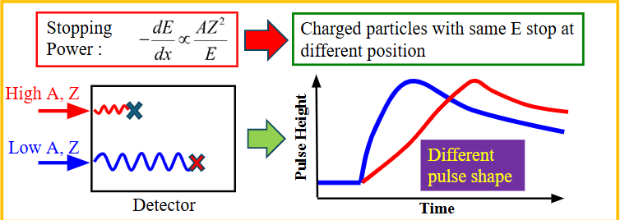
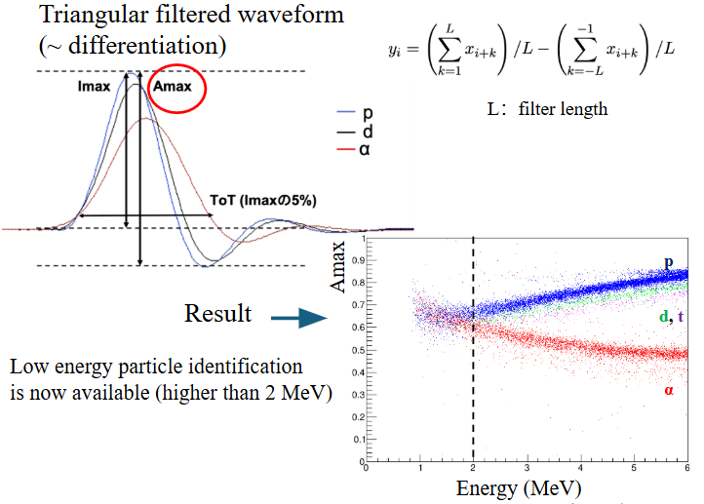
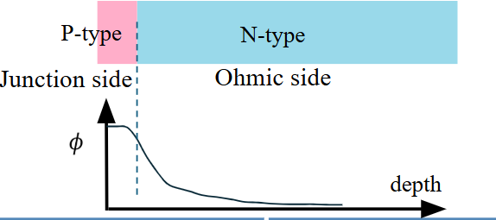
New Technique for PID - A_{max} using NTD’s
Developed and tested by ELI-NP/Osaka. Ready to be used for the October experiments!

Slide 14
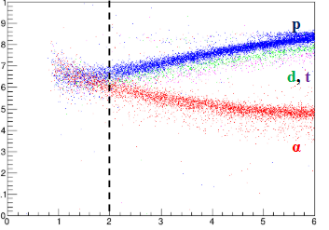
From threshold to punch through PID!
Alpha Locus
Threshold
Proton Locus

Slide 15
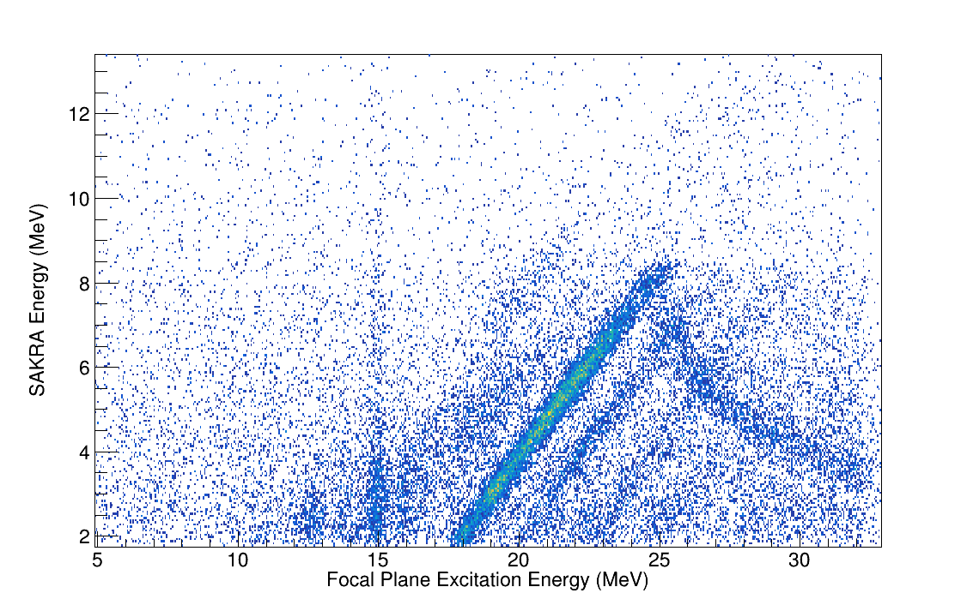
Proton Coincidence Loci for ¹²C
The proton Locus starts at ~16 MeV and the different decay modes can be seen here.
GDR Starts at ~17 MeV
Proton Punch through of the first silicon occurs at roughly 8 MeV and of the second at 12 MeV.
15.1 (1+)
Accidental “grass”
P(0)
P(1)

Slide 16
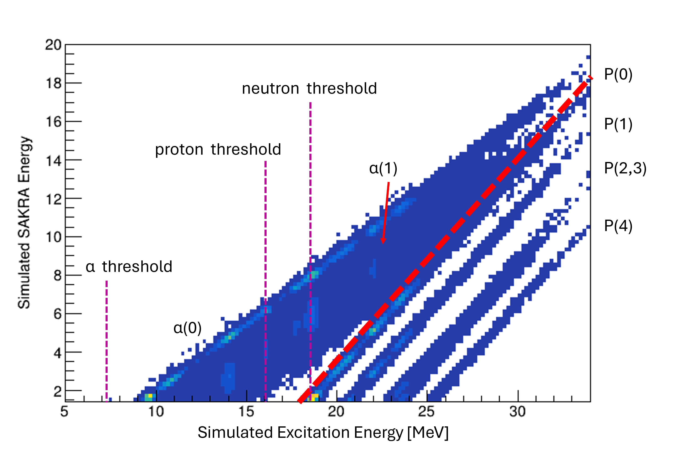
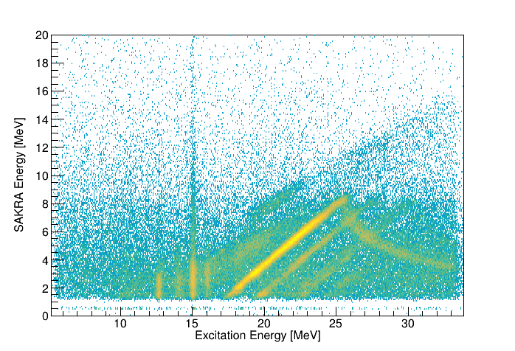
No PID cuts Sakra vs Simulation

Slide 17
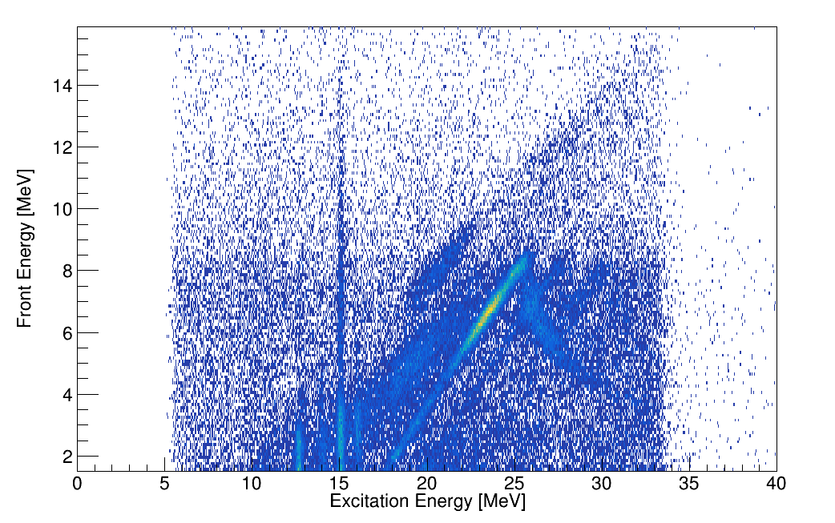
Alpha Coincidence Loci for ¹²C
The Alpha Decay threshold starts at the 7.36 MeV.
GDR Starts at ~17 MeV
Strange structure seen at 18-22 MeV (Not related to the GDR?)

Slide 18
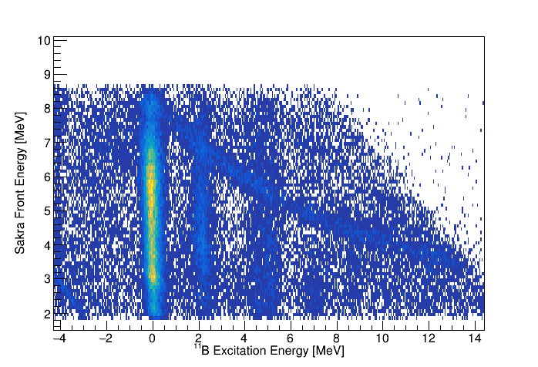
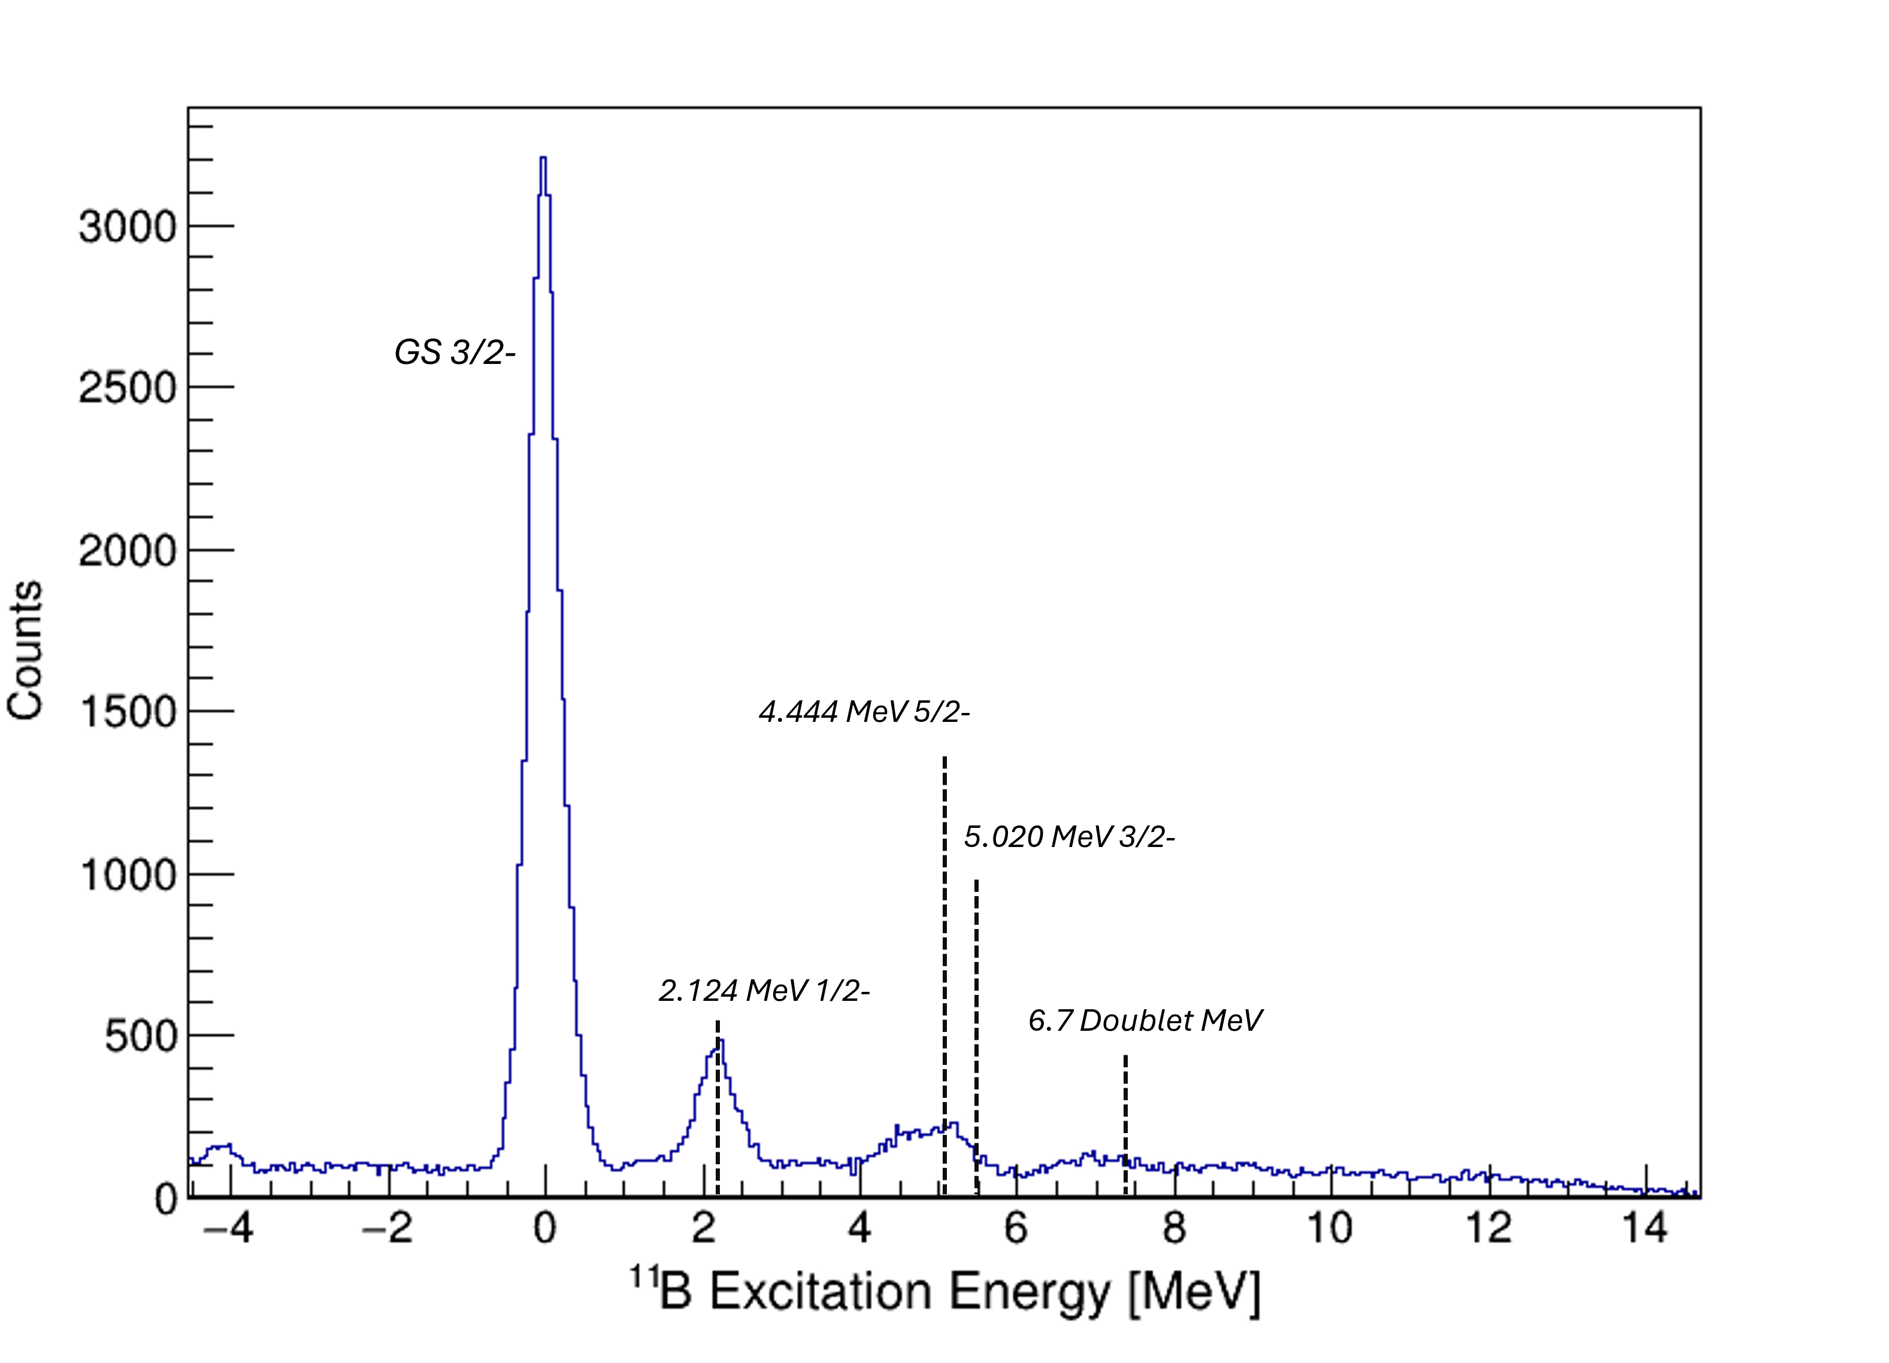
¹¹B Excited states by rotating the ¹²C Ex vs SAKRA Energy plot

Slide 19
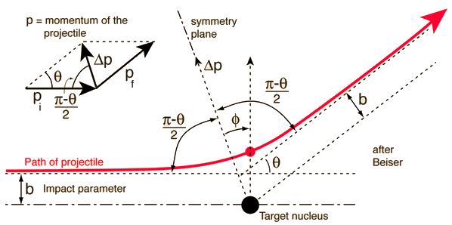
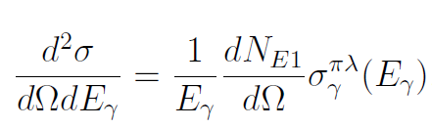
Virtual photon method
0° scattering
Theory and Applications of Coulomb Excitation. (C. A. Bertulani 2009) – VirtualPhotonCalculator code

Slide 20
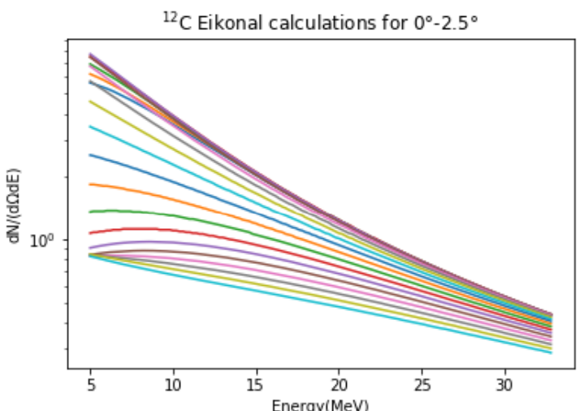
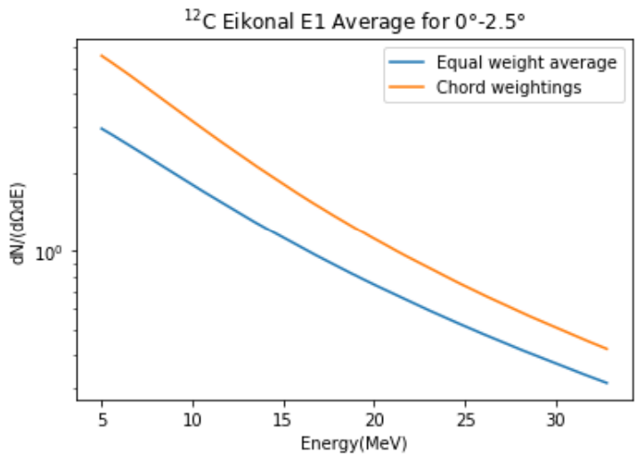
Virtual Photon numbers- Eikonal Estimate
2.5
2
1
0
1
2
2.5

Slide 21
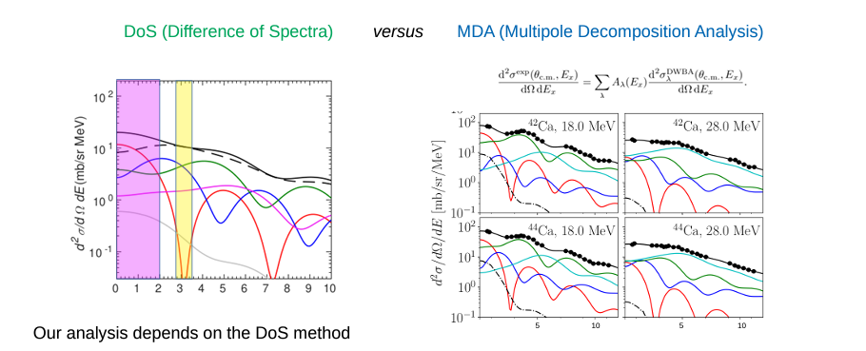
DoS Method
For this type of study with protons it is not yet well established!

Slide 22
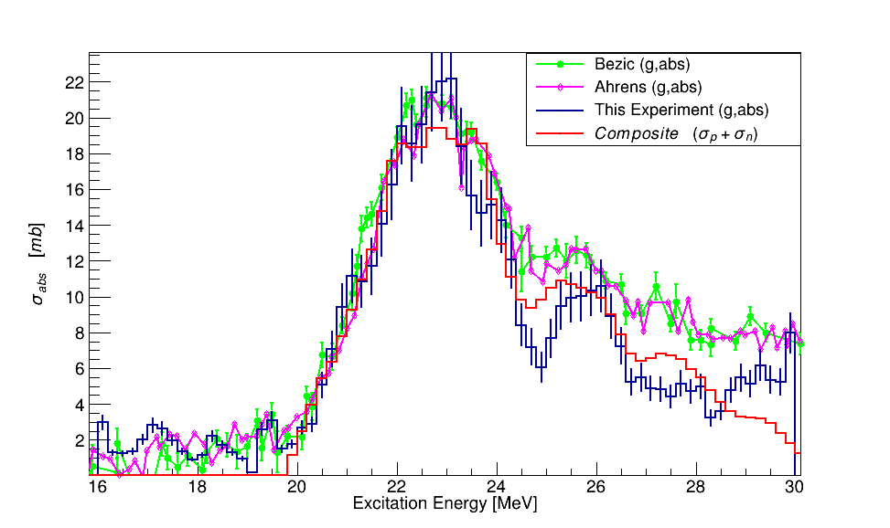
¹²C Total photoabsorption compared to EXFOR and composite cs

Slide 23
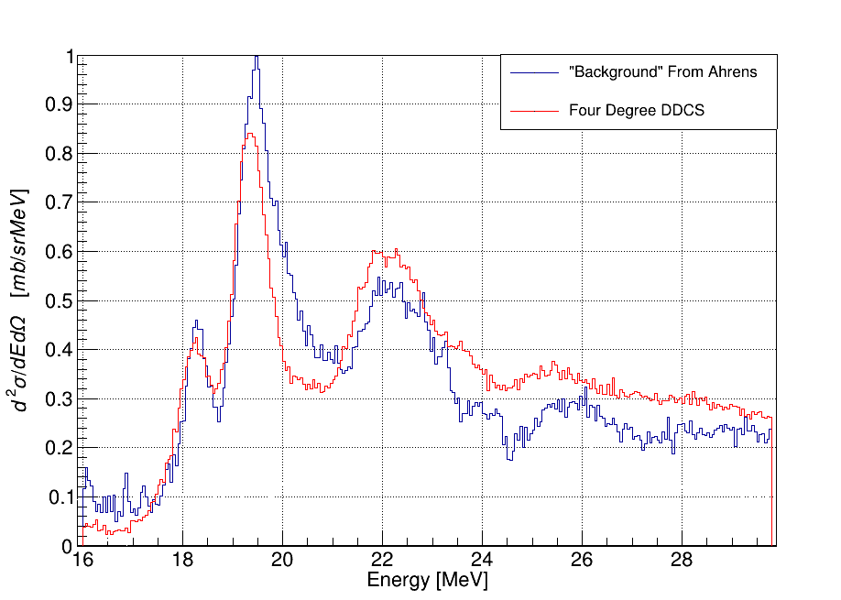
Reverse engineering the background show the strong agreement between the 4º spectrum and the real background

Slide 24
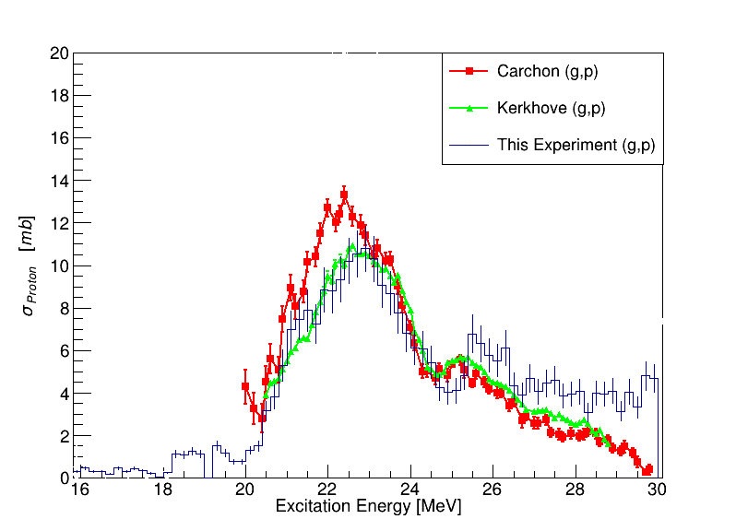
¹²C proton branching compared to Exfor
Slightly higher peak in one Carchon measurement
Decrease towards higher energies is spurious when comparing to (g,n) and (g,abs) data.

Slide 25
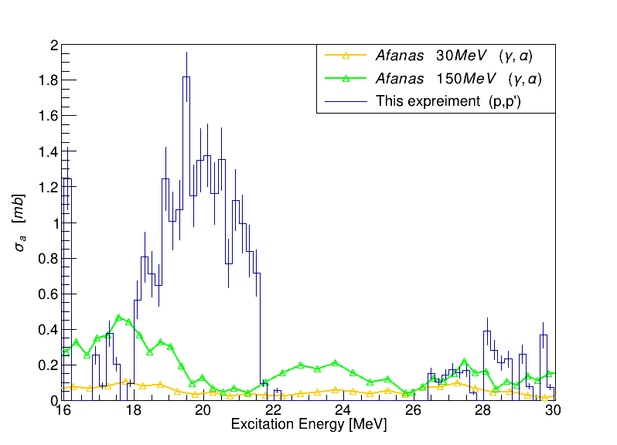
¹²C alpha branching compared to EXFOR.
Only 1 dataset available from a previous TPC experiment.
Structure at ~20 MeV was not seen in this experiment.

Slide 26
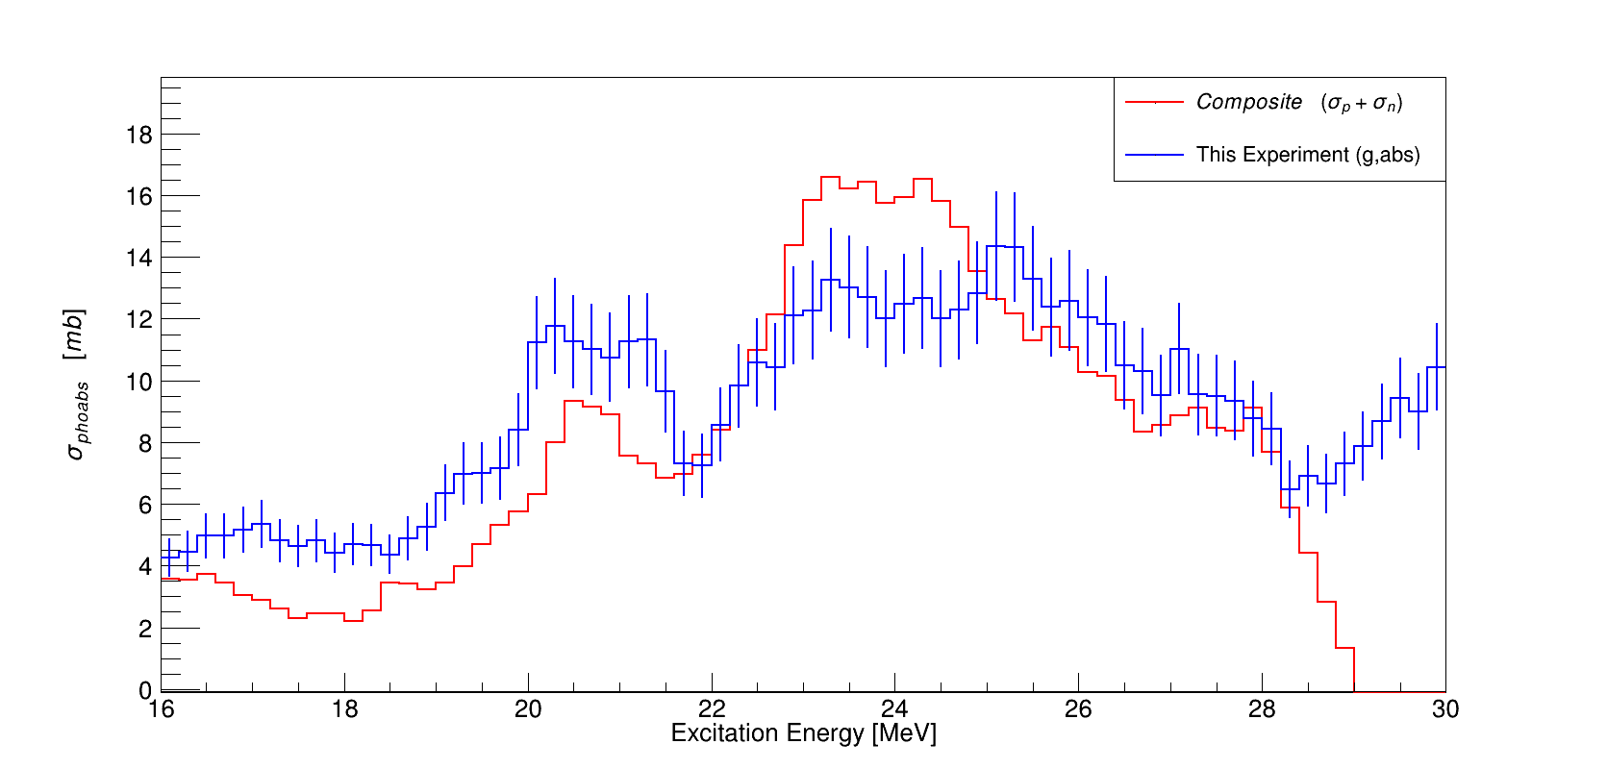
¹³C total photoabs compared to composite

Slide 27
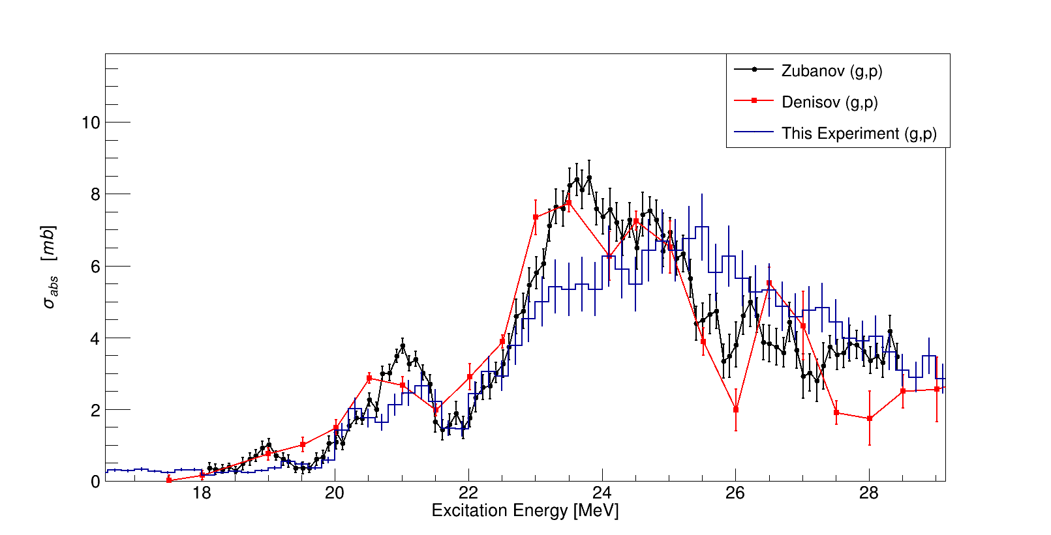
¹³C (g,p) compared to EXFOR
(g,p) and (g,n) are our only references with the ¹³C case.
The (g,p) is in very decent agreement

Slide 28


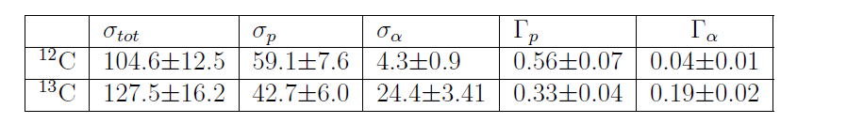
As a whole the cross sections are respectable.

Slide 29
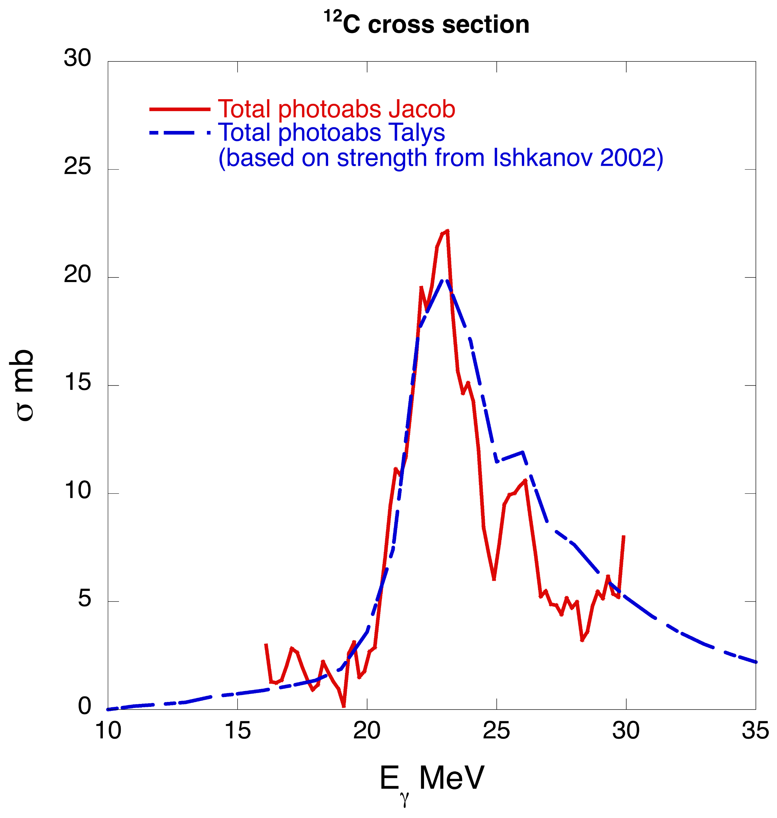
¹²C Total photoabs vs Talys

Slide 30
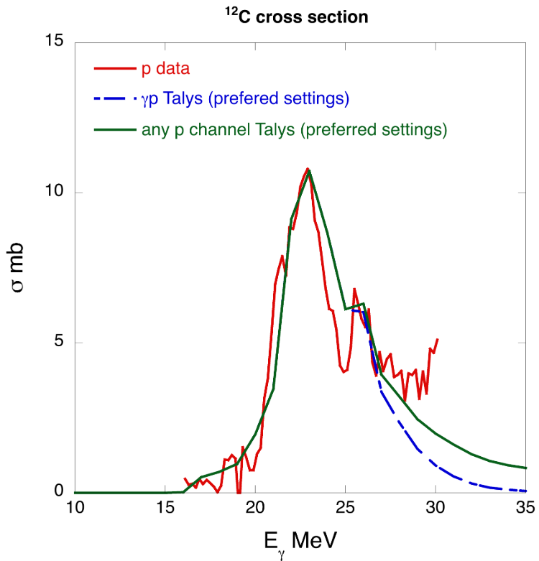
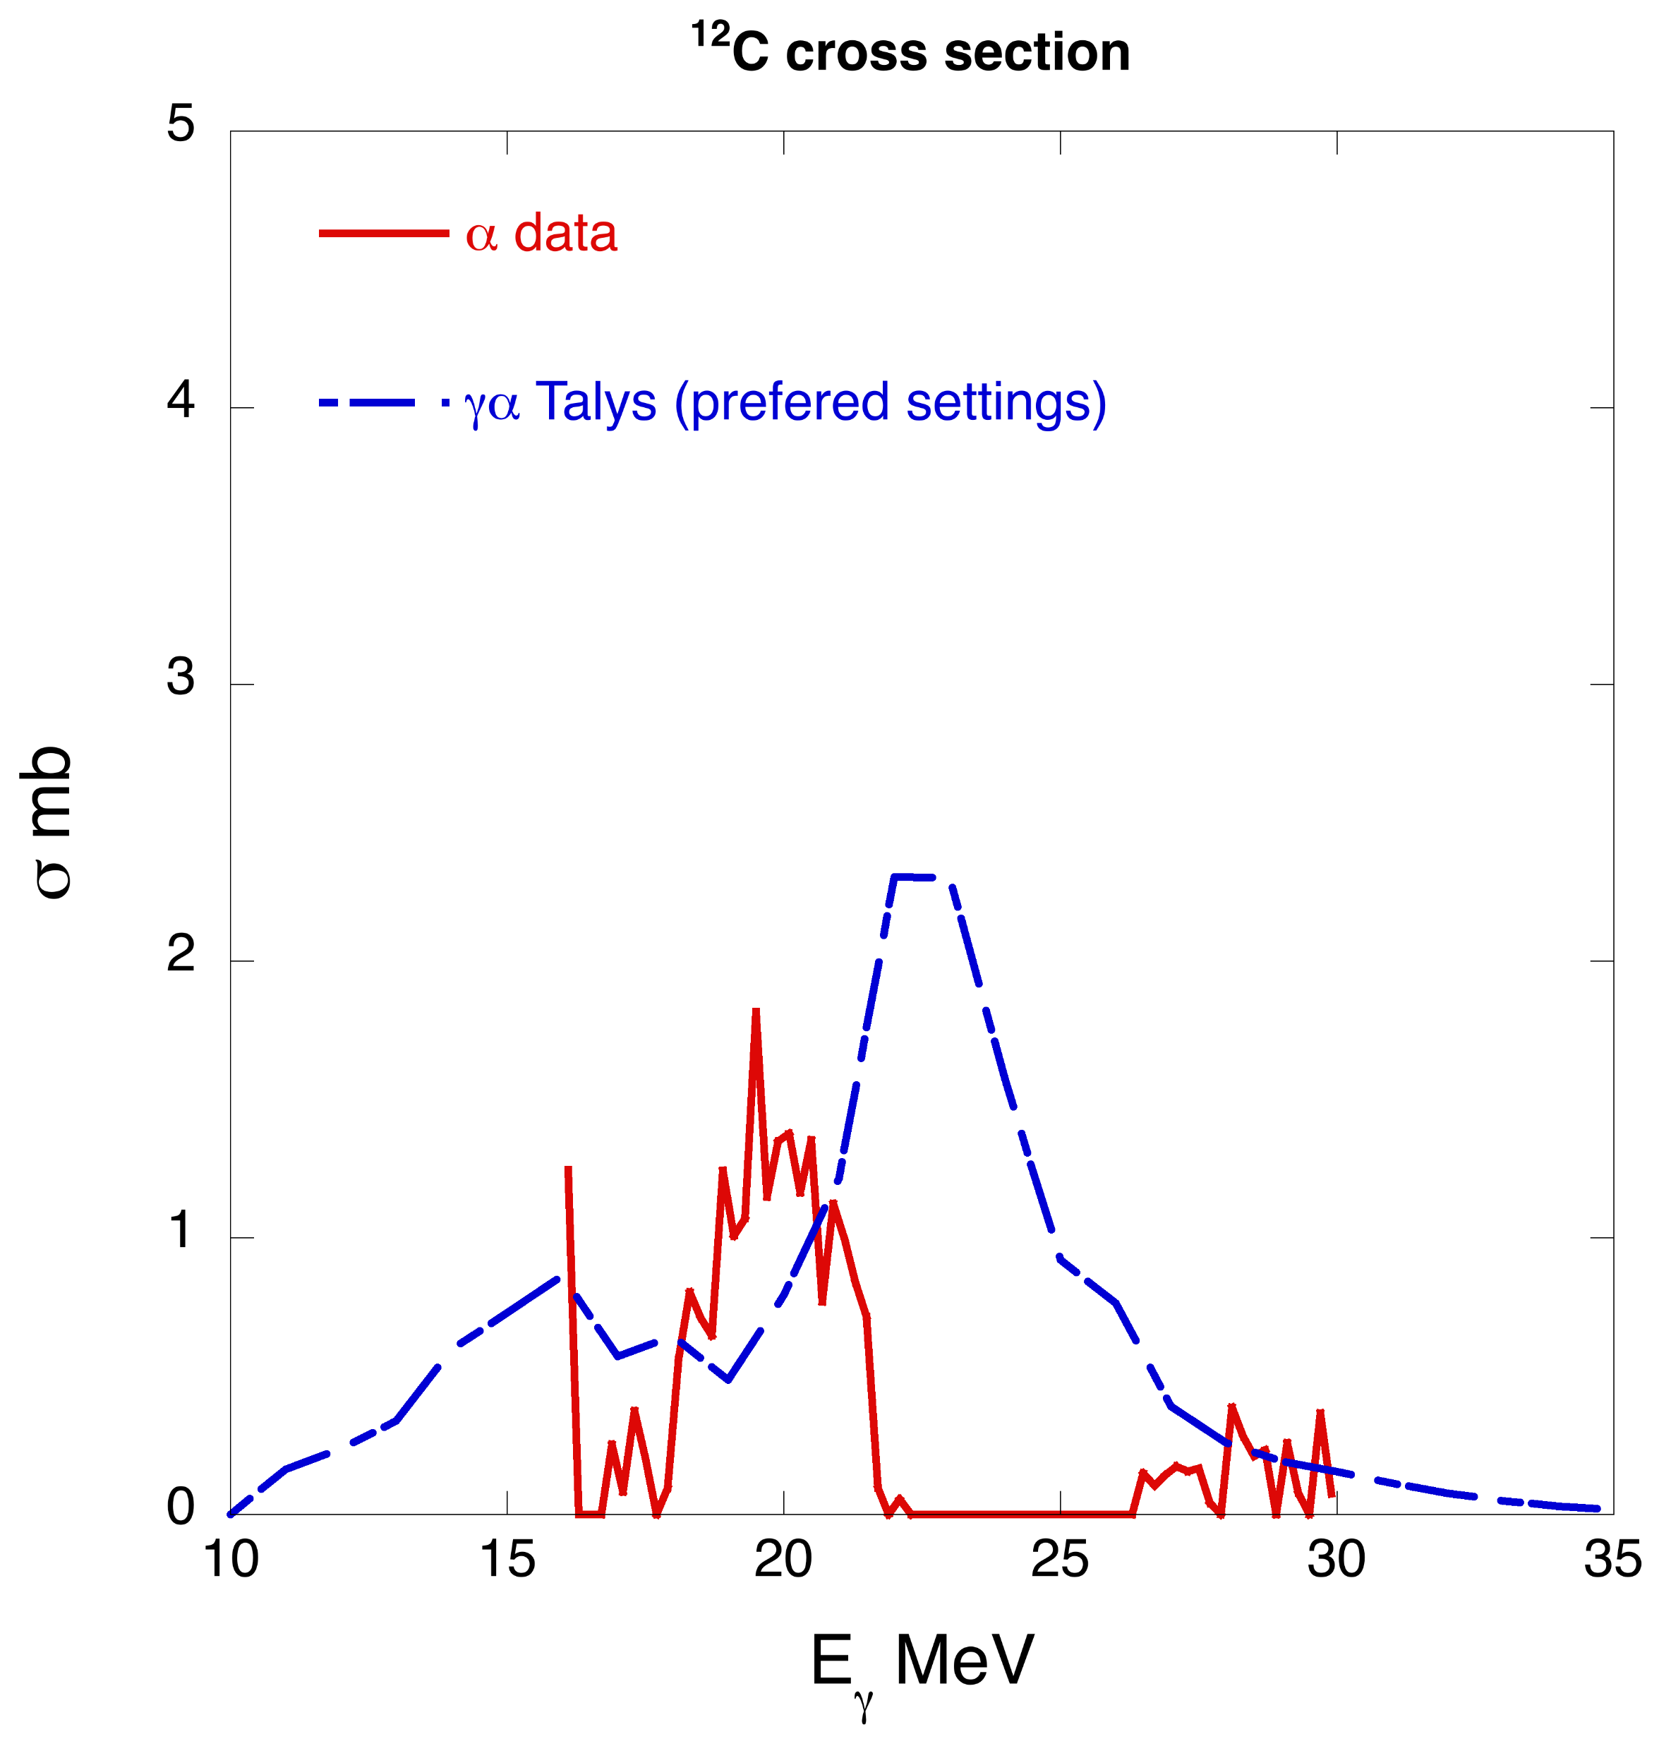
¹²C proton and alpha channels

Slide 31
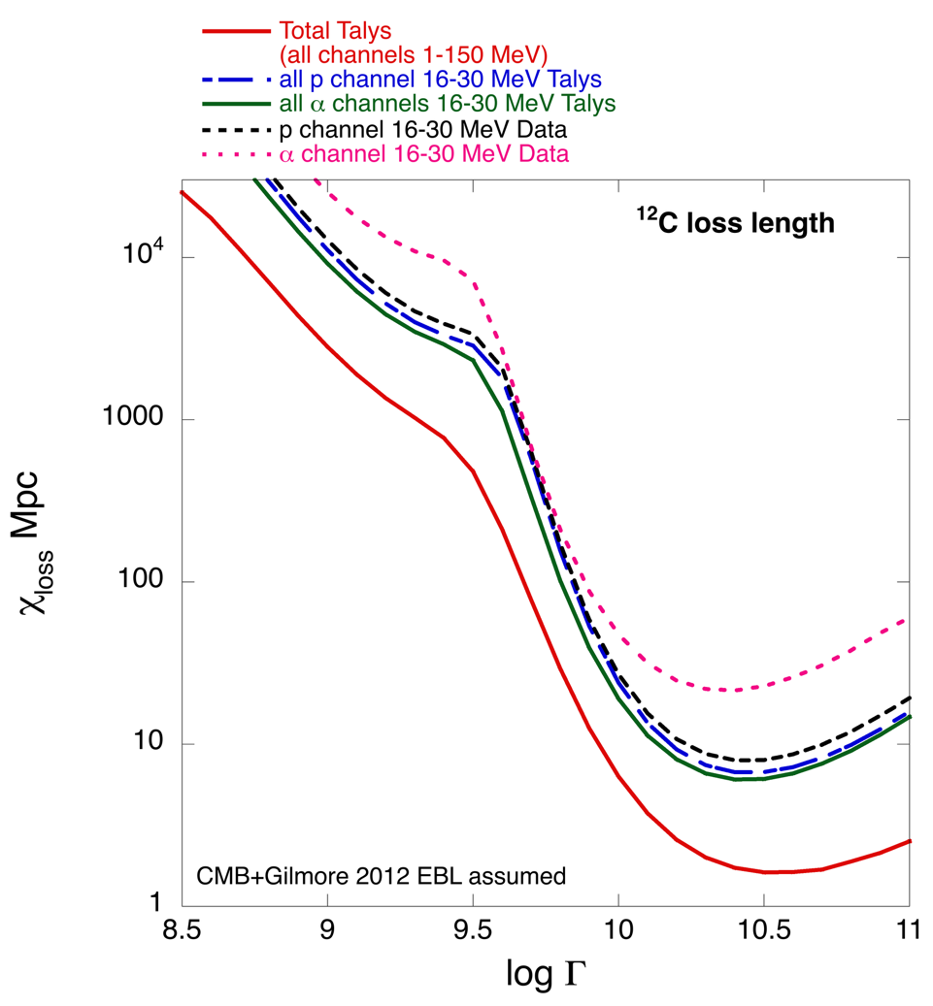
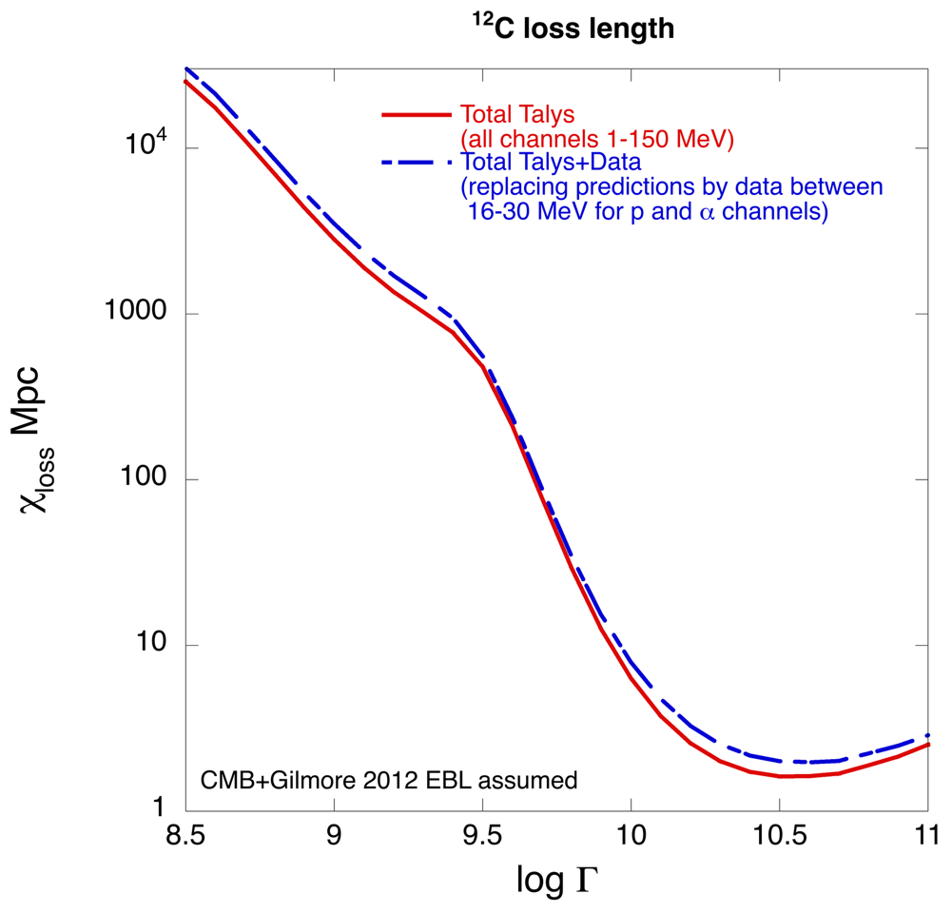
¹²C loss length comps, total vs partials

Slide 32
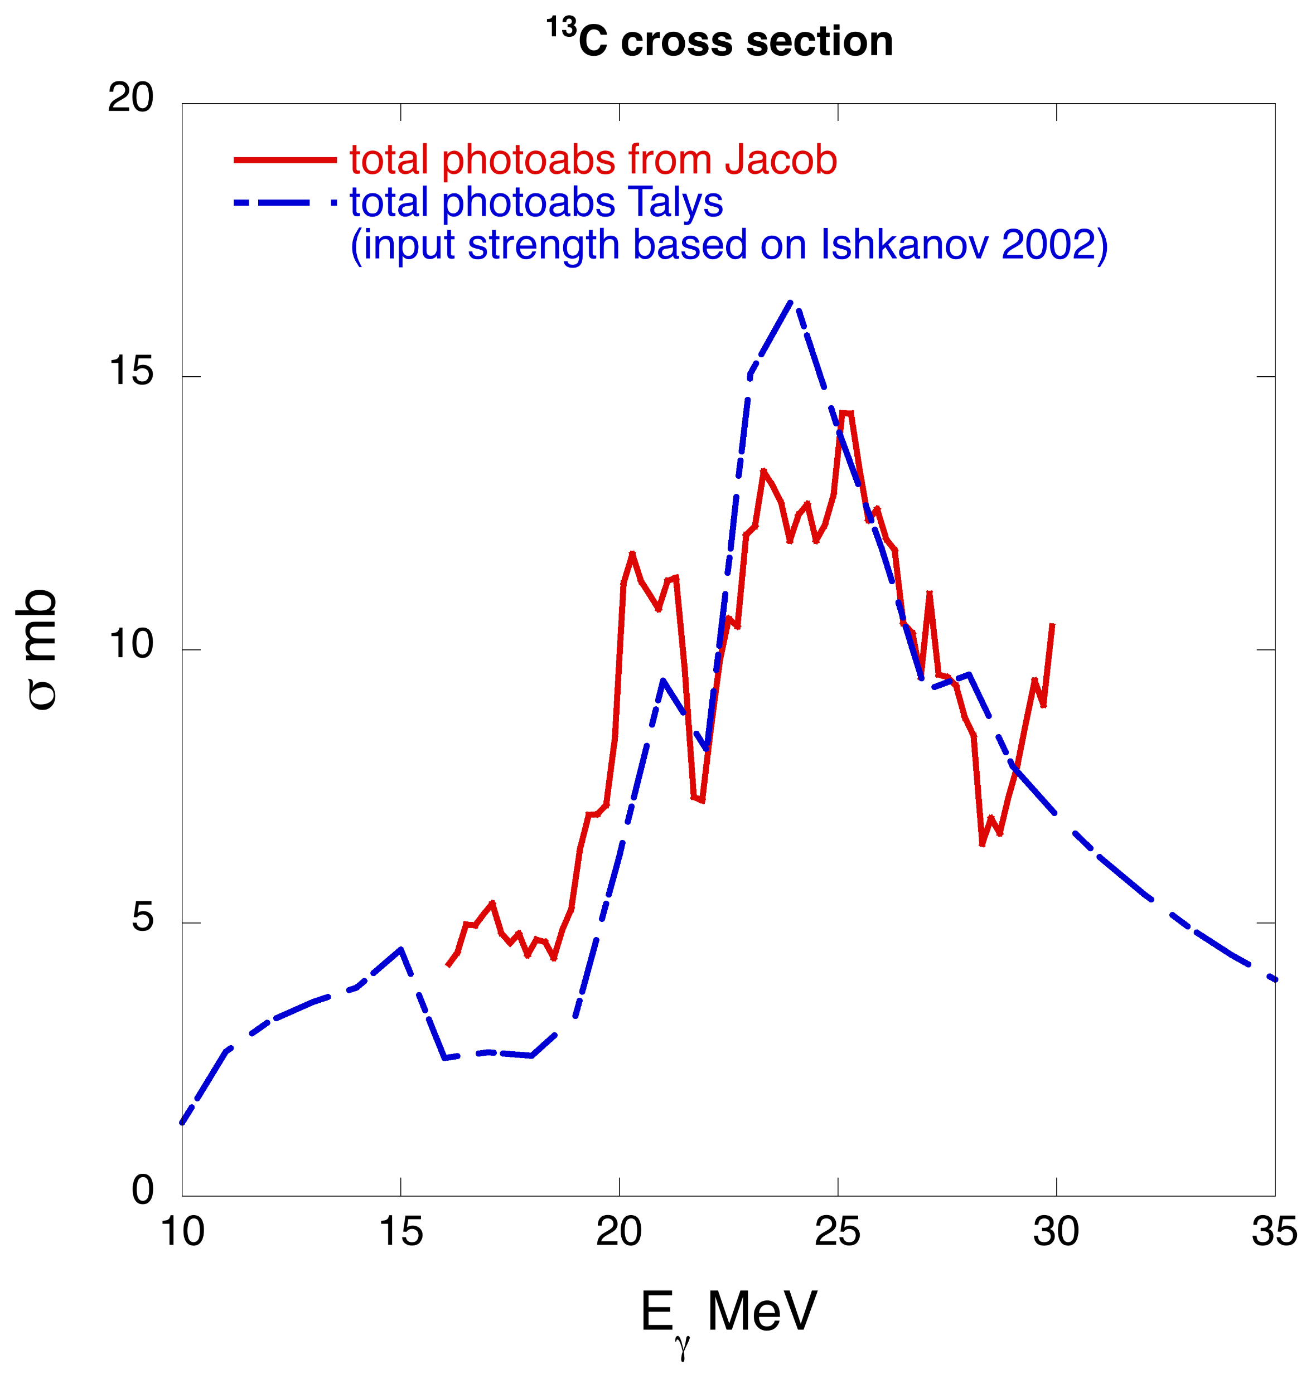
¹³C Total vs Talys

Slide 33
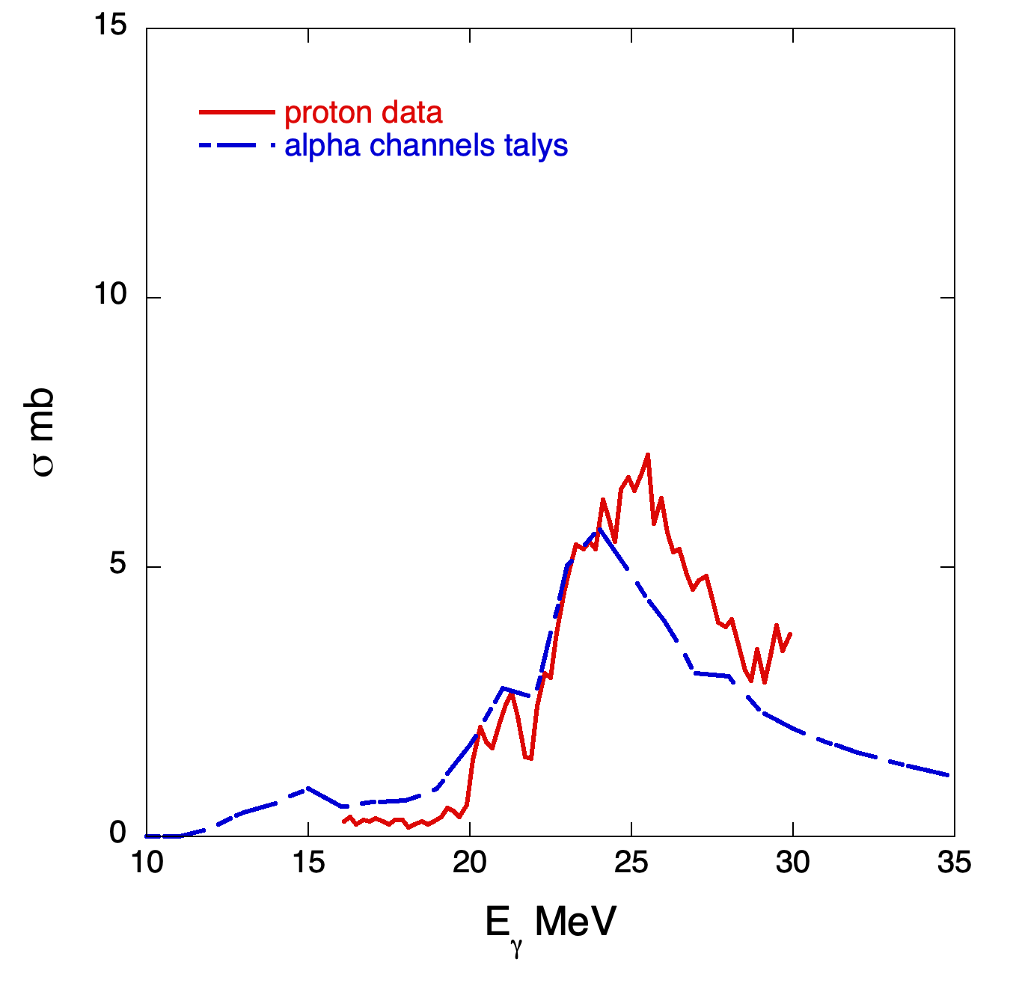
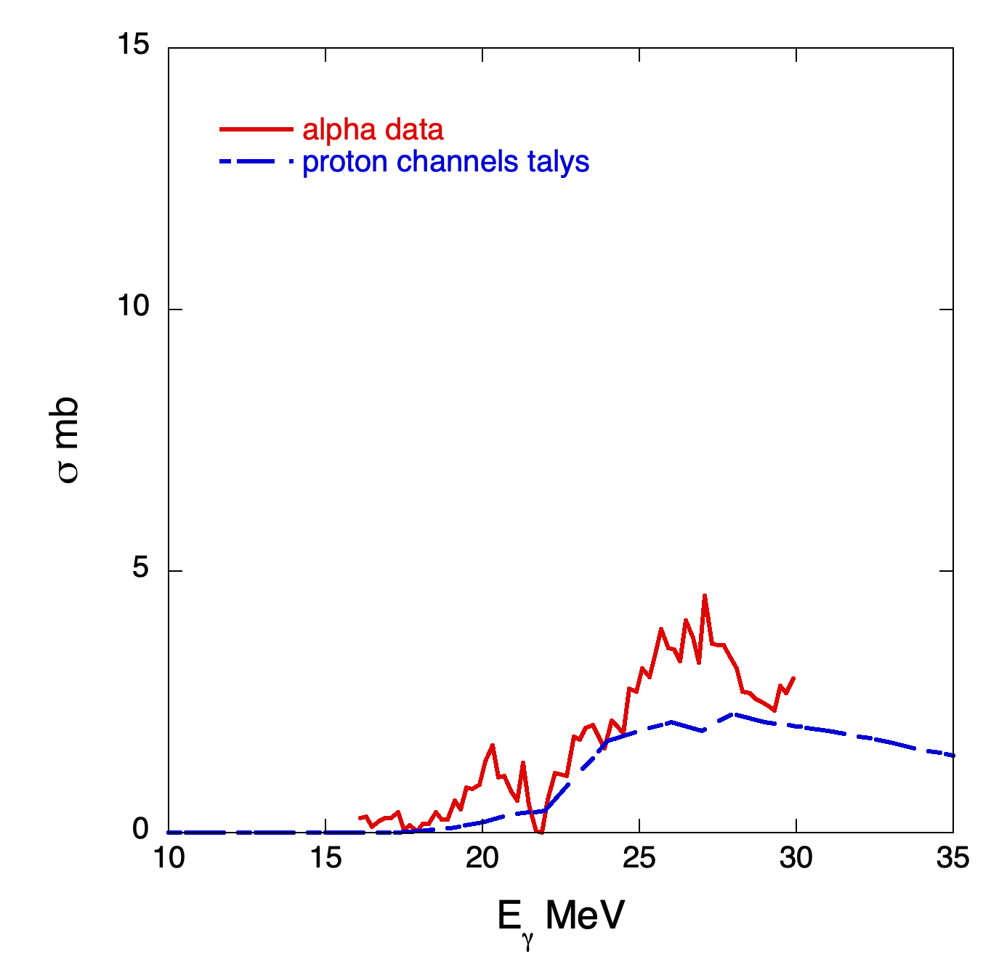
¹³C Proton and alpha channels

Slide 34
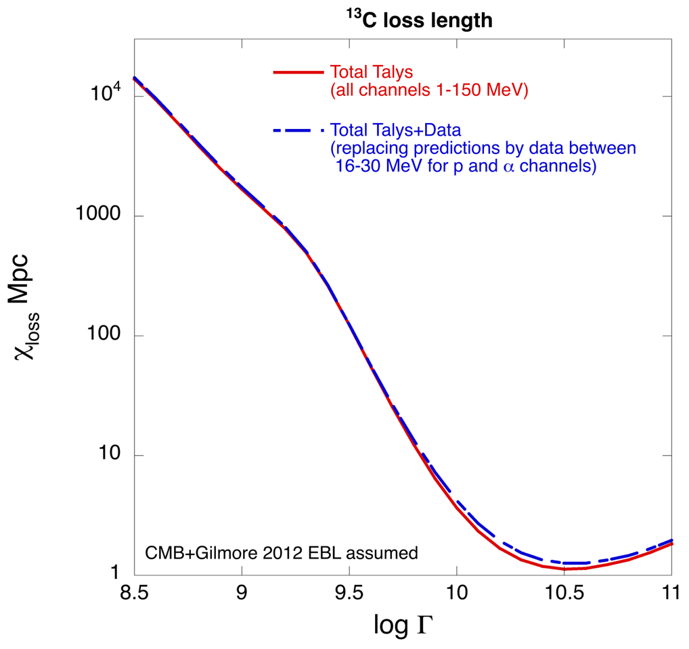

¹³C loss length comparisons, total vs partials

Slide 35


Questions?
NESCITUR IGNESCITUR – Gabrielle Rosetti
“unknown it burns”

