Slide 1
Photonuclear Reactions by Photon Vortex with Bessel Waves in Astronomical System
Tomoyuki Maruyama Nihon University
Collaborators
Takehito Hayakawa QST
Toshitaka Kajino Beihang University
Myung-Ki Cheoun Soongsil Univ., Korea.
Effect on stellar nucleosynthesis by Photon Vortex
T.M., T. Hayakawa, M.K.Cheoun, T.Kajino, ApJ 975, 51 (2024)

Slide 2
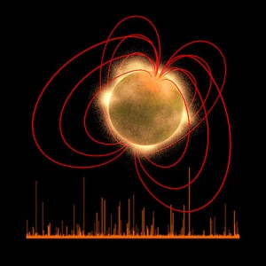
§1 Introduction
Optical Vortices L.Allen et al., PRA45, 8185 (‘94)
Optical vortices can bring large angular momentum.
This concept is applied to quantum mechanics
Photon Vortex : Eigen States of z-Comp. of Total Ang. Mom. (zTAM)
Strong Gravity (BH) ⇒ Optical Vortex
F. Tamburini et al., Nat.-Phys., Vol.7, 195 (`11),
MNRAS 492, L22 (’20)
Magnetar
Strong Mag. Field B ～ 10^{14ー15} G (normal B ～ 10^{12 －13} G)
Emitting High Energyγ Soft Gamma Repeater (SGR)
T.M, T. Hayakawa, M.K.Cheoun, T.Kajino, PLB826, 136779 (22)
Photon Vortex carrying zTAM
⇒ Different Multipole of Giant Resonances, Zhi-Wei Lu et al., PRL 131, 202502 (‘23)
Notes:
Not read Final Part

Slide 3
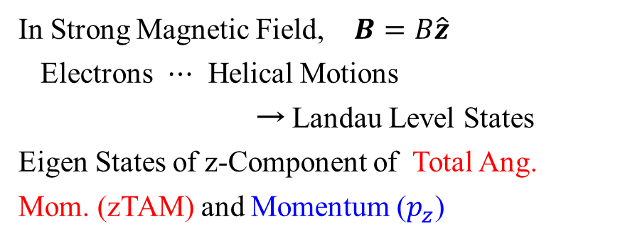
Photon Vortex Generation in Strong Magnetic Field
T.M, T. Hayakawa, M.K.Cheoun, T.Kajino, PLB826, 136779 (22)
In Strong Magnetic Field, $B=B\hat{z}$
Electrons $⋯$ Helical Motions
→ Landau Level States
Eigen States of z-Component of Total Ang. Mom. (zTAM) and Momentum ($p_{z}$)
Initial state
NL
L=1
NL-1
L=2
NL-2
L=3
NL-3
Emitted Photons are Photon Vortex
(Bessel Wave)
Stron Mag. Fld $⇒Phton Vortex$⇒ Photoreaction → Nucleosynthesis?

Slide 4
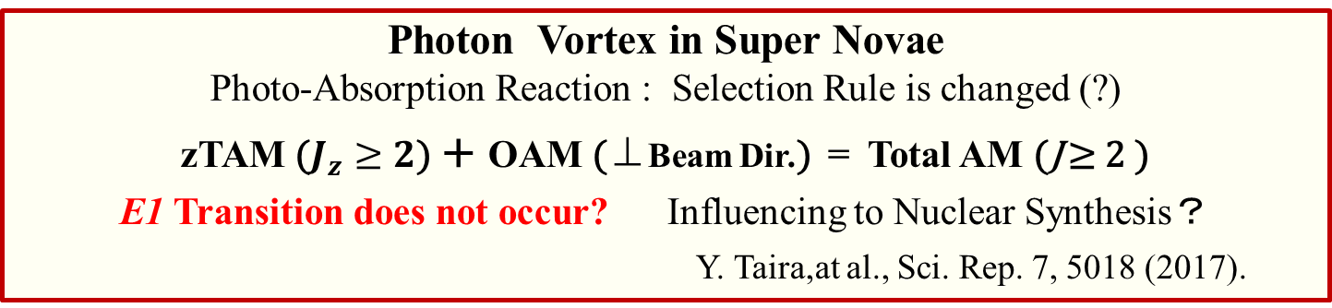
§2 Nuclear Photoreaction with Photon Vortex
Photon Vortex carrying zTAM
Its Interaction with Matter is different from that of Plane Wave Photon
Change of Selection Rule for Ｈ-atom A. Afanasev et al., PRA 88, 033841 (03)
A.Picón, et al. New J. of Phys. 12, 083053 (10)
Exp.: C.T.Schmiegelow, et al., Nat. Commun. 7, 12998 (16)
R.Lange, e al., PRL129, 253901 (22)
Photon Vortex in Super Novae
Photo-Absorption Reaction : Selection Rule is changed (?)
zTAM ($J_{z}≥2$) ＋ OAM (⊥Beam Dir.) = Total AM (J ≥ 2 )
E1 Transition does not occur? Influencing to Nuclear Synthesis？
Y. Taira,at al., Sci. Rep. 7, 5018 (2017).
n + p → γ + d, γ + d → n + p A. Afanasev et al., J. Phys. G 45 055102
Different Multipole of Giant Resonances, Zhi-Wei Lu et al., PRL 131, 202502 (23)
Y. Xu, et al., PLB 852,138622 (24)

Slide 5
Giant Resonance States excited by Bessel Wave Photons
Zhi-Wei Lu, et al. Phys. Rev. Lett. 131, 202502 (2023)
Changing Selection Rule ⇒ Nuclear Synthesis (?)

Slide 6
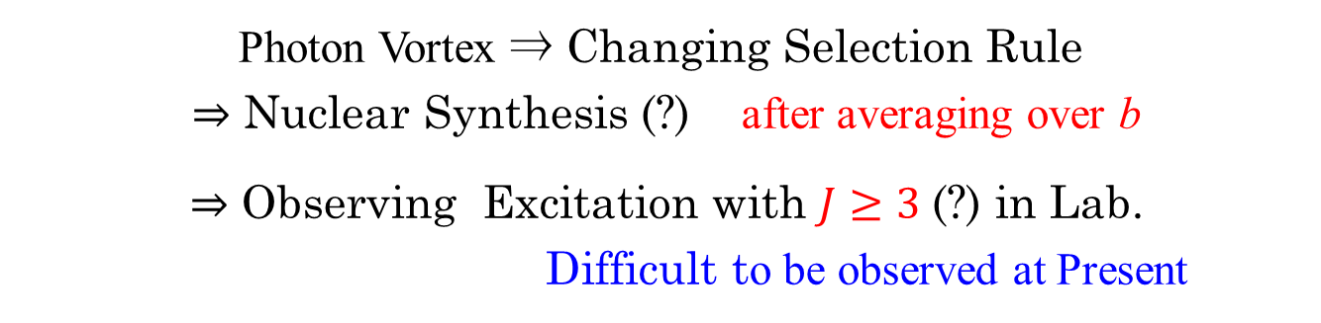
Impact Parameter Dependence
b ： Impact parameter
In Previous Works, b = 0 or Small b
In Nature, No Restriction ⇒ Integrating Results Over b
In Lab., Dependent on Technology
Photon Vortex ⇒ Changing Selection Rule
⇒ Nuclear Synthesis (?) after averaging over b
⇒ Observing Excitation with $J≥3$(?) in Lab.
Difficult to be observed at Present

Slide 7
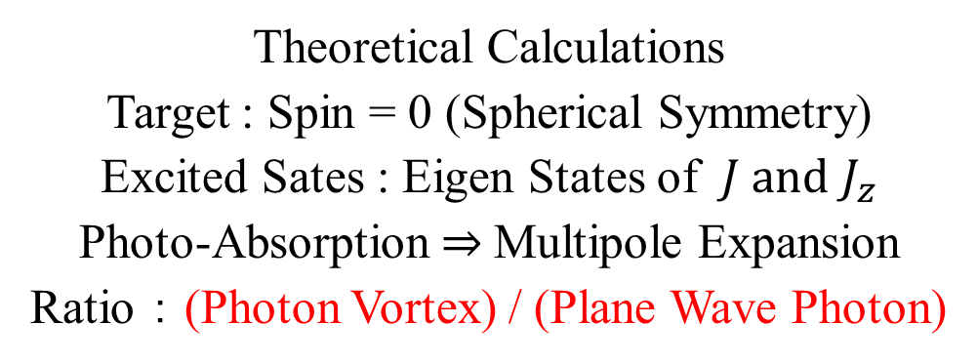
§3 Results in Photo-Absorption with Photon Vortex
Theoretical Calculations
Target : Spin = 0 (Spherical Symmetry)
Excited Sates : Eigen States of $J and J_{z}$
Photo-Absorption ⇒ Multipole Expansion
Ratio ： (Photon Vortex) / (Plane Wave Photon)
⇒ Impact Parameter Dependence

Slide 8
§3-1 Transition Strength with Plane Wave (PW)
Trans. Amp.
Current Op.
Excited States with ( J, M )
Parity : $κ$
Transition
Probability
Only for $M=h=±1$ (helicity)
Calculation in Nuclei

Slide 9
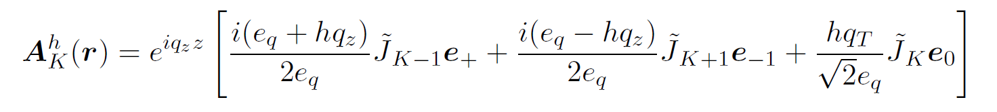

§3-2 Transition Strength with Bessel Wave
Photon Wave Func. Bessel Wave
Fourier Transformation
Polarization Vector ⊥ p
Multipole Expansion
Wigner D-Function
Excitation to Various M
Wigner d-Matrix

Slide 10
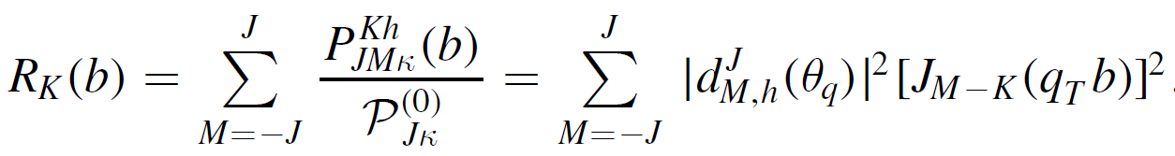

Transition Strength with Bessel Wave 2
Shifting Central Axis of BW with b
Transition Probability at fixed b
Ratio between
PW and BW
when $q\sim 0$ , Only $\left(M=K\right)$ contributes
Actual Transition Calculation is not Needed

Slide 11
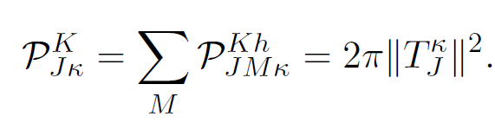
Transition Strength with Bessel Wave 3
Integrating over Impact Parameters
S_{T}：Cross-Section in System
$$S_{T}=\frac{2π}{q_{T}}δ\left(p_{T}−q_{T}\right)$$
$$\int{dr}rJ_{n}\left(qr\right)J_{n}\left(pr\right)=\frac{1}{q}ε(p−q)$$
Same as that in PW
No BW Effect for Total Excitation Probability

Slide 12
Transition by BW Photons
Trans. Prob. ：Averaging Over Impact Parameter (IP)
⇒ Same Results of PW
In Nature Selection Rule is not Changed
Changing Selection Rule is Observed for Atom
Restriction for Impact Parameter in Laboratory?
Experimental Projects of Gamma-ray Vortex Generation
Can we get New Information by controlling IP in Experiments?

Slide 13
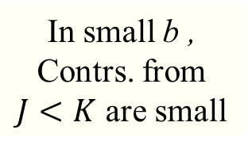
Impact Parameter (IP) Dependence
Exc. Prob. In BW
Exc. Prob. In PW
$$\sin{θ_{q}}={q_{T}}/{\left|q\right|}$$
This value is fixed for BW
In small b ,
Contrs. from
$J<K$ are small

Slide 14
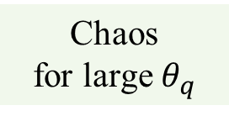
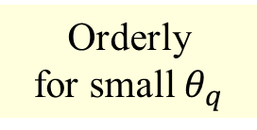
Impact Parameter (IP) Dependence
Orderly
for small $θ_{q}$
Chaos
for large $θ_{q}$
Special Regularities are Hard to see.

Slide 15
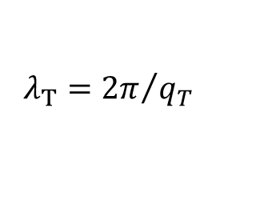
$$λ_{T}={2π}/{q_{T}}$$

Slide 16

K = M が大きい
K = M が小さい
$$λ_{T}={2π}/{q_{T}}$$

Slide 17
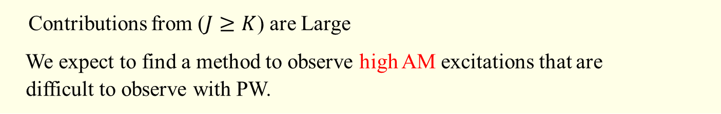
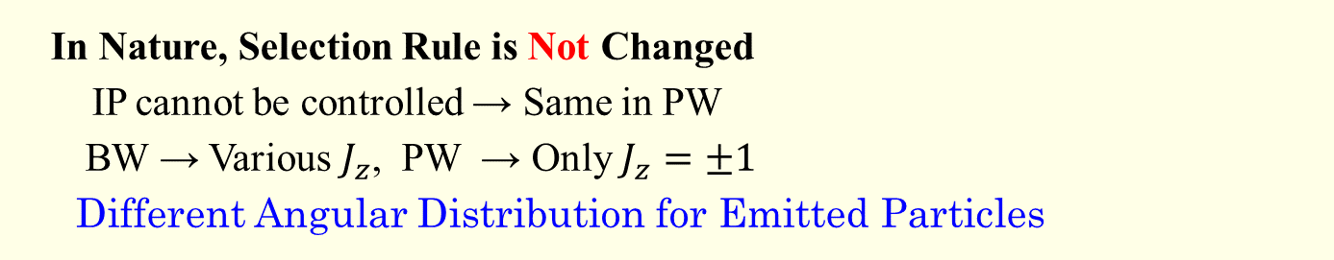
Nuclear Photoreaction with Bessel Wave
In Nature, Selection Rule is Not Changed
IP cannot be controlled → Same in PW
BW → Various $J_{z}$, PW → Only $J_{z}=±1$
Different Angular Distribution for Emitted Particles
Changing Selection Rule is observed for Atom with LG Wave, whose intensity distribution is concentrated around the symmetry axis.
In Laboratory, BW cannot be created.
Controlling Width of LG Wave ↔ Controlling IP ?
Contributions from ($J≥K$) are Large
We expect to find a method to observe high AM excitations that are
difficult to observe with PW.
Thank You!

Slide 18
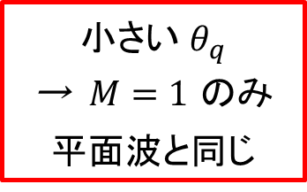
小さい $θ_{q}$
→ $M=1$ のみ
平面波と同じ

Slide 19
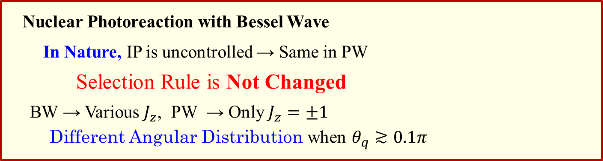
§4 Summary
Synchrotron Radiation ⇒ Photon Vortex in Dir. parallel to Mag. Fld.
T.M, T. Hayakawa, M.K.Cheoun, T.Kajino, PLB826, 136779 (2022)
Nuclear Photoreaction with Bessel Wave
In Nature, IP is uncontrolled → Same in PW
Selection Rule is Not Changed
BW → Various $J_{z}$, PW → Only $J_{z}=±1$
Different Angular Distribution when $θ_{q}≳0.1π$
Application to Experiments
Limiting Impact Parameter
Concentrating Strenghth around Symmetry Axis
Changing Selection Rule is observed for Atom with LG Wave, whose intensity distribution is concentrated around the symmetry axis.
But Nuclei are too Small (?)
Thank You!

Slide 20
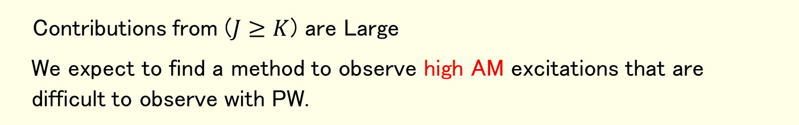
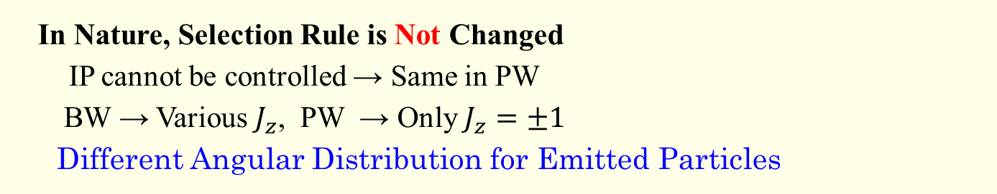
§4 Summary
In Nature, Selection Rule is Not Changed
IP cannot be controlled → Same in PW
BW → Various $J_{z}$, PW → Only $J_{z}=±1$
Different Angular Distribution for Emitted Particles
Changing Selection Rule is observed for Atom with LG Wave, whose intensity distribution is concentrated around the symmetry axis.
In Laboratory, BW cannot be created.
Controlling Width of LG Wave ↔ Controlling IP ?
Contributions from ($J≥K$) are Large
We expect to find a method to observe high AM excitations that are
difficult to observe with PW.
Thank You!

Slide 21
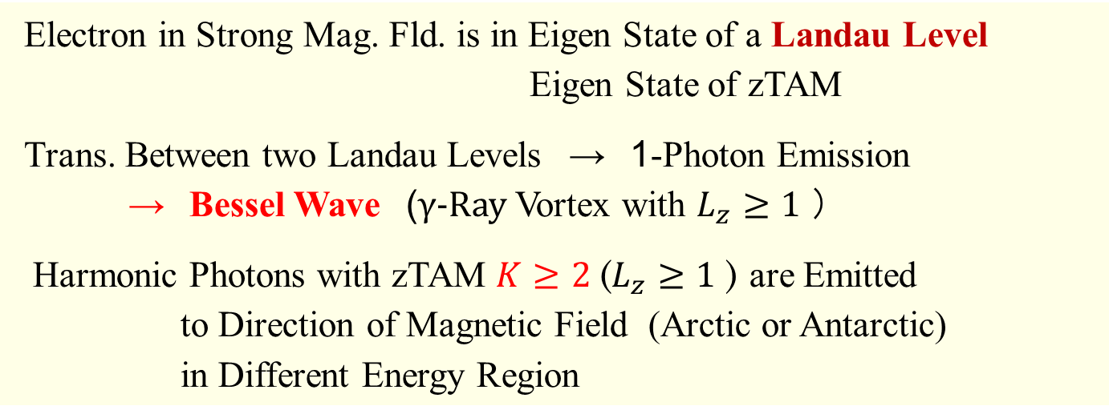
§4 Summary
Electron in Strong Mag. Fld. is in Eigen State of a Landau Level
Eigen State of zTAM
Trans. Between two Landau Levels → 1-Photon Emission
→ Bessel Wave (γ-Ray Vortex with $L_{z}≥1$ ）
Harmonic Photons with zTAM $K≥2$($L_{z}≥1$ ) are Emitted
to Direction of Magnetic Field (Arctic or Antarctic)
in Different Energy Region
Synchrotron Radiation
Linear Polarization in the Dir. perpendicular to Mag. Fld.
Circular Polarization to the Dir. parallel to Mag. Fld.
+ Vortex Wave in Strong Magnetic Field
This phenomena can be examined in Laboratory
T.M. et al., Phys. Rev. Res. 5, 043289 (2023)

Slide 22
Giant Resonance States excited by Bessel Wave Photons 2
Y. Xu, et al., Phys. Lett. B 852,138622 (2024)
zTAM $m_{γ}$ $\left(m_{γ}=2\right)−\left(m_{γ}=1\right)$ ： Significant Difference
Integrated over IP, b, in Small Region

Slide 23
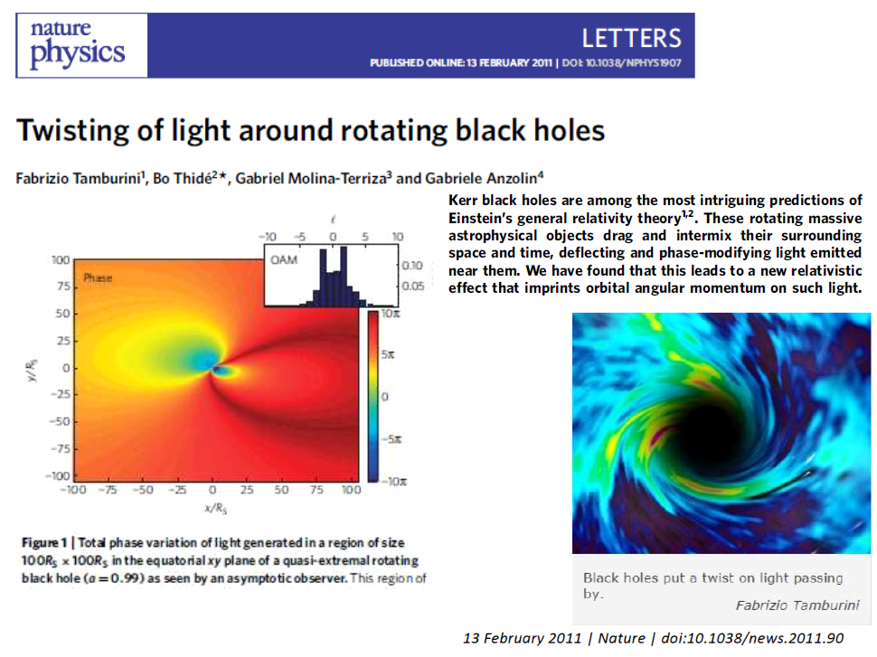
Optical Vortex Generation from Rotating BH
Fabrizio Tamburini et al.
Nature-Phys., Vol.7, 195 (2011)

Slide 24
Observation of Optical Vortex from Universe
Measurement of the spin of the M87 black hole from its observed twisted light
F.Tamburini et al., MNRAS 492, L22 (2020)
Observation from BH
Experiment with Plasma
Distribution of OAM

Slide 25
Theoretical Calculation Results
Emitted Photon Density
B.King, S.Tang, PRA 102, 022809 (2020)
Initial Photon Linear Polarization
Circular Polarization

Slide 26
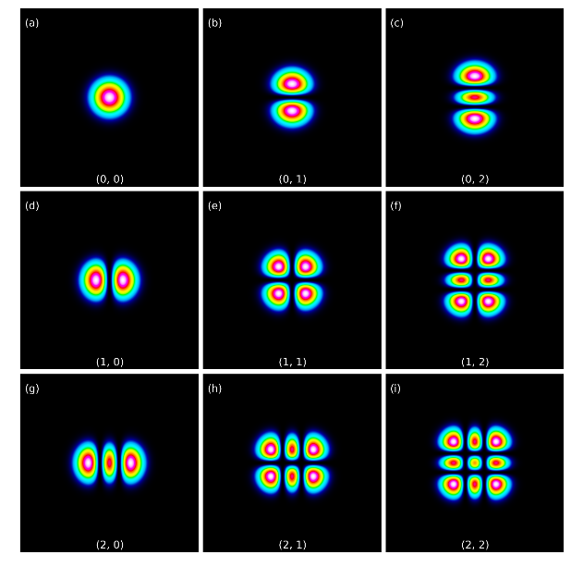
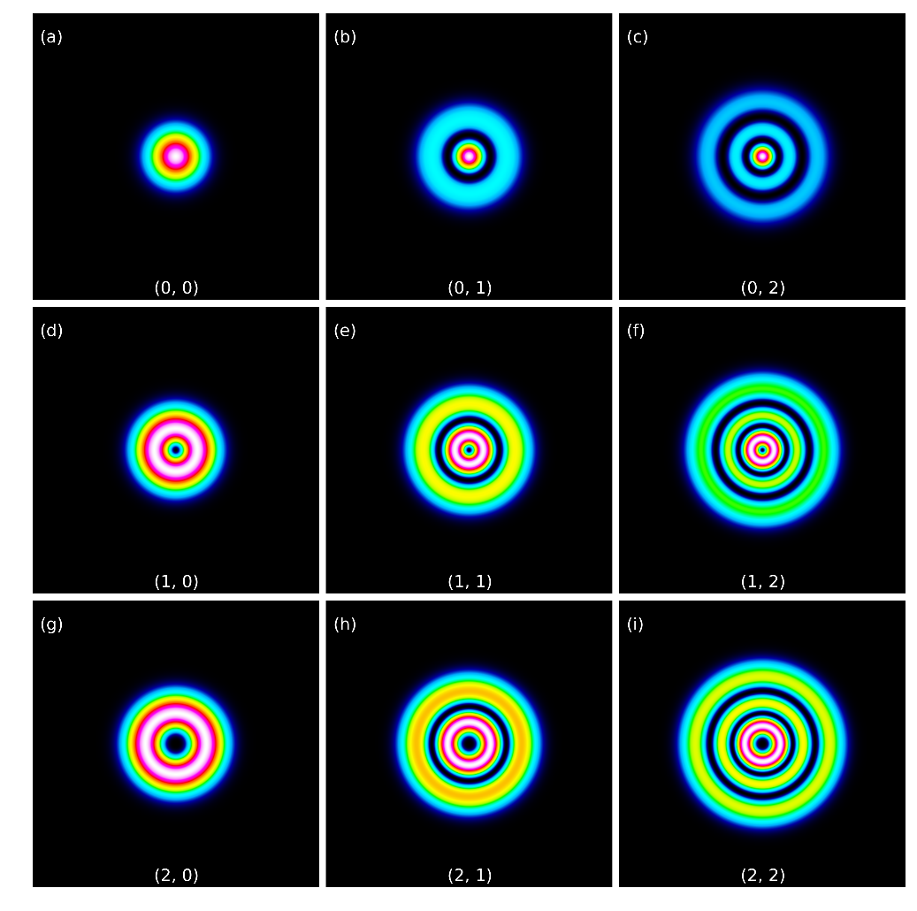
Hermit-Gaussian and Laguerre-Gaussian Mode
http://www.dataray.com/blog-m2-high-order-modes.html
Shape of Wave is equivalent to tPhoton Wave Function

