Slide 1

Nuclear Reaction Rates in
Laser-Driven Non-Equilibrium Plasmas
Eunseok Hwang
(Soongsil University)
In collaboration with
Dukjae Jang (Gachon University)
Myung-Ki Cheoun (Soongsil University)

Slide 2


































Evolution of elements
The synthesis of chemical elements is driven by thermonuclear reactions in astrophysical plasmas.
Understanding the evolution of elements requires investigating these nuclear reactions within such plasma environments.
The refinement of theoretical predictions is thus closely linked to the experimental validation of nuclear reaction rates.
$$^{7}Be$$
$$(p,γ)$$
$$(p,α)$$
$$(p,γ)$$
$$^{13}C$$
$$^{14}N$$
$$^{17}O$$
$$^{18}F$$
$$(α,γ)$$
$$(n,p)$$
$$(d,p)$$
$$(p,α)$$
$$(,e^{+}ν)$$
$$(p,γ)$$
$$(,e^{+}ν)$$
$$^{3}He$$
$$^{4}He$$
$$^{7}Li$$
$$(p,γ)$$
$$^{13}N$$
CNO1
$$^{15}O$$
CNO2
$$^{17}F$$
CNO3
$$(,e^{+}ν)$$
$$(n,p)$$
$$(d,n)$$
$$(α,γ)$$
$$(d,n)$$
$$(p,γ)$$
$$(,e^{+}ν)$$
$$(p,γ)$$
$$p$$
$$(n,γ)$$
$$d$$
$$(d,p)$$
$$t$$
$$^{12}C$$
$$(p,α)$$
$$^{15}N$$
$$(p,γ)$$
$$^{16}O$$
$$^{18}O$$
$$(p,γ)$$
$$^{19}F$$
$$n$$
$$(p,α)$$
CNO4
$$(p,α)$$
Primary reaction
CNO cycle
1/14

Slide 3
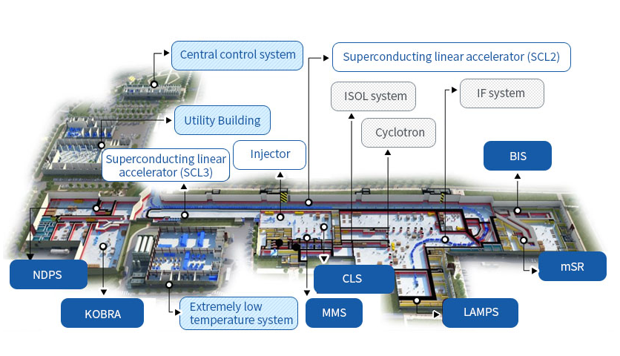
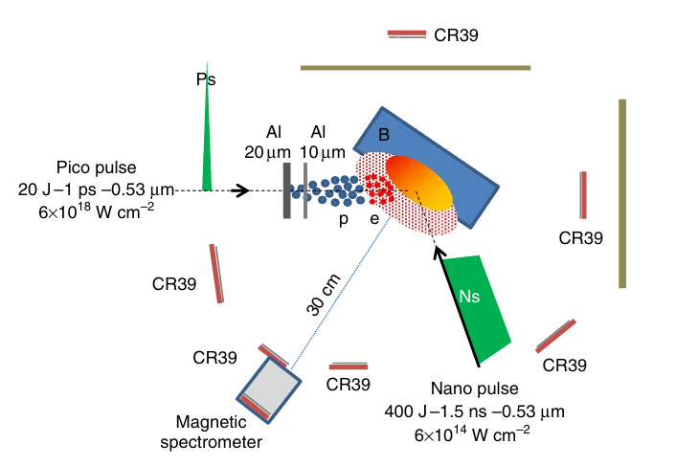
[1] The RAON heavy-ion accelerator facility in Korea.
Laser-driven nuclear physics
[2] Labaune C. et al., 2013 Nat. Commun. 4 2506
Traditionally, nuclear reaction cross-sections have been measured using accelerator facilities.
Recent advancements in high-power lasers have opened a new paradigm known as laser-driven nuclear physics.
This approach enables the direct measurement of reaction rates by generating nuclear reactions within a plasma environment.
Furthermore, it provides a unique testbed for experimentally investigating plasma medium effects, such as electron screening.
[1]
[2]
Accelerator experiment
Laser-driven experiment
2/14

Slide 4




[3] C. Iliadis Nuclear Physics of Stars (Wiley, 2007)
Pitcher-Catcher experiments
Solid target
nuclear reaction
Ion beam
Laser
Foil target
Laser
Pitcher
Catcher
Nuclear reaction
[3]
Ion beam
Solid or plasma target
$$r_{12}=N_{1}N_{2}\left\langle σv\right\rangle$$
$n_{i}$ : number density of nucleus $i$ (beam or target)
$r_{12}$ : reaction rate
$⟨σv⟩$ : reactivity
3/14

Slide 5



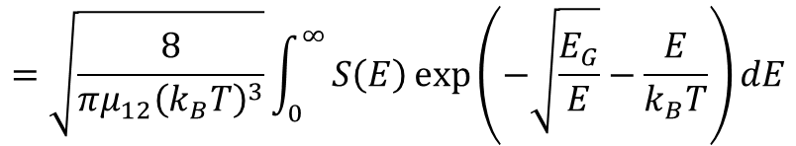

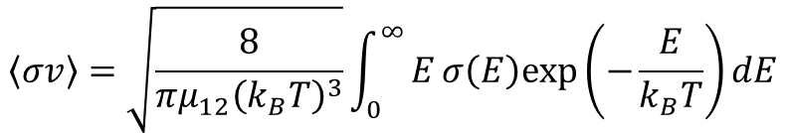



[4] Ian J. Thompson and Filomena M. Nunes Nuclear Reactions for Astrophysics
Nuclear reaction rate
$S(E)$ : astrophysical S-factor
$μ_{12}$ : reduced mass
$$E_{G}=2μ_{12}{\left(πZ_{1}Z_{2}e^{2}\right)}^{2}/ℏ^{2}$$
$f_{i}$ : normalized distribution of particle $i$
Reaction rate
$N_{i}$ : number density of particle $i$
$$r_{12}=N_{1}N_{2}\left\langle σv\right\rangle$$
Cross section
Gamow
window
$$σ\left(E\right)≡\frac{1}{E}e^{−\sqrt{E_{G}/E}}S(E)$$
Maxwell
Boltzmann
Reactivity
Probability (arbitrary unit)
Tunneling
through
Coulomb
barrier
[4]
$$\left\langle σv\right\rangle =\sqrt{\frac{8}{πμ_{12}{\left(k_{B}T\right)}^{3}}}\int_{0}^{∞}{Eσ\left(E\right)exp\left(−\frac{E}{k_{B}T}\right)dE}$$
$$=\sqrt{\frac{8}{πμ_{12}{\left(k_{B}T\right)}^{3}}}\int_{0}^{∞}{S\left(E\right)\exp\left(−\sqrt{\frac{E_{G}}{E}}−\frac{E}{k_{B}T}\right)dE}$$
Energy (arbitrary unit)
Gamow Factor
Maxwell-Boltzmann
4/14

Slide 6
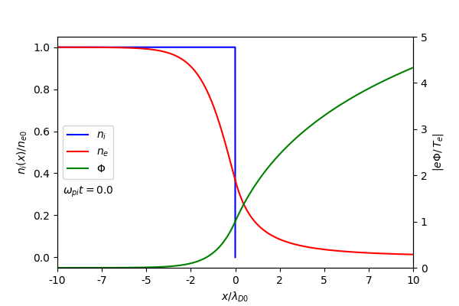
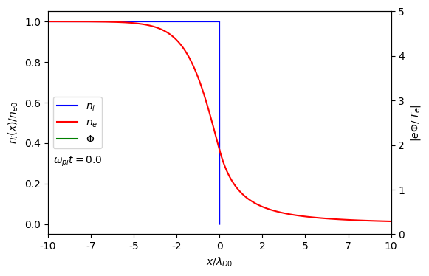
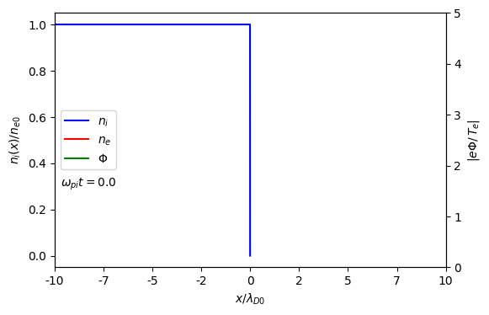

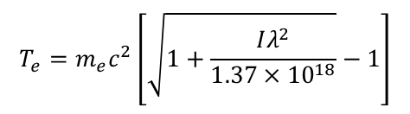











[5] Wilks S.C. et al., 1992 Phys. Rev. Lett. 69 1383–6
Target Normal Sheath Acceleration (TNSA)
1. When a laser irradiates a foil target, hot electrons are generated.
Foil target
$$T_{e}=m_{e}c^{2}\left[\sqrt{1+\frac{Iλ^{2}}{1.37×{10}^{18}}}−1\right]$$
$I$ : Laser intensity
[5]
$λ$ : Laser wavelength
Laser
2. The escape of these electrons results in charge separation,
which creates an electric field.
$$ε_{0}\frac{∂^{2}Φ}{∂x^{2}}=e(n_{e}−Zn_{i})$$
$n_{e}$: electron number density
$$+$$
$$+$$
$$n_{e}=n_{e0}\exp{(eΦ/k_{B}T_{e})}$$
$n_{i}$: ion number density
$$+$$
$$+$$
$$+$$
$$+$$
$$+$$
$$−$$
$$−$$
$$−$$
$$−$$
$$−$$
$$−$$
$$−$$
$$−$$
5/14

Slide 7

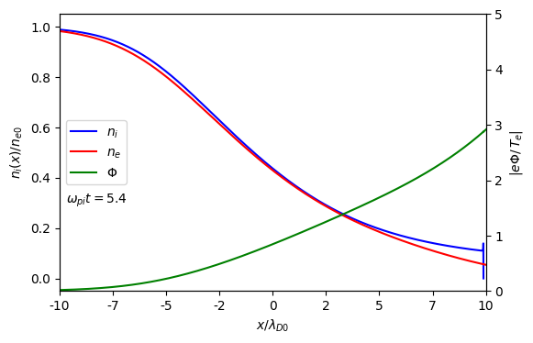


[5] Wilks S.C. et al., 1992 Phys. Rev. Lett. 69 1383–6
Target Normal Sheath Acceleration (TNSA)
1. When a laser irradiates a foil target, hot electrons are generated.
Foil target
$$T_{e}=m_{e}c^{2}\left[\sqrt{1+\frac{Iλ^{2}}{1.37×{10}^{18}}}−1\right]$$
$I$ : Laser intensity
[5]
$λ$ : Laser wavelength
Laser
2. The escape of these electrons results in charge separation,
which creates an electric field.
$$ε_{0}\frac{∂^{2}Φ}{∂x^{2}}=e(n_{e}−Zn_{i})$$
$n_{e}$: electron number density
$$n_{e}=n_{e0}\exp{(eΦ/k_{B}T_{e})}$$
$n_{i}$: ion number density
3. This electric field then accelerates ions from the target,
leading to the expansion of an ion beam
$$\left(\frac{∂}{∂t}+v_{i}\frac{∂}{∂x}\right)n_{i}=−n_{i}\frac{∂v_{i}}{∂x}$$
$$\left(\frac{∂}{∂t}+v_{i}\frac{∂}{∂x}\right)v_{i}=−\frac{Ze}{m_{i}}\frac{∂Φ}{∂x}$$
5/14

Slide 8
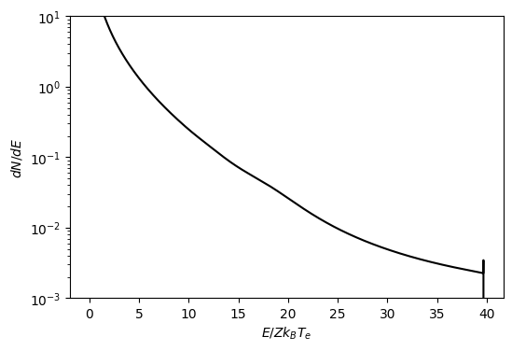



[5] Wilks S.C. et al., 1992 Phys. Rev. Lett. 69 1383–6
Target Normal Sheath Acceleration (TNSA)
1. When a laser irradiates a foil target, hot electrons are generated.
$$T_{e}=m_{e}c^{2}\left[\sqrt{1+\frac{Iλ^{2}}{1.37×{10}^{18}}}−1\right]$$
$I$ : Laser intensity
[5]
$λ$ : Laser wavelength
2. The escape of these electrons results in charge separation,
which creates an electric field.
$$ε_{0}\frac{∂^{2}Φ}{∂x^{2}}=e(n_{e}−Zn_{i})$$
$n_{e}$: electron number density
$$n_{e}=n_{e0}\exp{(eΦ/k_{B}T_{e})}$$
$n_{i}$: ion number density
3. This electric field then accelerates ions from the target,
leading to the expansion of an ion beam
$$\left(\frac{∂}{∂t}+v_{i}\frac{∂}{∂x}\right)n_{i}=−n_{i}\frac{∂v_{i}}{∂x}$$
$$\left(\frac{∂}{∂t}+v_{i}\frac{∂}{∂x}\right)v_{i}=−\frac{Ze}{m_{i}}\frac{∂Φ}{∂x}$$
4. The energy distribution is calculated from the position-dependent
ion number density and velocity at a given time.
$$n_{i}(t,x)$$
$$v_{i}(t,x)$$
$$dN/dE$$
5/14

Slide 9
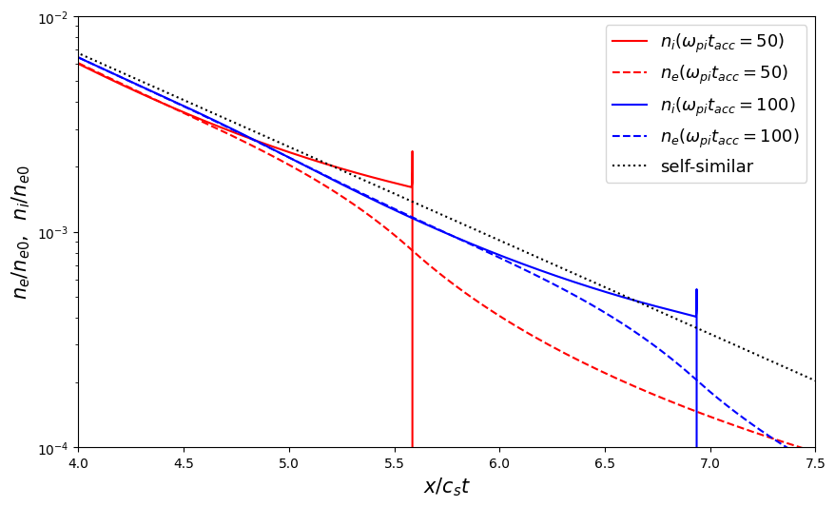
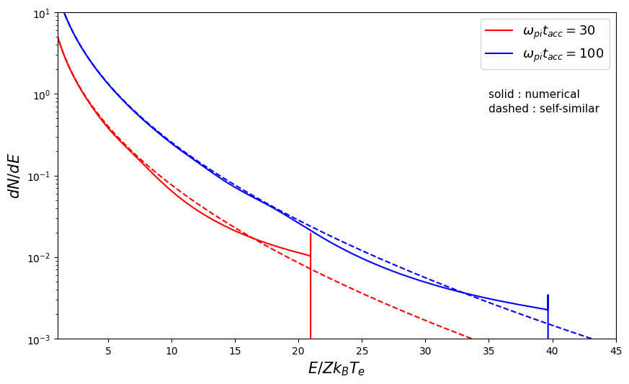



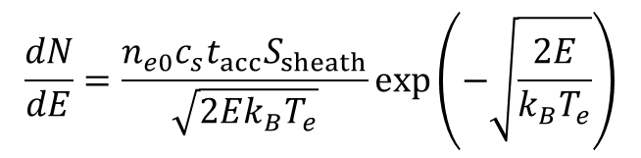
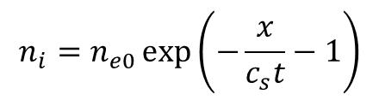

[6] Mora P. 2003 Phys. Rev. Lett. 90 185002
Self-similar solution
[6]
$$n_{i}=n_{e0}\exp\left(−\frac{x}{c_{s}t}−1\right)$$
$$\frac{dN}{dE}=\frac{n_{e0}c_{s}t_{acc}S_{sheath}}{\sqrt{2Ek_{B}T_{e}}}\exp\left(−\sqrt{\frac{2E}{k_{B}T_{e}}}\right)$$
$c_{s}$ : ion acoustic velocity
$t_{acc}=1.3×τ_{laser}$
$τ_{laser}$ : laser pulse duration
$S_{sheath}$ : sheath surface
6/14

Slide 10




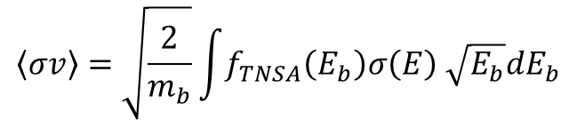

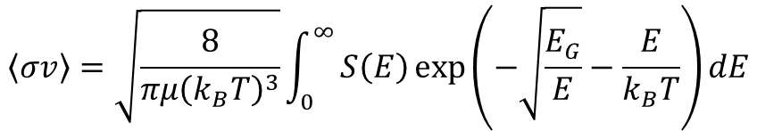

[7] E. Hwang. et al., Nucl. Fusion 65 106015
Reactivity
$$\left\langle σv\right\rangle =\sqrt{\frac{8}{πμ{\left(k_{B}T\right)}^{3}}}\int_{0}^{∞}{S\left(E\right)\exp\left(−\sqrt{\frac{E_{G}}{E}}−\frac{E}{k_{B}T}\right)dE}$$
$μ$: reduced mass
Equilibrium plasma
$S(E)$ : astrophysical S-factor
$$E_{G}=2μ_{12}{\left(πZ_{1}Z_{2}e^{2}\right)}^{2}/ℏ^{2}$$
[7]
$$\left\langle σv\right\rangle =\sqrt{\frac{2}{m_{b}}}\int{f_{TNSA}\left(E_{b}\right)σ\left(E\right) \sqrt{E_{b}}dE_{b}}$$
$E_{b}$ : kinetic energy of beam particle
Non-equilibrium plasma
$E$ : center-of-mass energy $\left(E=\frac{μ}{m_{b}}E_{b}\right)$
Numerical solution
(specific application)
Self-similar solution
(general formalism)
Energy window for nonequilibrium distribution
Applied to $p+ ^{11}B$ fusion
Peak energy of nuclear reaction
Laser parameter optimization
Reactivity for non-resonant reaction
7/14

Slide 11
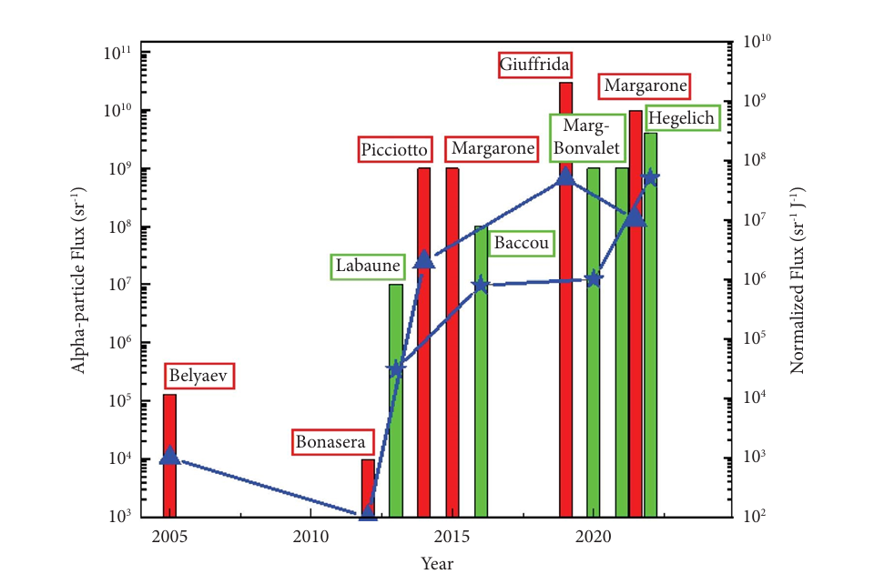


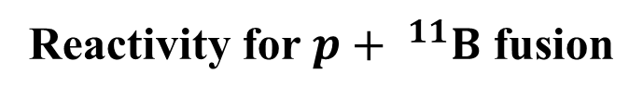

[8] Mehlhorn T.A. et al., 2022 Laser Part. Beams 2022 e1
Reactivity for $p+ ^{11}B$ fusion
$p+ ^{11}B$ fusion
[8]
$p+ ^{11}B→3α+8.7 MeV$
As aneutronic fusion, it is widely researched
as a clean energy source.
Extensive experimental studies have already
been carried out.
8/14

Slide 12
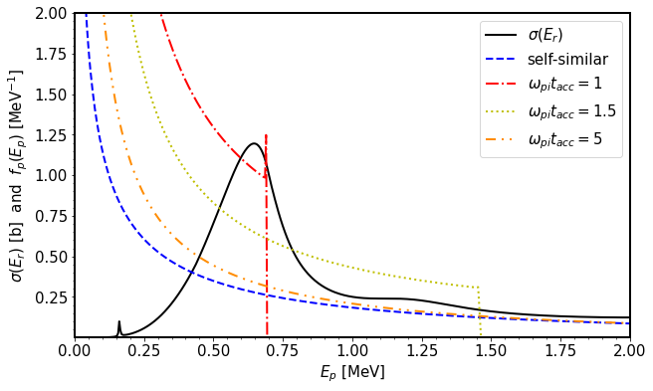
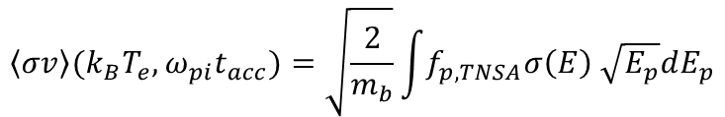






[7] E. Hwang. et al., Nucl. Fusion 65 106015
Reactivity for $p+ ^{11}B$ fusion
Numerical solution
[7]
$k_{B}T_{e}$ = 2 MeV
proton energy $E_{p}$.
Distribution function depend on
electron temperature $k_{B}T_{e}$.
normalized time $ω_{pi}t_{acc}$.
$$f_{p,TNSA}(E_{p},{k_{B}T}_{e},ω_{pi}t_{acc})$$
$$\left\langle σv\right\rangle ({k_{B}T}_{e},ω_{pi}t_{acc})=\sqrt{\frac{2}{m_{b}}}\int{f_{p,TNSA}σ\left(E\right) \sqrt{E_{p}}dE_{p}}$$
$E$ : center-of-mass energy $\left(E=\frac{μ}{m_{p}}E_{p}\right)$
9/14

Slide 13
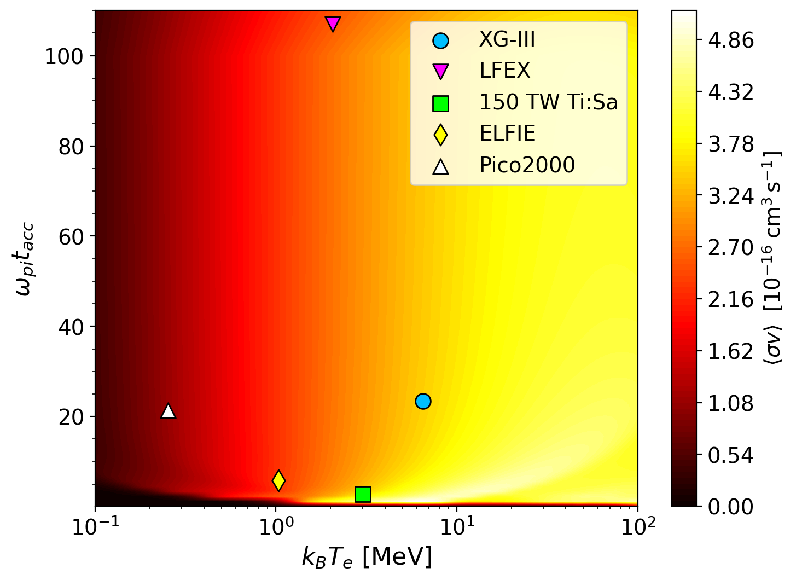
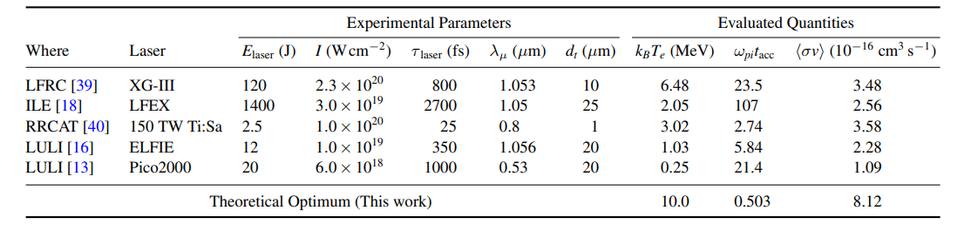





[7] E. Hwang. et al., Nucl. Fusion 65 106015
Reactivity for $p+ ^{11}B$ fusion
[7]
[7]
$E_{laser}$: Laser energy
$I$ : Laser intensity
$τ_{laser}$ : pulse duration
$λ_{μ}$ : Laser wavelength
$d_{t}$ : target width
Reactivity exhibits a theoretical upper limit under a specific set of conditions.
10/14

Slide 14

Reactivity for non-resonant reaction
Gamow window
$$\left\langle σv\right\rangle ∝\int_{0}^{∞}{S\left(E\right)e^{−\sqrt{\frac{E_{G}}{E}}}e^{−\frac{E}{k_{B}T}}dE}$$
Gamow
window
The energy range of the most active nuclear reactions within
an equilibrium plasma.
Maxwell
Boltzmann
Probability (arbitrary unit)
Tunneling
through
Coulomb
barrier
The Gamow window it stands as a critical guide for designing
experiments aimed at studying stellar nucleosynthesis.
Gamow peak energy
The energy at which the probability is maximized.
Energy (arbitrary unit)
The Gamow peak energy is often used as a reference point
in the development of theoretical approximation.
Gamow window is a powerful predictive tool, providing guidance for both experimental and theoretical studies in nuclear astrophysics.
11/14

Slide 15
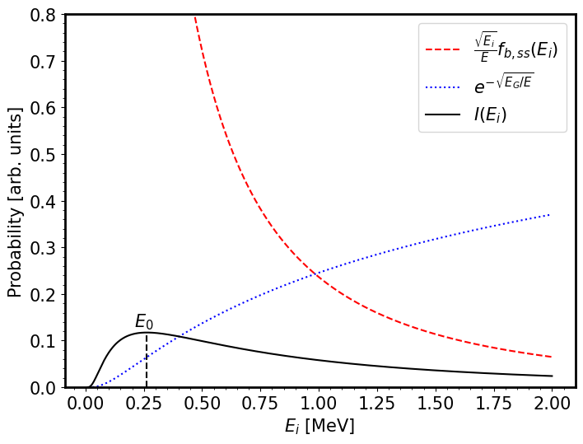
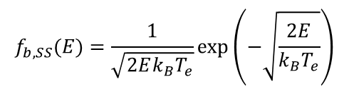


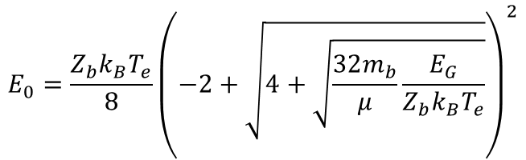
Reactivity for non-resonant reaction
$$f_{b,SS}(E)=\frac{1}{\sqrt{2Ek_{B}T_{e}}}\exp\left(−\sqrt{\frac{2E}{k_{B}T_{e}}}\right)$$
Laser Gamow window
$$\left\langle σv\right\rangle ∝\int_{0}^{∞}{S\left(E\right)e^{−\sqrt{\frac{E_{G}}{E}}}e^{−\frac{E}{k_{B}T}}dE}$$
$$\left\langle σv\right\rangle ∝\int_{0}^{∞}{S\left(E\right)e^{−\sqrt{\frac{E_{G}}{E}} }\frac{\sqrt{E_{i}}}{E}f_{b,SS}(E_{i})dE_{i}}$$
$$I(E_{i})$$
Laser Gamow peak energy
$$E_{0}=\frac{Z_{b}k_{B}T_{e}}{8}{\left(−2+\sqrt{4+\sqrt{\frac{32m_{b}}{μ}\frac{E_{G}}{Z_{b}k_{B}T_{e}}}}\right)}^{2}$$
12/14

Slide 16
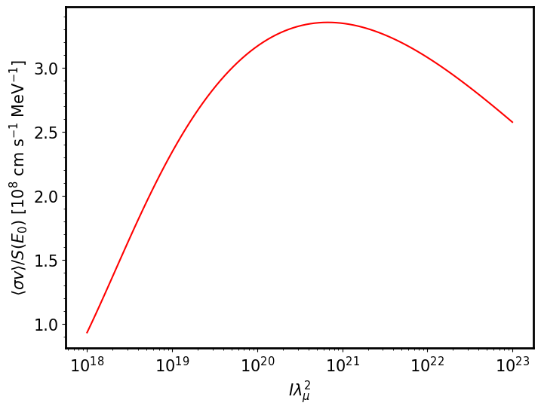
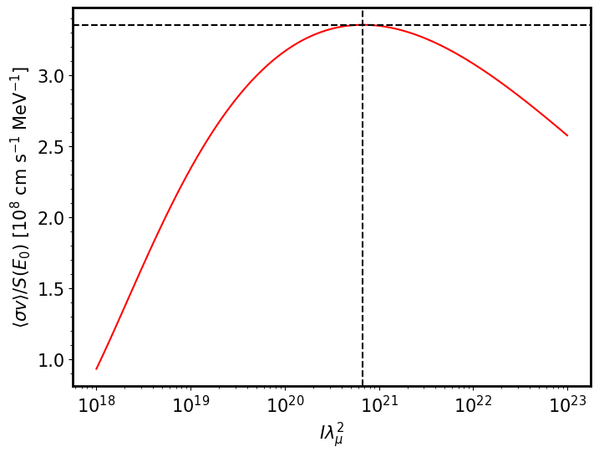
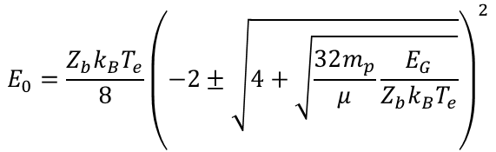

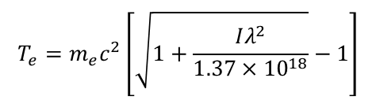

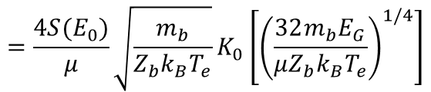
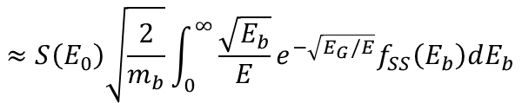

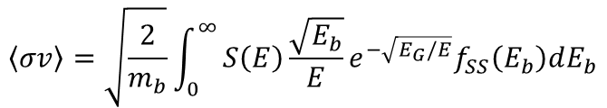

Reactivity for non-resonant reaction
Non-resonant reaction
$$\left\langle σv\right\rangle =\sqrt{\frac{2}{m_{b}}}\int_{0}^{∞}{S\left(E\right)\frac{\sqrt{E_{b}}}{E}e^{−\sqrt{E_{G}/E}}f_{SS}\left(E_{b}\right)dE_{b}}$$
$$≈S\left(E_{0}\right)\sqrt{\frac{2}{m_{b}}}\int_{0}^{∞}{\frac{\sqrt{E_{b}}}{E}e^{−\sqrt{E_{G}/E}}f_{SS}\left(E_{b}\right)dE_{b}}$$
$$\frac{{\left\langle σv\right\rangle }_{max}}{S\left(E_{0}\right)}=0.4815\sqrt{\frac{A}{B}}$$
$$=\frac{4S(E_{0})}{μ}\sqrt{\frac{m_{b}}{Z_{b}k_{B}T_{e}}}K_{0}\left[{\left(\frac{32m_{b}E_{G}}{μZ_{b}k_{B}T_{e}}\right)}^{1/4}\right]$$
$$k_{B}T_{e,max}=0.1720B$$
$$A=16m_{i}/(μ^{2}Z_{i})$$
$$B=32m_{i}E_{G}/(μZ_{i})$$
$K_{0}$ :modified Bessel function of the second kind order zero
$$T_{e}=m_{e}c^{2}\left[\sqrt{1+\frac{Iλ^{2}}{1.37×{10}^{18}}}−1\right]$$
$$E_{0}=\frac{Z_{b}k_{B}T_{e}}{8}{\left(−2±\sqrt{4+\sqrt{\frac{32m_{p}}{μ}\frac{E_{G}}{Z_{b}k_{B}T_{e}}}}\right)}^{2}$$
13/14

Slide 17
Summary
We derived non-equilibrium energy distributions via the TNSA mechanism using both self-similar analytical
and numerical approaches.
We proposed a theoretical framework for reactivity based on non-equilibrium distributions.
Using numerical solutions, we applied to p-¹¹B fusion and investigated optimal laser parameters.
Using a self-similar solution, we derived analytical forms for the energy window, peak energy, and reactivity
for non-resonant reactions.
For future work, we plan to derive the reactivity for resonant reactions and apply various models
beyond the self-similar solution.
14/14

Slide 18
Thank you
For your attention

Slide 19
Backup

Slide 20









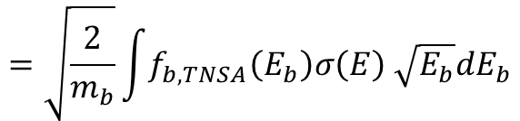
[7] E. Hwang. et al., Nucl. Fusion 65 106015
Reactivity
[8] Wei W.Q. et al arXiv:2308.10878v1 [physics.plasm-ph] 21 Aug 2023
$$\left\langle σv\right\rangle =\int{\int{f_{1}\left(v_{1}\right)f_{2}\left(v_{2}\right)σ\left(\left|v_{1} −v_{2}\right|\right)\left|v_{1} −v_{2}\right| dv_{1}dv_{2}}}$$
[7]
$$\left\langle σv\right\rangle =\int{\int{f_{b,TNSA}\left(v_{b}\right)f_{t}\left(v_{t}\right)σ\left(E\right)\left|v_{b} −v_{t}\right| dv_{b}dv_{t}}}$$
[8]
$$≈\int{\int{f_{b,TNSA}\left(v_{b}\right)f_{t}\left(v_{t}\right)σ\left(E\right)\left|v_{b} \right| dv_{b}dv_{t}}}$$
$$E_{b}\sim 𝒪({10}^{0−1} MeV)$$
$$v_{b}≫v_{t}$$
$$E_{t}\sim 𝒪({10}^{1−2} eV)$$
$$=\int{f_{b,TNSA}\left(v_{b}\right)σ\left(E\right)\left|v_{b} \right| dv_{b}\int{f_{t}\left(v_{t}\right)dv_{t}}}$$
$$=\sqrt{\frac{2}{m_{b}}}\int{f_{b,TNSA}\left(E_{b}\right)σ\left(E\right) \sqrt{E_{b}}dE_{b}}$$
$E_{i}$ : kinetic energy of $i$ (beam or target)
$E$ : center-of-mass energy $\left(E=\frac{μ}{m_{b}}E_{b}\right)$

Slide 21
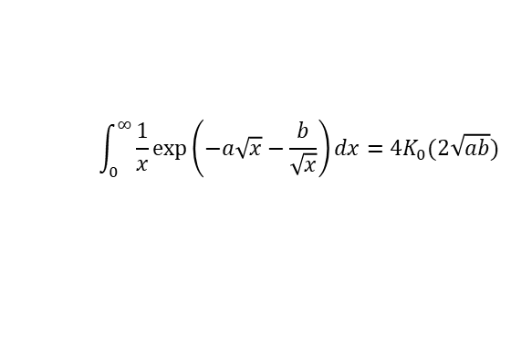
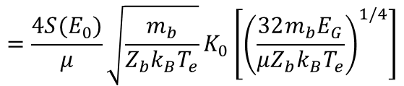
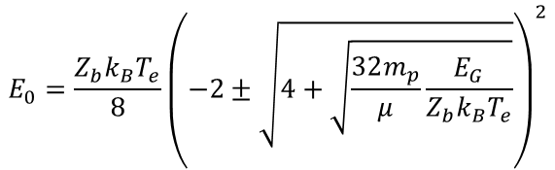
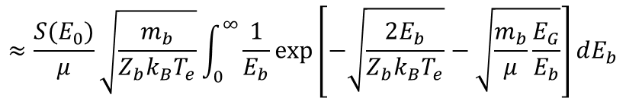
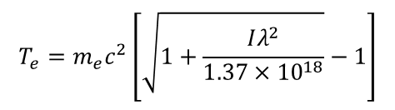
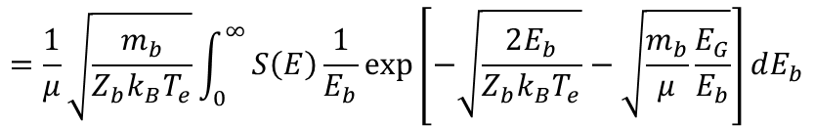

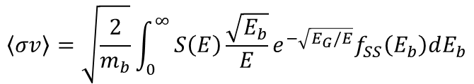
Reactivity for non-resonant reaction
$$\int_{0}^{∞}{\frac{1}{x}\exp\left(−a\sqrt{x}−\frac{b}{\sqrt{x}}\right)dx}=4K_{0}(2\sqrt{ab})$$
($K_{0}$ :modified Bessel function of the second kind order zero)
Non-resonant reaction
$$\left\langle σv\right\rangle =\sqrt{\frac{2}{m_{b}}}\int_{0}^{∞}{S\left(E\right)\frac{\sqrt{E_{b}}}{E}e^{−\sqrt{E_{G}/E}}f_{SS}\left(E_{b}\right)dE_{b}}$$
$$=\frac{1}{μ}\sqrt{\frac{m_{b}}{Z_{b}k_{B}T_{e}}}\int_{0}^{∞}{S\left(E\right)\frac{1}{E_{b}}\exp\left[−\sqrt{\frac{2E_{b}}{Z_{b}k_{B}T_{e}}}−\sqrt{\frac{m_{b}}{μ}\frac{E_{G}}{E_{b}}}\right]dE_{b}}$$
$$≈\frac{S(E_{0})}{μ}\sqrt{\frac{m_{b}}{Z_{b}k_{B}T_{e}}}\int_{0}^{∞}{\frac{1}{E_{b}}\exp\left[−\sqrt{\frac{2E_{b}}{{Z_{b}k}_{B}T_{e}}}−\sqrt{\frac{m_{b}}{μ}\frac{E_{G}}{E_{b}}}\right]dE_{b}}$$
$$=\frac{4S(E_{0})}{μ}\sqrt{\frac{m_{b}}{Z_{b}k_{B}T_{e}}}K_{0}\left[{\left(\frac{32m_{b}E_{G}}{μZ_{b}k_{B}T_{e}}\right)}^{1/4}\right]$$
$$T_{e}=m_{e}c^{2}\left[\sqrt{1+\frac{Iλ^{2}}{1.37×{10}^{18}}}−1\right]$$
$$E_{0}=\frac{Z_{b}k_{B}T_{e}}{8}{\left(−2±\sqrt{4+\sqrt{\frac{32m_{p}}{μ}\frac{E_{G}}{Z_{b}k_{B}T_{e}}}}\right)}^{2}$$
$$E_{G}=2μ_{12}{\left(πZ_{1}Z_{2}e^{2}\right)}^{2}/ℏ^{2}$$

Slide 22
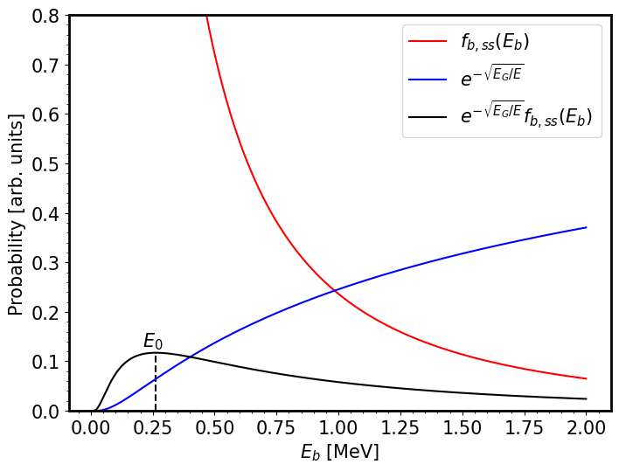
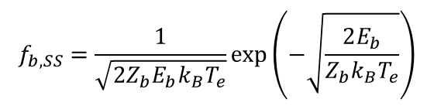
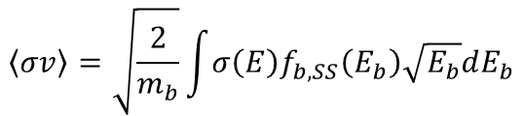

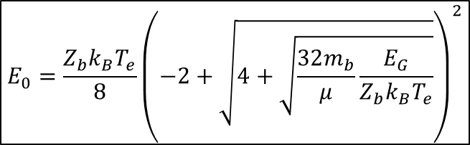
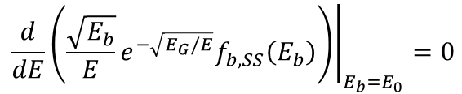

Reactivity for non-resonant reaction
Gamow window
$$f_{b,SS}=\frac{1}{\sqrt{2Z_{b}E_{b}k_{B}T_{e}}}\exp\left(−\sqrt{\frac{2E_{b}}{Z_{b}k_{B}T_{e}}}\right)$$
$$σ\left(E\right)=\frac{1}{E}e^{−\sqrt{E_{G}/E}}S(E)$$
$$\left\langle σv\right\rangle =\sqrt{\frac{2}{m_{b}}}\int{{σ\left(E\right)f}_{b,SS}\left(E_{b}\right)\sqrt{E_{b}}dE_{b}}$$
$$∝\int_{0}^{∞}{S\left(E\right)\frac{\sqrt{E_{b}}}{E}e^{−\sqrt{E_{G}/E}}f_{b,SS}\left(E_{b}\right)dE_{b}}$$
$$E_{0}=\frac{Z_{b}k_{B}T_{e}}{8}{\left(−2+\sqrt{4+\sqrt{\frac{32m_{b}}{μ}\frac{E_{G}}{Z_{b}k_{B}T_{e}}}}\right)}^{2}$$
$${\left.​\frac{d}{dE}\left(\frac{\sqrt{E_{b}}}{E}e^{−\sqrt{E_{G}/E}}f_{b,SS}\left(E_{b}\right)\right)\right|}_{E_{b}=E_{0}}=0$$

Slide 23
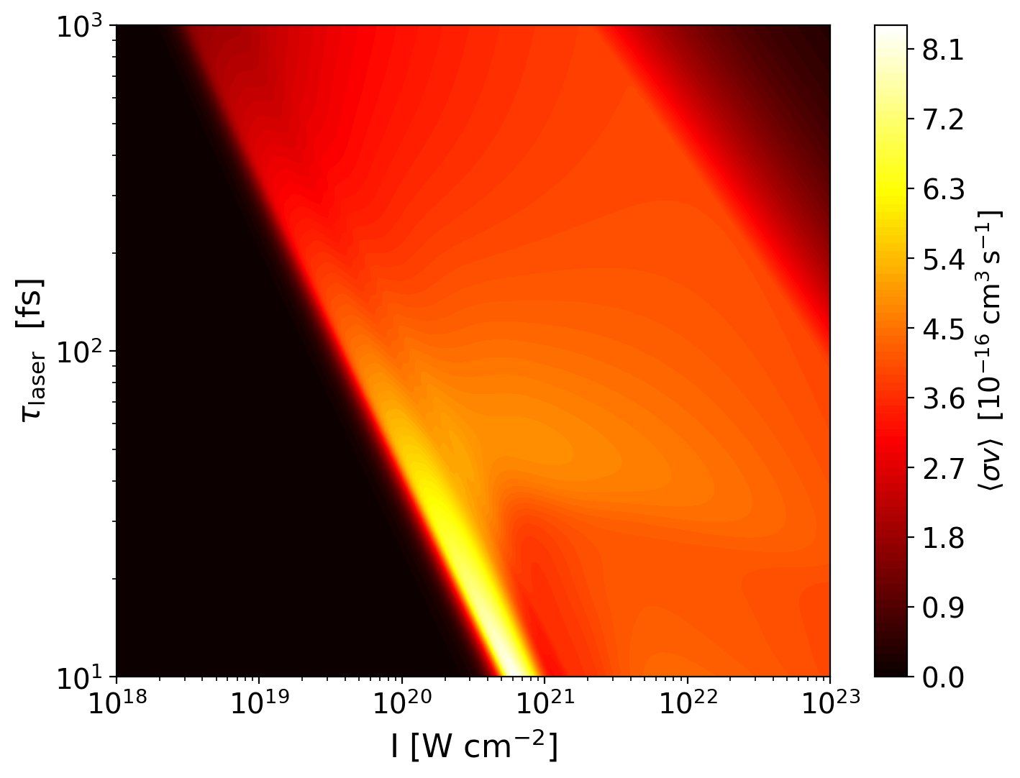










[7] E. Hwang. et al., Nucl. Fusion 65 106015
Reactivity for $p+ ^{11}B$ fusion
[7]
$$λ_{μ}=1 μm$$
$$r_{0}=10 μm$$
$$d_{t}=10 μm$$
$I$ : Laser intensity
$λ_{μ}$ : Laser wavelength
$$\left\langle σv\right\rangle (ω_{pi}t_{acc},k_{B}T_{e})$$
$τ_{laser}$ : Laser pulse duration
$d_{t}$ : target width
$r_{0}$ : Laser spot size
$$\left\langle σv\right\rangle (I,τ_{laser},r_{0},λ_{μ},d_{t})$$

Slide 24
